Slide 1
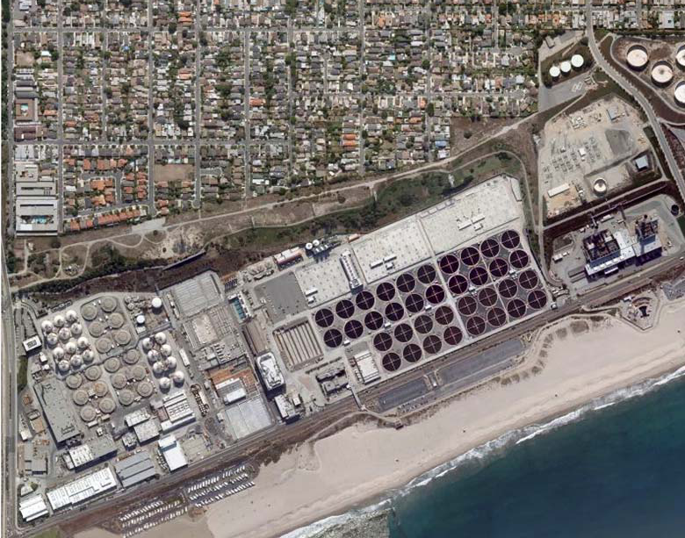
Los Angeles City's Hyperion Treatment Plant Digester Gas Utilization Project (“DGUP”)
SCAP Energy Management Committee - February 27, 2014
10th draft Feb 25 2014
Notes:
Need to identify building and facilities

Slide 2

Hyperion Treatment Plant –
Existing Use of Digester Gas since 1995
Natural Gas
LADWP SGS 1/2
Digester Gas
Steam
HTP Boundary
Solids Treatment
Class A Biosolids
Kern / TIRE
Wastewater
Primary & Secondary Treatment
Reuse
Ocean
10th draft Feb 25 2014
2

Slide 3
Current generation and Utilization of Digas
3
Notes:
Need to identify building and facilities

Slide 4
DGUP: Project History
Year | Description
1995 | Scattergood-Hyperion Electrical Energy Exchange Agreement: 7-MSCFD digester gas (renewable energy, 15.5MW) ➔ DWP SGS electricity ➔ HTP at fixed rate . . . Has high DG associated emissions
2001 | Steam Agreement
2003-07 | SGS: Technical obsolescence, cooling water issues, market issues . . . .
2007-09 | SHARE: DWP financed/operated cogeneration project at HTP using digester gas
2009 | DWP: Notice to Terminate agreements in 5 years
2010 | SHARE: Abandoned by DWP ➔ (flaring, Costs: $8M/yr → +$30M/yr)
2010-11 | Alternatives considered / financing constraints
2011 | DGUP RFP: Best use of HTP digester gas considering technical performance and cost with “alternate delivery.” BOS willing to consider alternative solutions
2011-12 | GFE: Complicated issues resolved
2012 | Contract Selection: Cogeneration as best value (Constellation Energy)
2012-13 | CEQA/EIR: November 2013
2013 | Current Contract Structure: addresses ownership, financing, DWP
2014 | DWP: Agreement Extended to 2017
2014 | Contract Approved: January 2014
Next 3 yrs | Commercial Operation: Before December 31, 2016
4

Slide 5
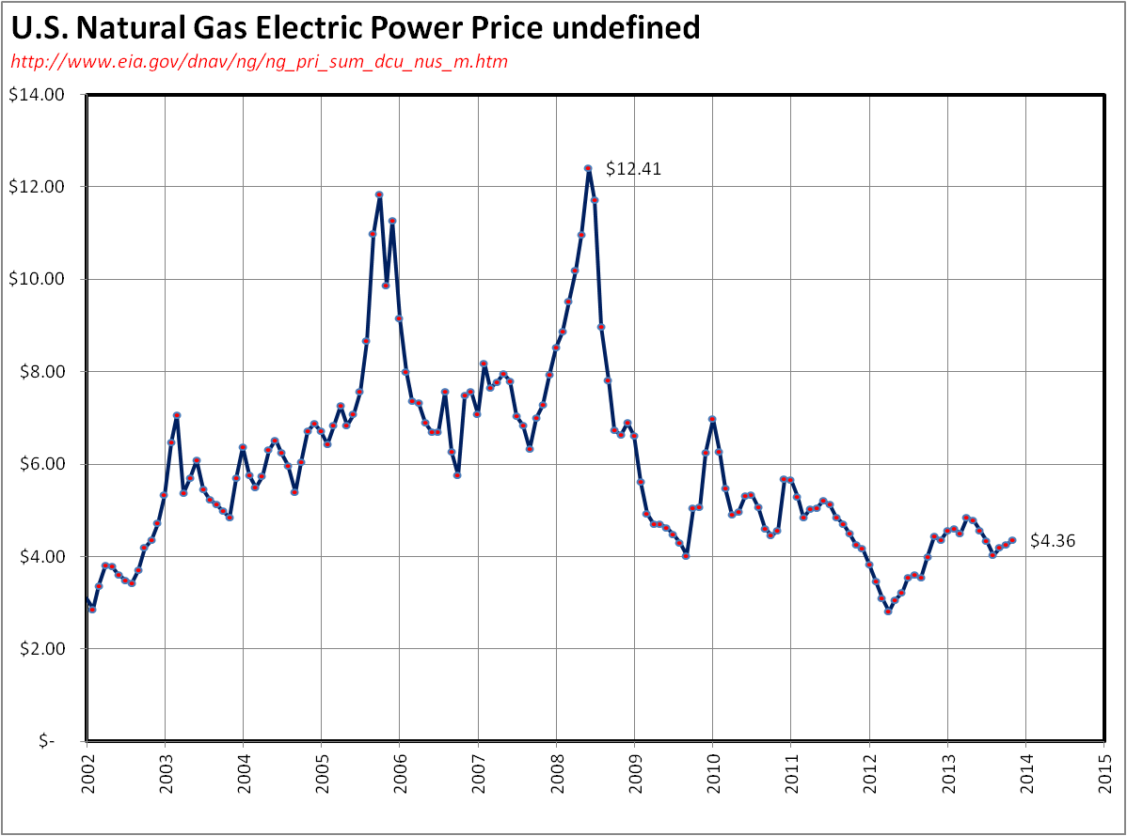
Why DGUP?
There are underlying economic factors
Source: EIA
5

Slide 6
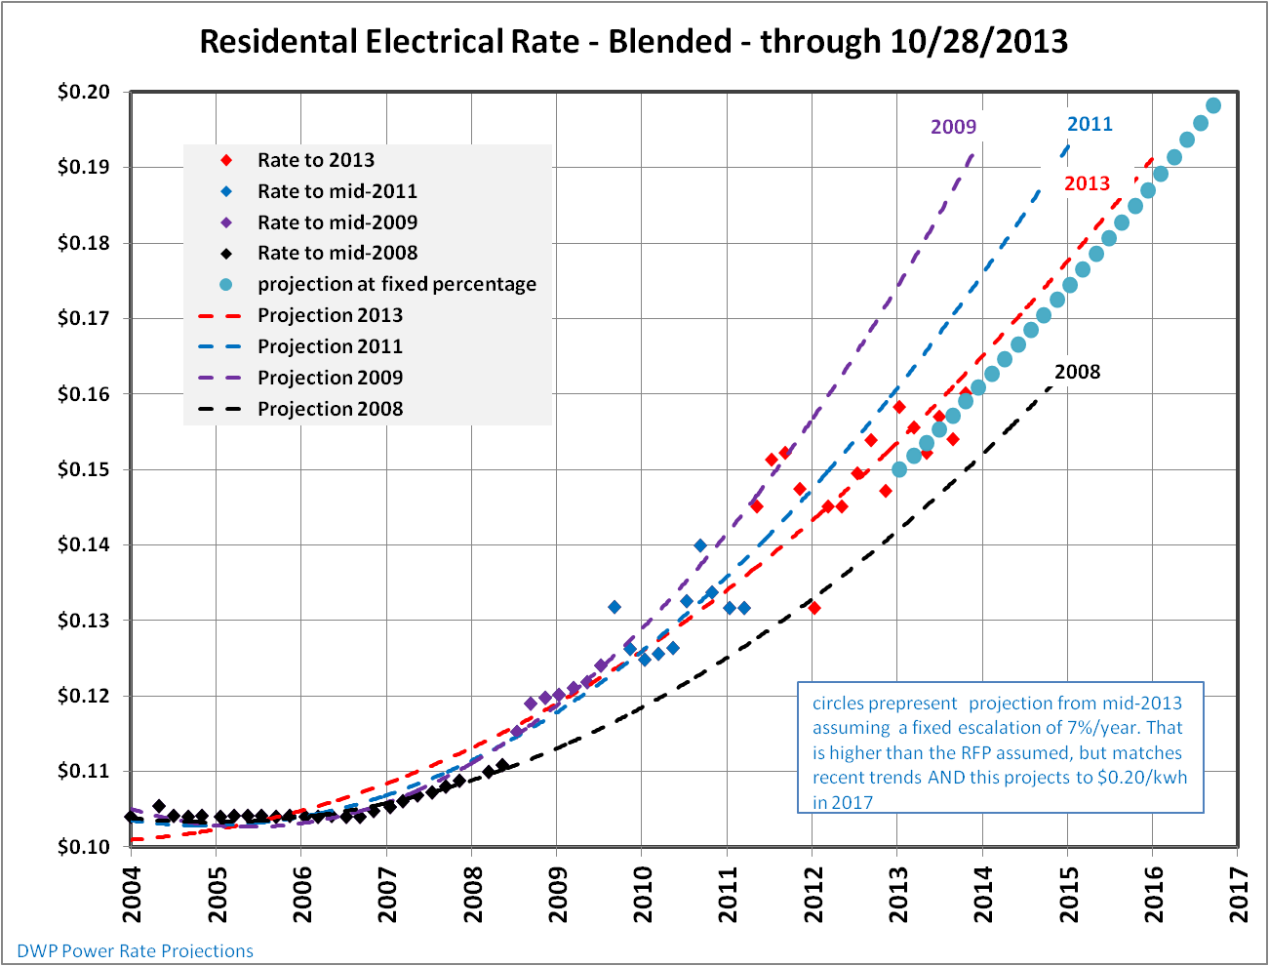
DWP Energy Rate Trends
(HTP currently pays ≈ $0.05/kwh)
Cost of Electricity from the “GRID”
21MW-hr x 1000kw/MW x 24hr x 365d/yr x $0.18/kw-hr = $33,000,000/yr
Each $0.01/kw-hr increase impact HTP by $1,800,000/yr
HTP Energy Costs (of annual budget): 10% (now) → +30% (2017)
6

Slide 7
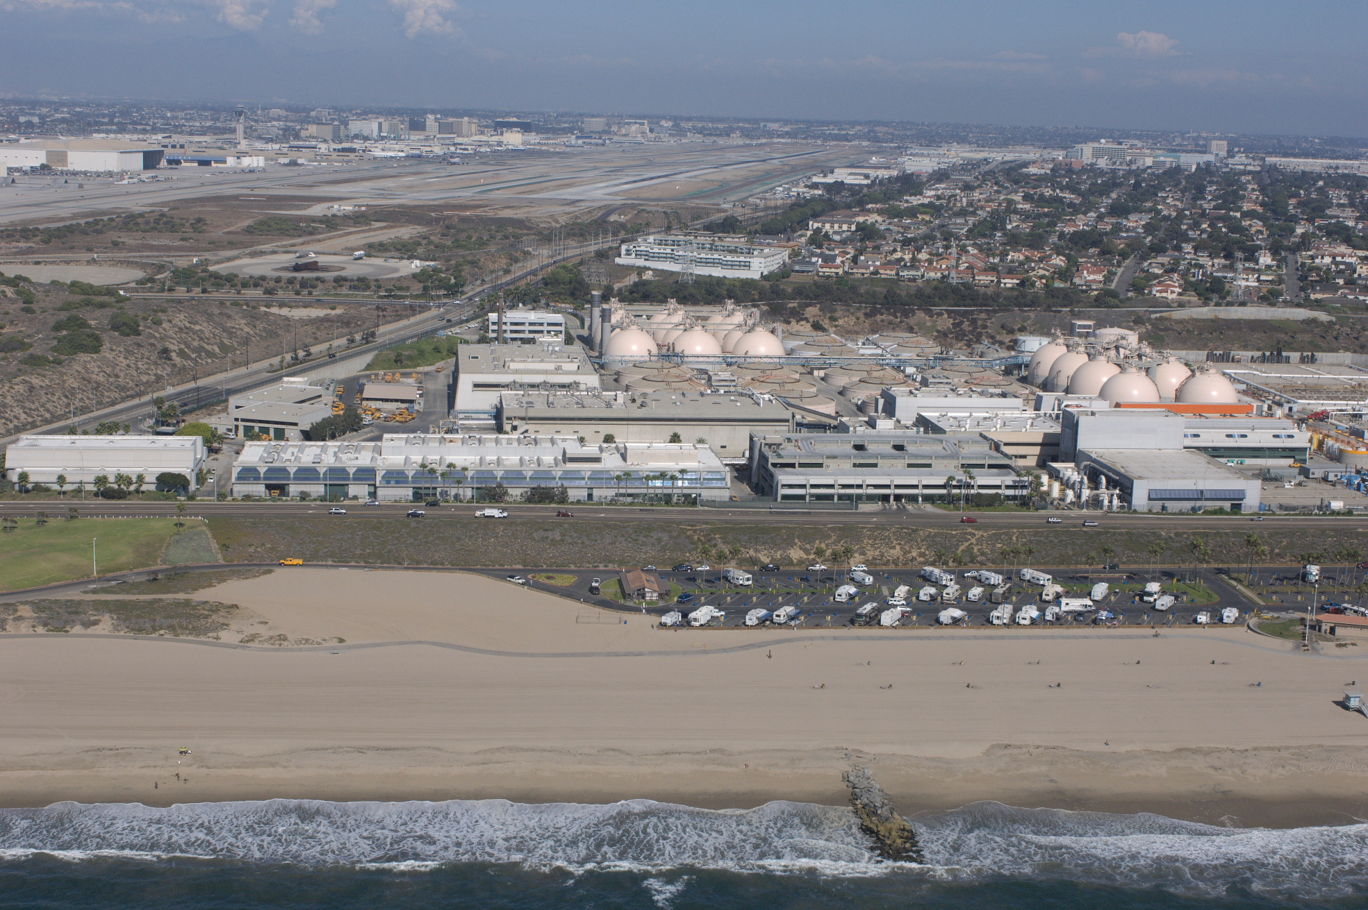
California Coastline Project http://www.californiacoastline.org/cgi-bin/image.cgi?image=200802433&mode=sequential&flags=0&year=2008
HTP Location: Complex Environmental Situation
7

Slide 8
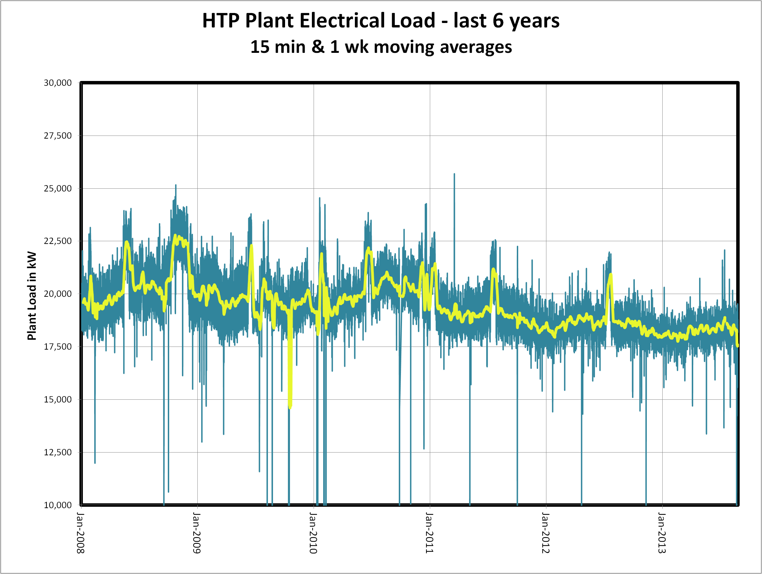
Hyperion: Electrical Demand last 6 years
In 2009-10, I predicted a significantly different Trend
Demand has gone down
Use has improved
Constraints will change in the future
1-week average demand
HTP-elect load-8-29-13
8

Slide 9
Many Stakeholder-specific Project Drivers
City was Open to Alternative solutions

Slide 10
Proposals (in response to 2011 RFP)
10 proposals with 2 general approaches:
  Bio-methane
      Ameresco
      BioFuels
      Southern California Gas
  Co-generation
      Ameresco
      Constellation
      DTE
      DCO
      NORESCO
      Southern California Gas
      UTS
10

Slide 11
Proposal Evaluation process
RFP Section 9
    Ameresco (1&2)
    BioFuels
    Constellation
    DCO
    DTE
    NORESCO
    Southern California Gas (1&2)
    UTS
10/12
11/12
    Constellation
    DCO
    NORESCO
    Constellation
    NORESCO
    DCO
3/11
8/12
Proposals
Preliminary Evaluation
Shortlisted Projects
Final Evaluation
Select
“Best Value”
Project
Initial Screening (GFE)
    BioFuels
    So.Cal.Gas
    DTE
    So.Cal.Gas
    Ameresco (2)
    UTS
A multi-step, comprehensive process . . .Evaluated both cost and non-cost factors
11

Slide 12
DGUP Project - Summary
  Selection addresses the plant’s electricity and steam needs
    Utilizes 100% of digester gas, and
    Generates up to 29 MW
    Generates all the steam required for solids treatment
  Uses existing resources
  Addressed environmental concerns:
    air emissions and health risks
    noise
    no flaring of gas, except during emergencies
  Capability of “islanded” operation during emergencies
  Slight export of power, significantly reduces potential demand charges
  Potential growth (digas, electricity, steam) and flexibility (fuel)
  Alternative Delivery – time was main factor
  Overall: Technical + Cost ➔ “Best Value Project”
12

Slide 13
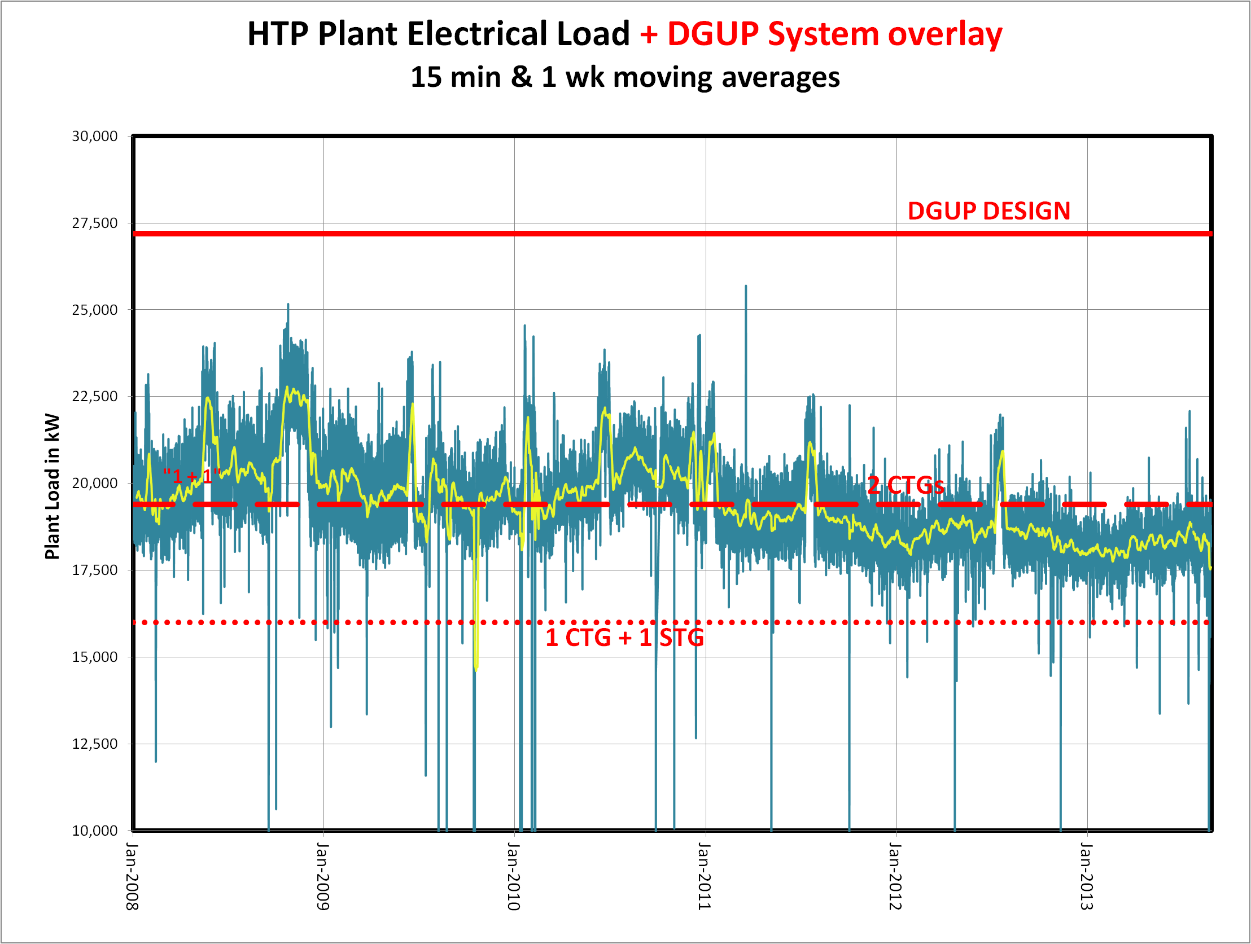
DGUP: System capacity VS. Htp Demand
Guarantees System will meet demand > 95% of time.
HTP-elect load-8-29-13
13

Slide 14
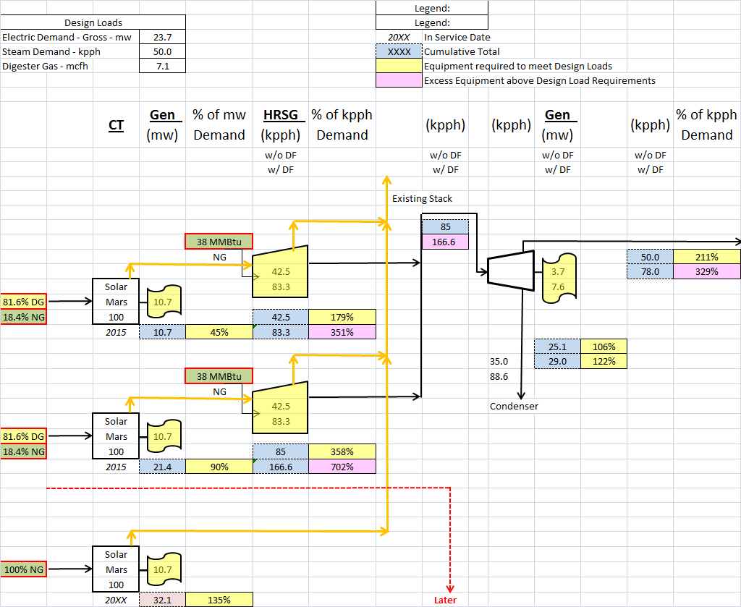
Constellation
Summary
Two Mars 100 units
w/ HRSG, w DF, w/STG
~25 MW normal output
Future: 1 Mars
14
14

Slide 15
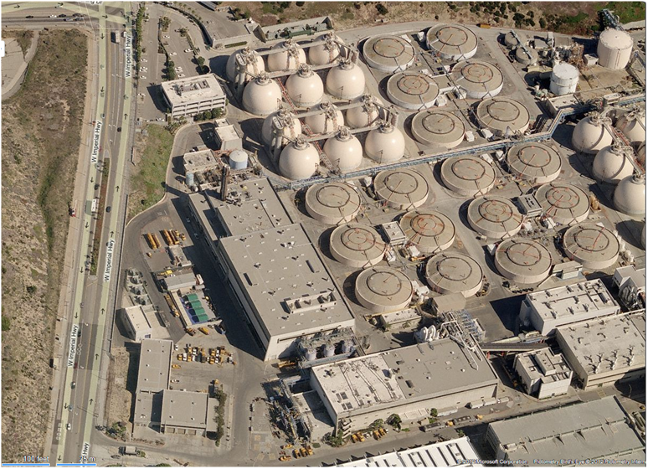
HTP – ERB from South – View, from Bing
Gas Treatment
NSY
CoGen Area
DGUP PROJECT
Hyperion Treatment Plant
15

Slide 16
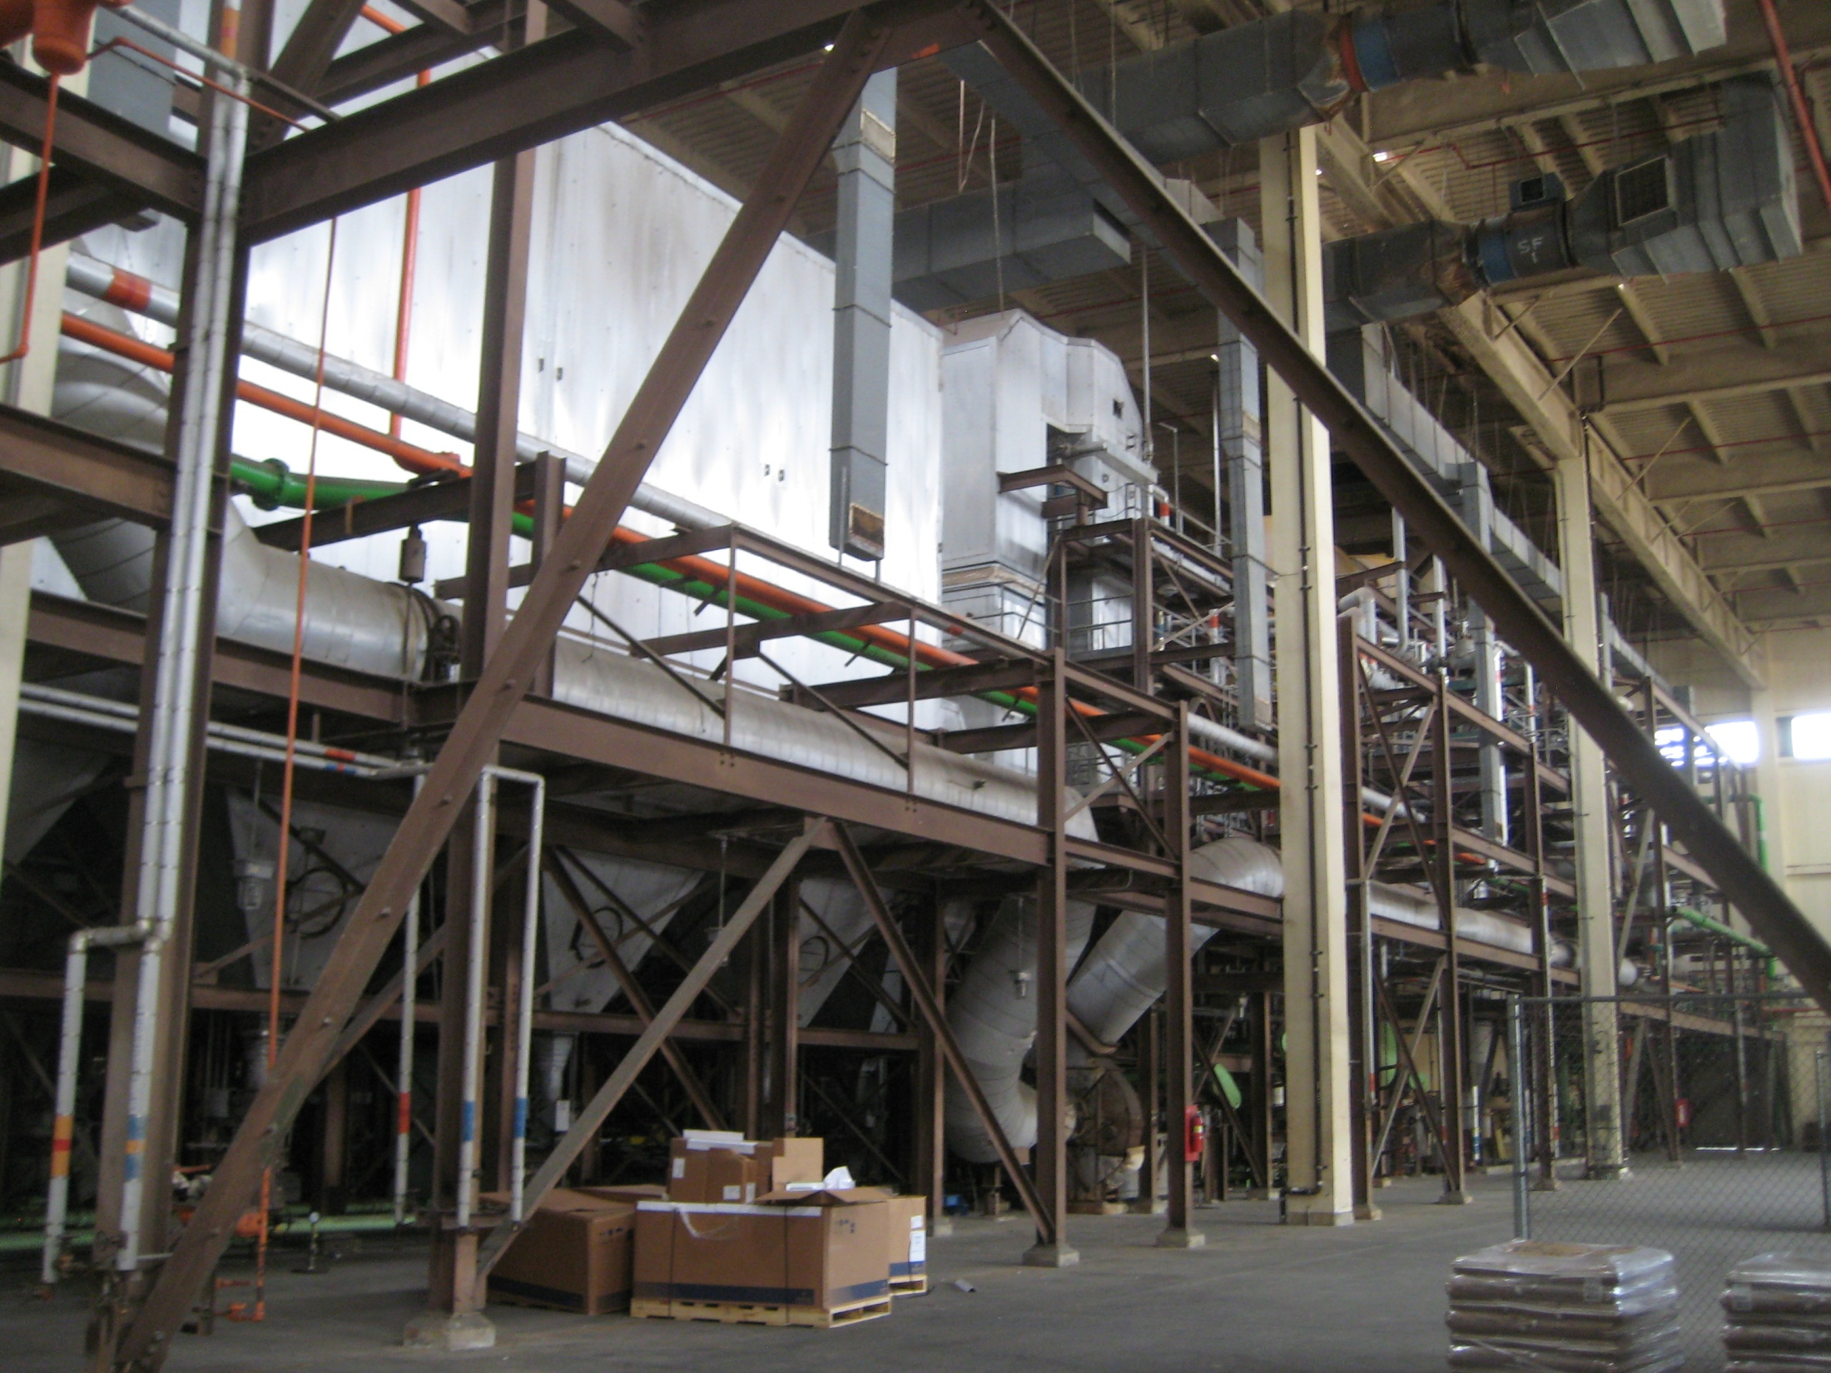
DGUP: Demolition will be an early task
16

Slide 17
HTP Digester Gas Utilization Project
Overall Timeline (estimated 2/13/2014)
Complete CEQA/EIR
NTP
Commercial Operation &
“Final Acceptance”
Selection
Complete Demo
DGUP RFP
Complete Design
“SHARE”
Start Testing
City Starts Operation
DWP/BOS Agreement
City Starts Training
1995
2007
2011
2012
2013
2014
2015
2016
2017
≈2025
≈2026
← DWP/BOS “partnership”→
← Procurement →
←⎯ Design ⎯→
← Construct→
← CEQA →
←Test→
←⎯⎯ Operation ⎯→
←⎯⎯⎯⎯⎯⎯⎯ LADWP Energy Agreements/Partnership ⎯⎯⎯⎯⎯⎯⎯→
←⎯ Cogeneration ⎯⎯→
17

Slide 18
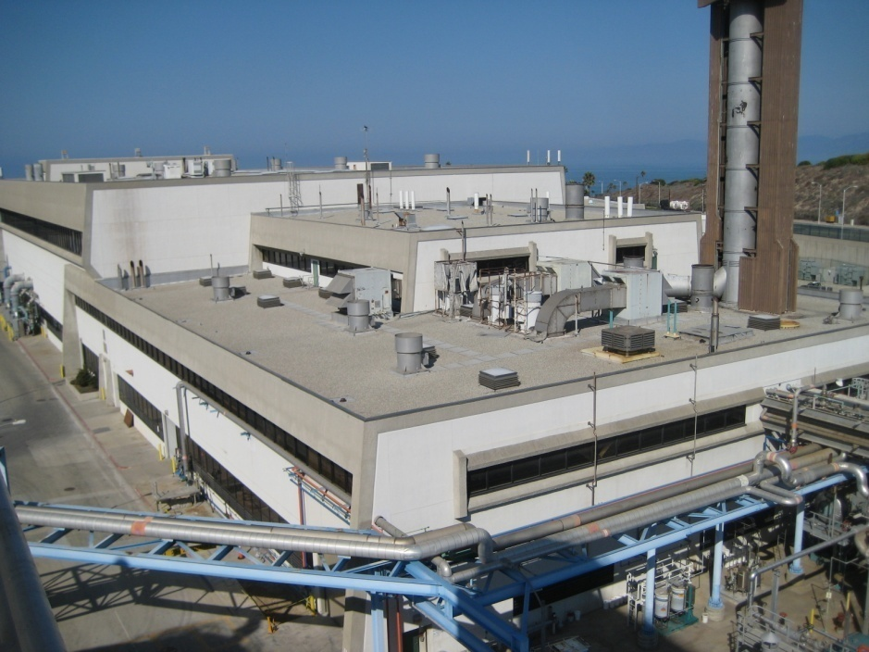
Questions
Digester Gas Utilization Project Site
18

Slide 19
HTP
  One of largest plants in the world
  Located in El Segundo . . . Next to Dockweiler, butterflys, airport
  Reliably treats water to high standards
  Treats and manages bio-solids for beneficial use
  WWTP by-product, Digester Gas, renewable energy resource at SGS
  DWP Provides 20 MW (on average)
  DWP Provides 35,000 lb/hr steam
  Provide extremely reliable electricity and steam source
  Energy Costs: $8 to 9 Million/year
T-3
19

Slide 20
HTP Digester Gas – Some Reference Numbers
Gas Production Rate: 7 MSCFD
    The generation of the digester gas is expected to increase by 30% over the next 5 years.
Energy Content: 1.5 x 10¹² btu/yr
Potential Renewable Value: $tbd
Current HTP Budget: $77-80 M/yr
Current HTP Electric: $5.2M/yr
➔ will go to +$30M/yr w/ no project
Current HTP Steam: $2.9M
➔ will go to $tbd M w/ no project
Renewable Electricity
15 MW now ➔ 18 MW or depending on the math
T-3
20

Slide 21
Why DGUP?
  LADWP Economics . . . Starting about 2005 . . . . .→ CHART
  HTP electricity from LADWP (about 20.5 MW)
    ≈ $0.05/kwh now
    > $0.19/kwh w/o DGUP after 2016
    About $0.13-0.15/kwh w/DGUP
  Because of Regulatory Constraints, SGS is not an option after 2016
  Existing agreements expire January 31, 2015 December 31, 2016
T-5, 6
21

Slide 22
HTP Digester Gas – Options Considered
T-9
Option 1: Power Generation - Use digas to self-generate HTP steam and electricity.
Option 2: Sell Digas “as is” - Use digas for plant steam, sell excess digas as a green energy source. Purchase electricity from DWP.
Option 3: Clean Digas/Sell Biomethane - Use digas for plant steam, purify excess digas to pipeline quality, sell as a renewable energy source to make electricity. Purchase electricity from DWP.
Option 4: Clean Digas/Store Biomethane - Same as Option 3, but store gas underground to maximize value. Purchase electricity from DWP.
Option 5: “Do Nothing” - Use digas for plant steam. Flare excess digas. Purchase electricity from DWP.
22

Slide 23
What DID RFP Seek?
T-9
Reliable source of electricity
Reliable source of steam
Minimum Environmental impact
Small Carbon footprint (renewable fuel)
Make best beneficial use of biogas, reduced flaring
Schedule that works
Affordable Fiscal Impact, considering:
  Capital cost
  O&M cost
  It is unrealistic to get an alternative project operational by January 2015 → extension
DGUP RFP
Authorized January 2011
USE HTP'S DIGESTER GAS TO EITHER:
  (1) PROVIDE STEAM FOR HTP DIGESTERS AND ELECTRICAL ENERGY FOR CURRENT AND FUTURE PLANT OPERATIONS OR
  (2) PROVIDE A MONETARY BENEFIT TO OFFSET THE PURCHASE OF ELECTRICITY FOR HTP PLANT OPERATIONS
23

Slide 24
DGUP Overview
Technical
  7.2 MSCFD digester gas
    Very significant energy resource
  Low risk, proven technology
  25 MW for HTP
  50-kpph reliable source of steam
Sustainability
  Low environmental impact
  Renewable Energy:
  currently → 15 MW
  w/ No project → 0 MW
  w/project (includes steam) → 24 MW
Schedule
  SGS option ends December 2016
  Startup: October 2016 w/NTP in February
Alternative Delivery
  Design & Construction
  Startup/Testing
  Operation - 10 years operation by Contractor
Best Financial Value to City
  Performance based contract
  NPV determination over 20 years
  Current HTP Budget: $77-80M/yr
    Current Electric/Steam: $8.2 M/yr
    No project, Electric/Steam: $35 M/yr
    DGUP, Electric/Steam: $21 M/yr
24

Slide 25
HTP Digas Options
HTP
1/3 gas to boilers
2/3 gas flared
Total emissions: ???
$28M direct electrical charge (@$0.16)
Upgrades to Flares and boiler required
SGS
$3.6M to maintain
Estimated $15M to generate
Xxx emissions
Taller stack, remoter location
DROP ?
25

Slide 26
Electrical
  Considerations –
    Construction cost (uncertainty)
    Reliability (relative to today)
    Technical risk (future)
    Rate Risk (not negotiated yet)
    Financial risk (next 20 years)
    What benefits BOS, not DWP
  Options (premise: any of these are acceptable, pending detailed analysis)
    Connect to Grid (reliability a wash, high cost, best chance for bucket 1)
    Connect to MSY (reliability -, high cost, difficult to implement, good chance for bucket 1)
    Connect to NSY (reliability +, low cost, bucket 1 uncertainty)
26

Slide 27
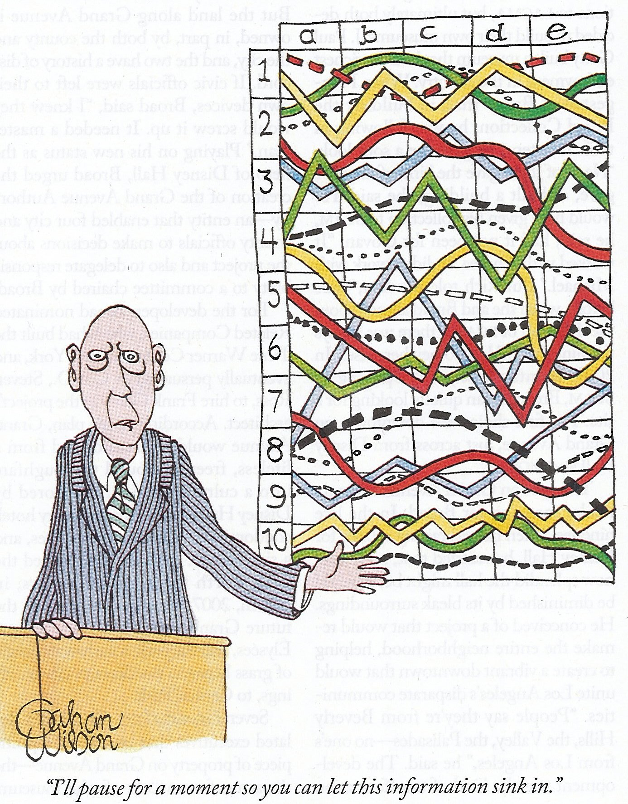
HTP Digester Gas Utilization Project
Project Variables
  Electric cost
  Natural gas costs– Chart?
  Electrical growth – Chart?
  Digas production – volume and quality
  Capital costs
  Emissions
  City Policies
  Time Constraints
  Real World Issues
  Politics
  Reliability / Risk
“I’ll pause for a moment so you can let this information sink in.”
27

Slide 28
Proposal Evaluation process
Followed process described in RFP §9
Evaluation Teams
  Included 16 subject-area specialists
  11 different functional areas, including 3 different Bureaus
  Over 400 years of combined experience [eval. team] + more on support staff
  Management and Consultant review
Equal, Unbiased Assessment of all proposals
28

Slide 29
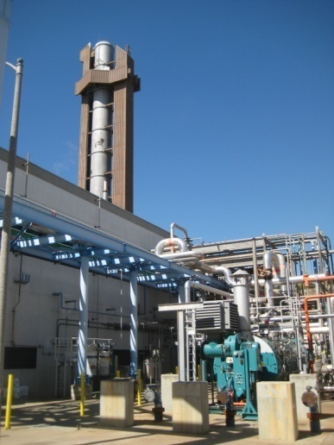
Evaluation criteria
RFP Section 9
Technical
  Teaming Experience & Financing
  Terms & Conditions
  Technology
  Project Implementation
  Project Operation
Financial
  20-year “net present value” analysis
RFP Defines “Best Value”
29

Slide 30
DGUP Motivation (Best Interests of the City)
Constraints:
    schedule dictated by external circumstances
    limited available funding
    possible lack of specialized technical expertise
BUREAU decided DBOOT would serve the best interests to realize:
    Significantly lower operational costs for steam and electricity for HTP compared to no project,
    Improved beneficial use of a renewable energy source compared to current use, and
    Lower emissions associated with digester gas flaring as compared to no project.
    Shifts substantial technical and financial RISK to Contractor by tying payments to performance requirements . . . . . But
    Later had to change ownership to address external requirements . . . .
    . . . . But this ultimately proved beneficial
30

Slide 31
HTP Digester Gas Utilization Project
Purpose of Project
  Develop the best beneficial use of digester gas generated at HTP to meet its energy needs by January 2015, considering:
    Financing
    Demolition
    Design
    Construction
    Operation (as integrated into HTP)
31

