Slide 1
SCAP Collection Systems Committee - February 21, 2013
Leucadia Water District - Carlsbad, CA
www.scap1.org
“Strangled by Disposables”
An Update on Flushable but Not Dispersible Products
Nick J. Arhontes, P.E.
Director Facilities Support Services Dept.
Orange County Sanitation District, California
www.ocsewers.com
Notes:
Self introduction
1

Slide 2
OCSD Regional System
572 miles of sewers
15 lift stations
2 treatment plants
La Habra
Brea
Buena
Fullerton
Yorba Linda
Placentia
Park
La Palma
Anaheim
Cypress
Anaheim
Villa
Park
Los
Stanton
Alamitos
Orange
Garden Grove
Westminster
Seal
Beach
Santa Ana
Tustin
Fountain
27 Local
Satellite Systems
~5,000 miles sewers
~109 lift stations
Valley
Plant 1
Huntington
Costa
Beach
Mesa
Pacific
Ocean
Plant 2
Irvine
Newport
Beach
Ocean
Pipeline
Notes:
Own, operate, maintain 572 total miles sewer lines: over 398 miles Regional sewers, 174 miles small Local city lines

Slide 3
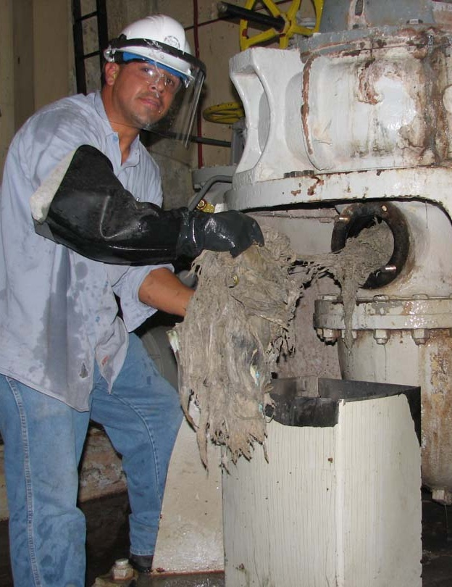
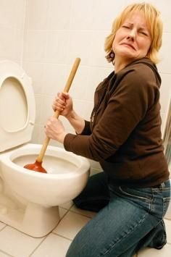


What’s the Problem?
System Reliability
Costs to Prevent Sewer Spills
Flushable vs.
Non-dispersible
Confusion
Notes:
Sewers are a cost inefficient means to send rags to a landfill
The trash can is a better transport mechanism to move used nonwovens to the landfill
Helps prevent sewer spills and reduce O&M costs
Helps improve ratepayer access to a better functioning sewer and treatment system?
Other options and ideas ?

Slide 4
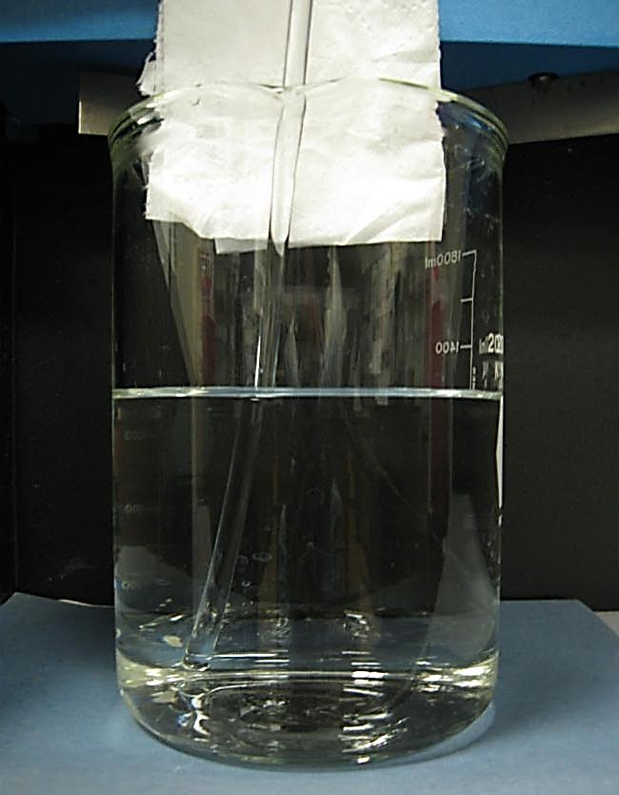
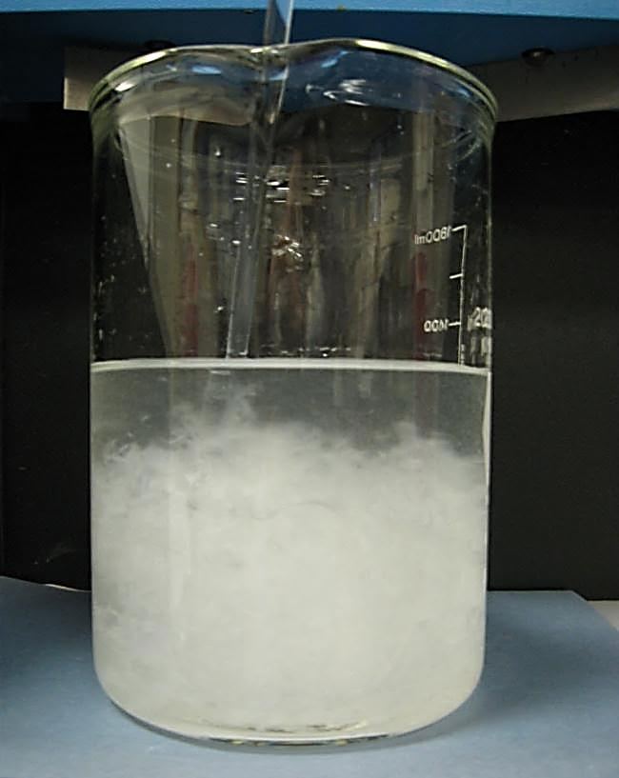
Toilet Paper Rapidly Disperses in less than 30 seconds in OCSD Lab 2010

Slide 5
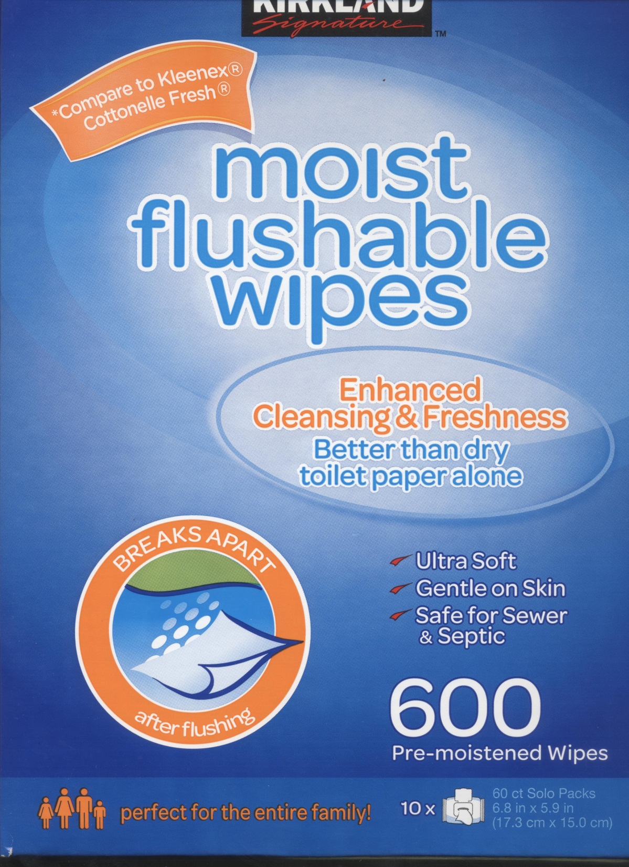
??
?
?
2012

Slide 6
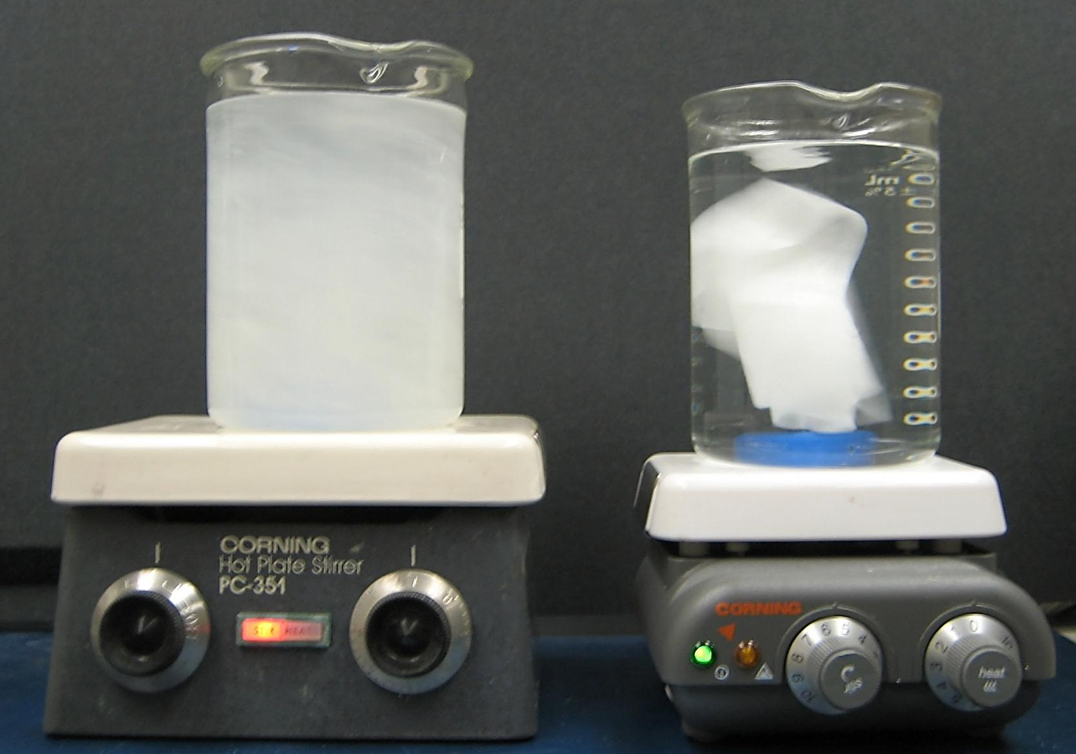
Kirkland – Flushable vs. Dispersible?
OCSD Lab 2012
Toilet Paper after 5 min.
Wipes after 24 hours

Slide 7
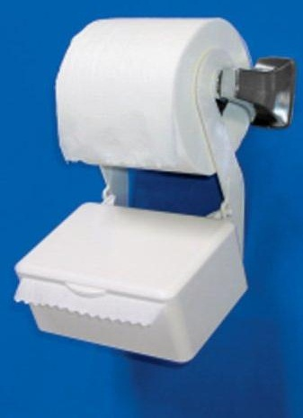
Presentation Outline
History
  California plumbing code
  Statewide WDR Order
  Legislative attempts
  Who are INDA and EDANA?
Characterization Studies
What OCSD is doing
How SCAP members can help
Notes:
Photo example slides of flushables that don’t disperse
Existing plumbing code prohibitions in CA
Existing statewide WDR Order to reduce sewer spills in CA……a version of EPA’s old unpublished SSO Rule……. a.k.a. cMOM
NACWA’s Core Attributes of Effectively Managed Wastewater Collection Systems (final draft)
AB 2256 proposed in CA
How can INDA help the wastewater industry and it’s ratepayers ……….also INDA’s consumers?
Can we all agree to dispose of non-dispersibles in the trash?

Slide 8

California Uniform Plumbing Code Chapter 3 http://www.iapmo.org/Pages/2009UniformCodes.aspx
§ 306.1 Damage to Drainage System or Public Sewer…
It shall be unlawful for any person to deposit… solids; rags; … oils; grease; or any other thing whatsoever that would, or could, cause damage to the drainage system or public sewer.
Statewide WDR Order No. 2006-003
  http://www.waterboards.ca.gov/water_issues/programs/sso/
Notes:
Existing Plumbing Code Prohibitions

Slide 9
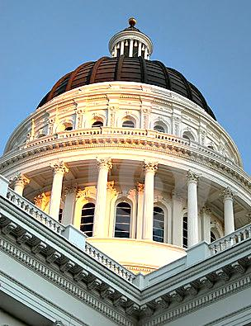
Proposed Legislation
2010 – AB 2256 California Proposed labeling and third-party verification of dispersibilty, and fines
2011 – LD 781 Maine
Proposed establishing standards for products advertised as flushable
Inactive NOV 2010
Under review FEB 2013

Slide 10




Who is INDA, EDANA, HAPPI, TAPPI ?
INDA – (1968) Association of Nonwoven Fabrics, North America
www.inda.org
EDANA – (1971) European Disposables and Nonwovens Association, 220 member companies, based in Europe, focused in Europe, Mid East, and Africa.
www.edana.org
TAPPI – (1915) Association for the worldwide pulp, paper, packaging, and converting industries and publisher of Paper360º and TAPPI JOURNAL www.tappi.org
HAPPI – Households and Personal Products Industry Magazine www.happi.com

Slide 11
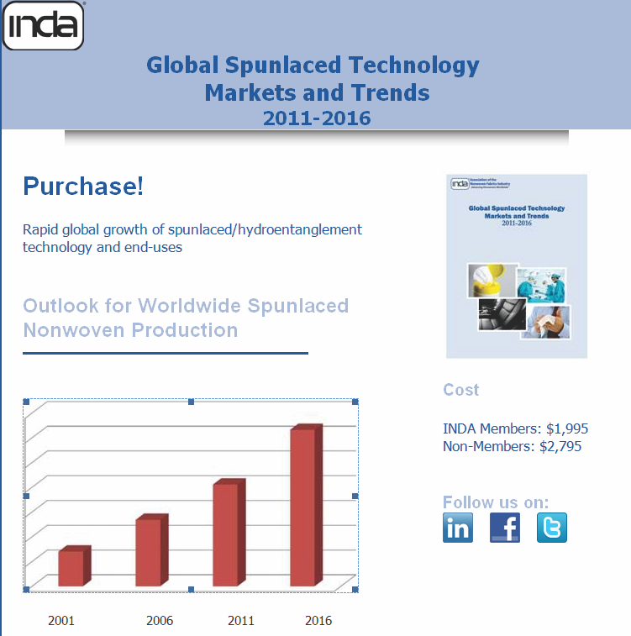

Slide 12
Nonwoven Industry Guidelines
2003 WERF DOCUMENT #02CTS7P - “Protocols to Assess the Breakdown of Flushable Consumer Products” for Proctor and Gamble - did not fully address potential problems between the toilet and treatment plant
Contains voluntary guidelines for testing for “flushability”
INDA’s current guidelines based on this desire– “become unrecognizable in a reasonable amount of time”
Notes:
– “be compatible with wastewater conveyance and treatment plants”

Slide 13
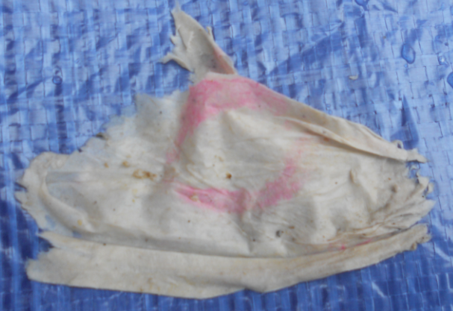


Portland, Maine Sept. 2011
Characterization Study
INDA Members
  Kimberly Clark
  Proctor and Gamble
WEF Collections Systems Committee
Maine WEA
Portland WD, ME

Slide 14
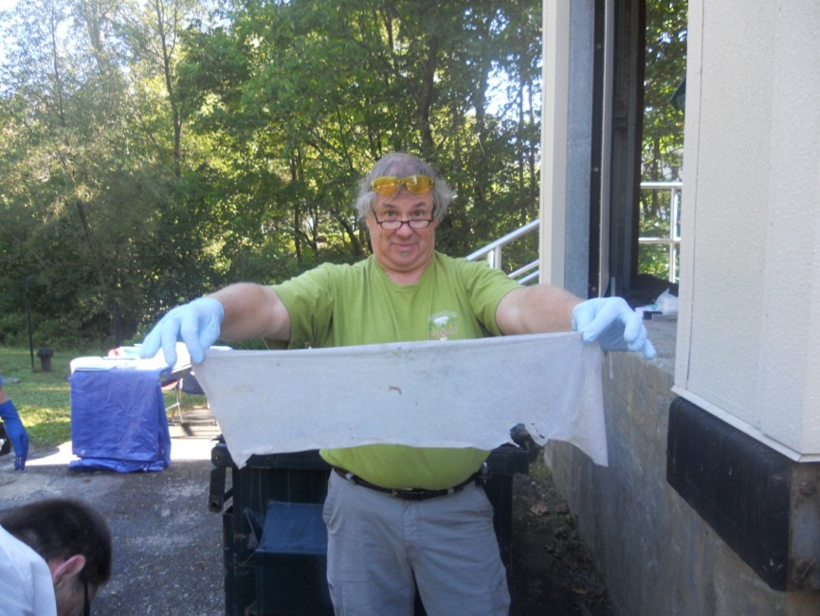
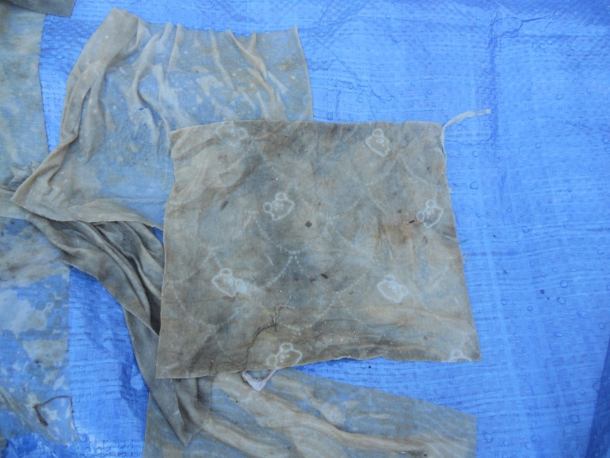
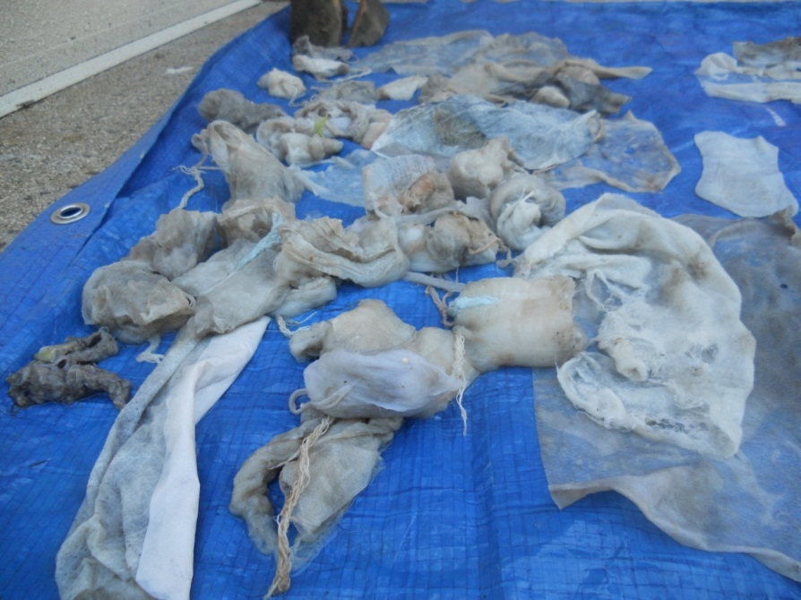
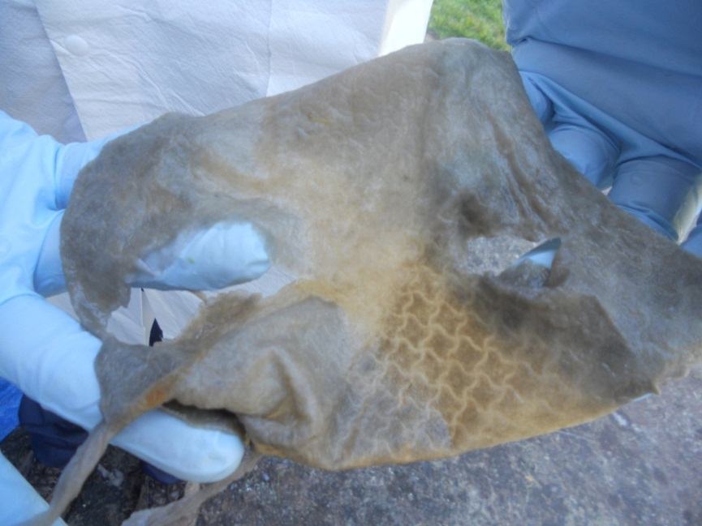
2011 Characterization Results from Portland, Maine
Paper Products 42%
Baby Wipes 24%
Feminine Hygiene 17%
Flushables 8%
Other: Household Wipes 4%, Cosmetic 3%, Medical 2%, Hands, Face and Body (HFB) 1%

Slide 15
What We Learned in Maine
90% +/- of the products removed from the sewer during the test are non-dispersible
Tampons are great accumulators of other material and form larger clumps
Some flushable baby wipes are indestructible squares of nonwoven plastic fibers
Developed SOP for characterization studies
http://www.mwwca.org/PumpClogSOP.pdf

Slide 16
Redefining the Problem
Modern toilets will flush just about anything!
Products that are flushable, but don't rapidly disperse are the problem!
Lack of consistent labeling and instructions on how to dispose/flush products leads to consumer confusion
Improve transparency and adopt third-party mandatory testing – example: www.nsf.org

Slide 17
Recommendations
Require better package labeling
  Universal “Do Not Flush” label in a prominent place and size
More consumer education
  From both nonwoven industry and wastewater sector
Product reengineering
  Require any product used “below the waist”
  to be made of a dispersible substrate
Remove paper towels from restrooms, provide toilet seat covers, and air dryers for hands

Slide 18
OCSD Activities
Changing role of Source Control
Dispersiblity test lab set up by OCSD Source Control Staff in May 2012
Continue to assist WEF Collections System Committee and NACWA, APWA and SCAP
Networking with other organizations
Public Outreach with www.What2Flush.com

Slide 19
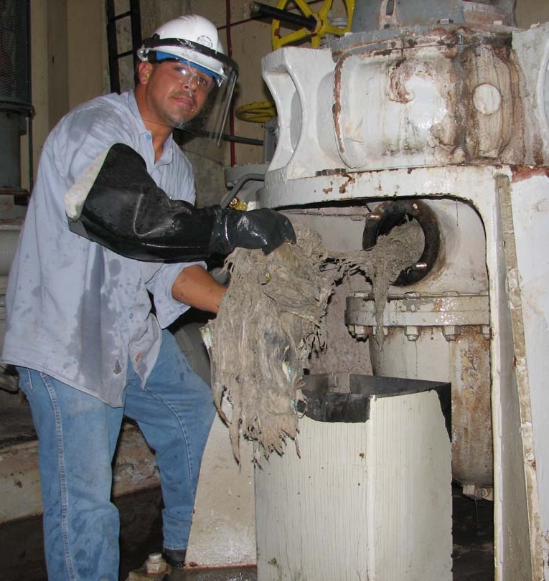
OCSD’s Deragging Study
2010-11
971 preventative or corrective deragging tasks on 10 pump stations
Total labor cost $320,000
08/13/2012
New Plant 2 Headworks
40 large trash bags of debris removed from 3 plugged washer compactors took 6-8 hours and
10 staff to correct
Engineering the problem away – pushes it down the line
  Debris doesn’t disappear
  $$$
Notes:
Currently – every Monday and Thursday crews remove nondispersibles from 3 pump stations.
At each station a minimum of 3 pumps must be taken out of service to be cleaned.
A task that takes two employees up to two hours to complete.

Slide 20

OCSD’s Message - What2Flush
OCSD’s Public Outreach
It’s simple – the toilet is only meant to flush the three P’s –
  Pee
  Poop
  Toilet Paper
  www.What2Flush.com

Slide 21
Getting the Word Out
Public Works Magazine
Strangled by Disposables
October 2012 Issue - Part 1
www.PWMAG.com
http://www.pwmag.com/
wastewater/strangled-by-disposables.aspx
Networking with others
in the media
Notes:
Sewers are a cost inefficient means to send rags to a landfill
The trash can is a better transport mechanism to move used nonwovens to the landfill
Helps prevent sewer spills and reduce O&M costs
Helps improve ratepayer access to a better functioning sewer and treatment system?
Other options and ideas ?

Slide 22
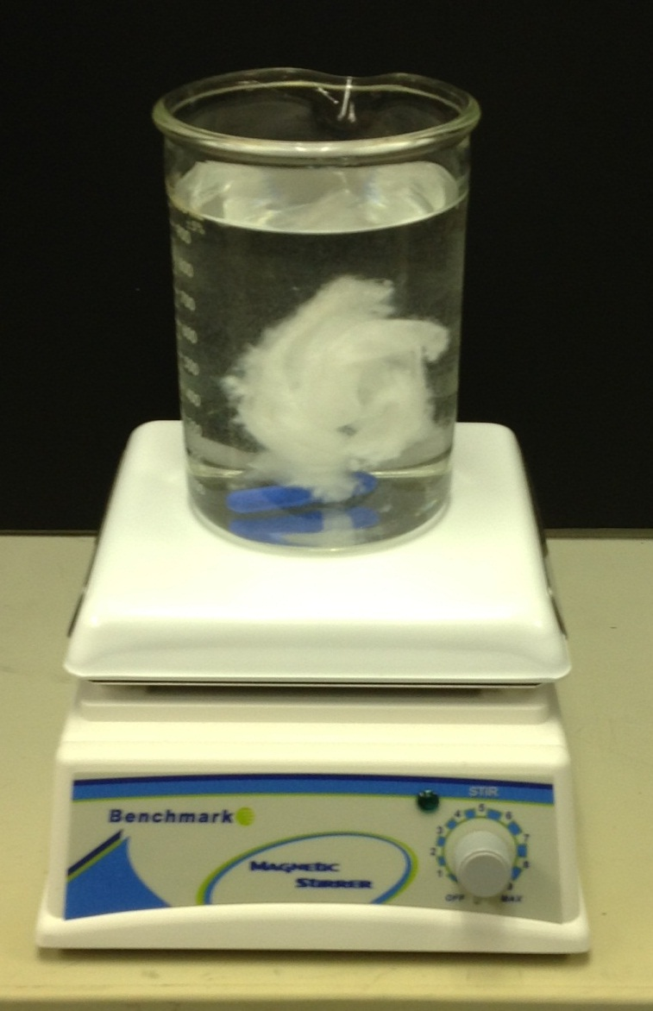
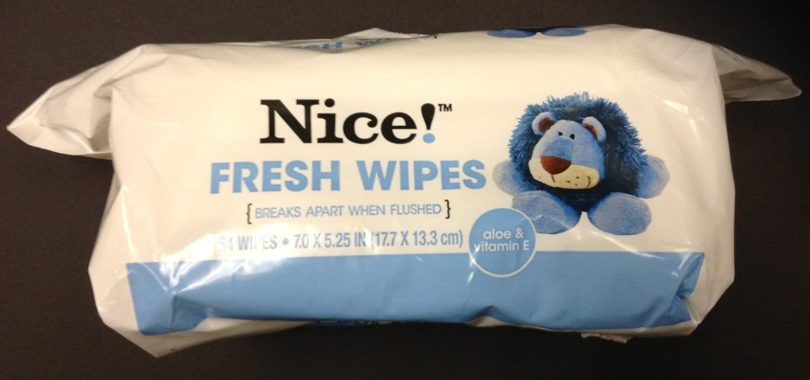
HydraSpun® – Flushable vs. Dispersible? OCSD Lab JAN 2013
HydraSpun® nonwoven substrate after 1 hour – some dispersion – some good news?
Test report due in March

Slide 23
UK WIR Reports
United Kingdom Water Industry Research Limited (UKWIR) – 2012 published two reports:
12/CU/02/12 “Best Practice for National Communications - Responsible Use of Sewers” http://www.ukwir.org/ukwirlibrary/94930
12/WM/07/16 “Test Protocol to Determine the Flushability of Disposable Products” http://www.ukwir.org/ukwirlibrary/95043

Slide 24

Next Steps: Other options and ideas?
Put Non-Dispersibles in the Trash, Not the Sewer
Sanitary and/or Combined Sewers are not an effective or proper way to move non-dispersibles to the landfill
Sustainability – long-term
  Water Conservation
  Energy Conservation
  Extended Producer Pesponsibility
  Lower our labor needs
  Help update INDA Voluntary Guidelines Rev. 3
Graphic courtesy of King County
Notes:
Sewers are a cost inefficient means to send rags to a landfill
The trash can is a better transport mechanism to move used nonwovens to the landfill
Helps prevent sewer spills and reduce O&M costs
Helps improve ratepayer access to a better functioning sewer and treatment system?
Other options and ideas ?

Slide 25
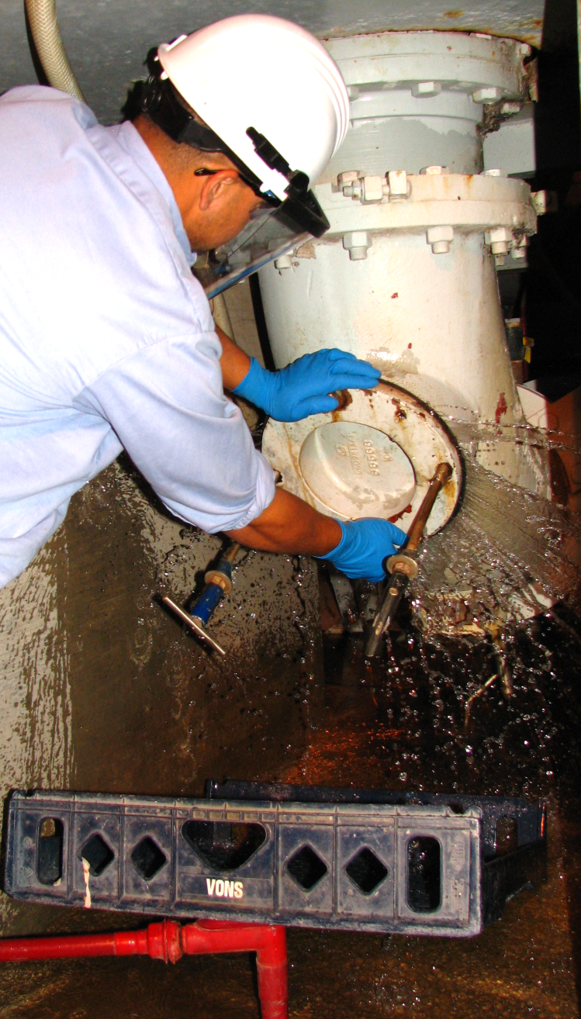
How SCAP Members Can Help
Collect and Document all Costs
Preventative and corrective maintenance tasks in sewers/pump stations/treatment plants
Labor hours/costs
Equipment repair/replacement costs
Fuel costs
Debris hauling fees
Blockages, SSO events, and fines
Document your “deragging” costs and share info with SCAP CSC
Notes:
Sewers are a cost inefficient means to send rags to a landfill
The trash can is a better transport mechanism to move used nonwovens to the landfill
Helps prevent sewer spills and reduce O&M costs
Helps improve ratepayer access to a better functioning sewer and treatment system?
Other options and ideas ?

Slide 26
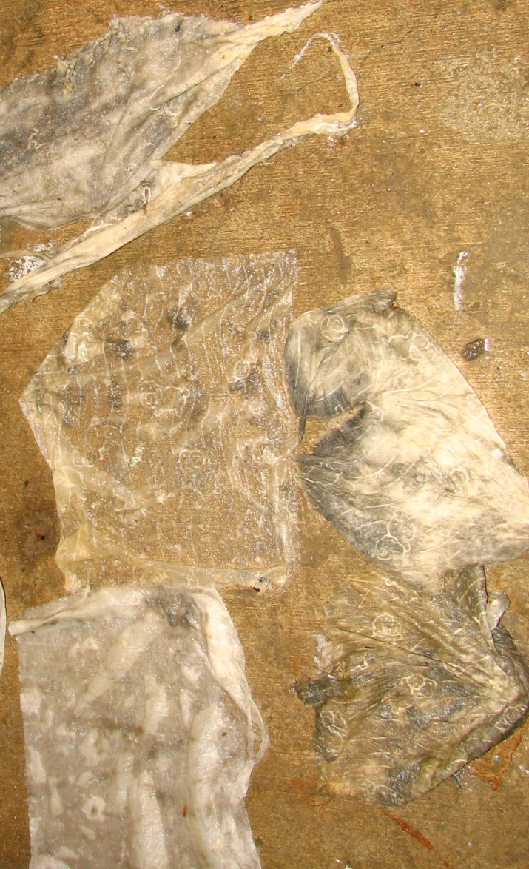
How SCAP Members Can Help
Conduct Characterization Studies
Use a standardized methodology
“Standard Operating Procedures for Evaluation Materials in Pump Clogs and Sewer Obstructions”
http://www.mwwca.org/PumpClogSOP.pdf and on NACWA website
Support the NEWEA position paper of 1/27/13
Notes:
Sewers are a cost inefficient means to send rags to a landfill
The trash can is a better transport mechanism to move used nonwovens to the landfill
Helps prevent sewer spills and reduce O&M costs
Helps improve ratepayer access to a better functioning sewer and treatment system?
Other options and ideas ?

Slide 27
Networking Opportunities
CWEA P3S Committee
California Clean Water Summit Partners (CCWSP)
Water Environment Federation (WEF), WEF House of Delegates (HOD), WEF Member Associations, and Europeans
National Association of Clean Water Agencies (NACWA) – Resource Center www.nacwa.org/flushables
American Public Works Assoc. (APWA)
American Water Works Assoc. (AWWA)
Canadian Water and Wastewater Assoc. (CWWA)
Onsite Systems: www.cowa.org and www.nowra.org
Need your suggestions!
Graphic courtesy of King County
Notes:
Sewers are a cost inefficient means to send rags to a landfill
The trash can is a better transport mechanism to move used nonwovens to the landfill
Helps prevent sewer spills and reduce O&M costs
Helps improve ratepayer access to a better functioning sewer and treatment system?
Other options and ideas ?

Slide 28
www.What2Flush.com
Questions?
Nick J. Arhontes, P. E.
Director of Facilities Support Services Dept.
714.593.7210
narhontes@ocsd.com
Notes:
28

