Slide 1
SCAP CSC Meeting – September 24, 2013
City of Ontario, CA Municipal Utilities Company
Non-Dispersibles Update
Nick J. Arhontes, P.E. Director Facilities Support Services Dept. Orange County Sanitation District, Fountain Valley, CA www.ocsewers.com
www.What2Flush.com
Notes:
Self introduction
1

Slide 2
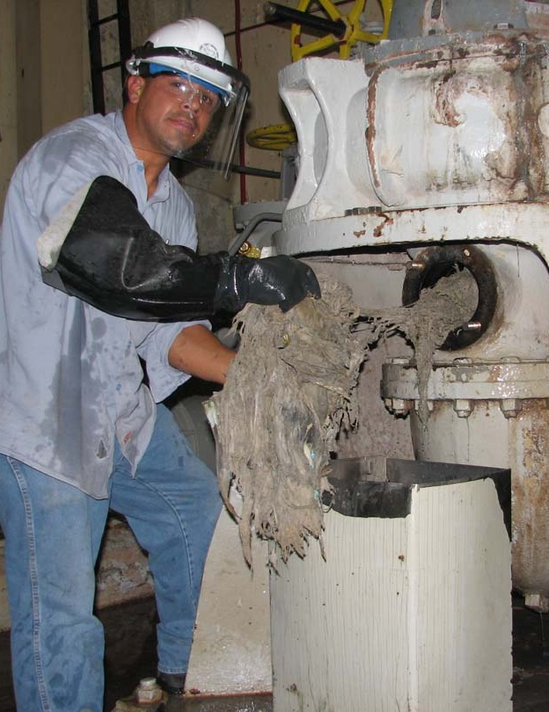
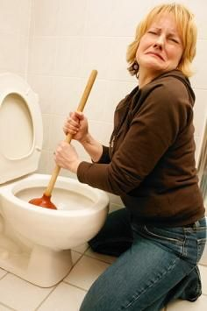
What’s the Problem?
System Reliability
Costs to Prevent Sewer Spills
Flushable vs. Non-dispersible Confusion
Product labeling
Notes:
Sewers are a cost inefficient means to send rags to a landfill
The trash can is a better transport mechanism to move used nonwovens to the landfill
Helps prevent sewer spills and reduce O&M costs
Helps improve ratepayer access to a better functioning sewer and treatment system?
Other options and ideas ?

Slide 3
Nonwoven Industry Guidelines
2003 WERF DOCUMENT #02CTS7P - “Protocols to Assess the Breakdown of Flushable Consumer Products” for Proctor and Gamble - did not fully address potential problems between the toilet and treatment plant
Contains voluntary guidelines for testing for “flushability”
INDA/EDANA’s 2nd ed. guidelines based on this desire– “become unrecognizable in a reasonable amount of time”
June 2013 INDA/EDANA 3rd ed. voluntary guidelines released to members – very limited comments taken from WEF & NACWA
Notes:
– “be compatible with wastewater conveyance and treatment plants”

Slide 4
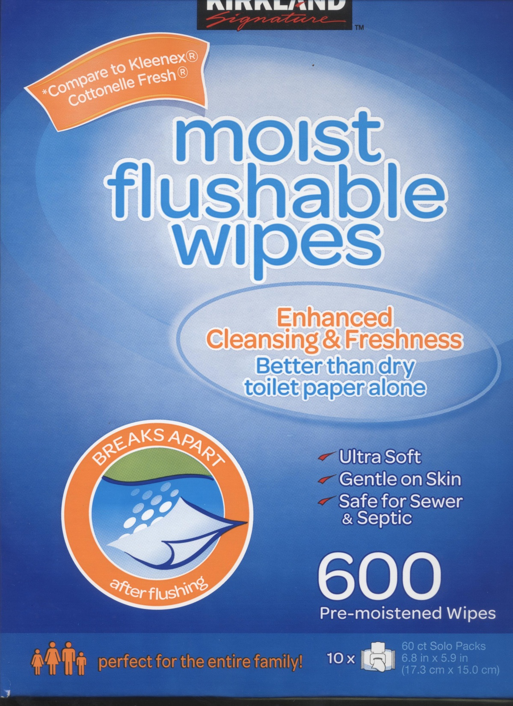
??
?
?
2012

Slide 5
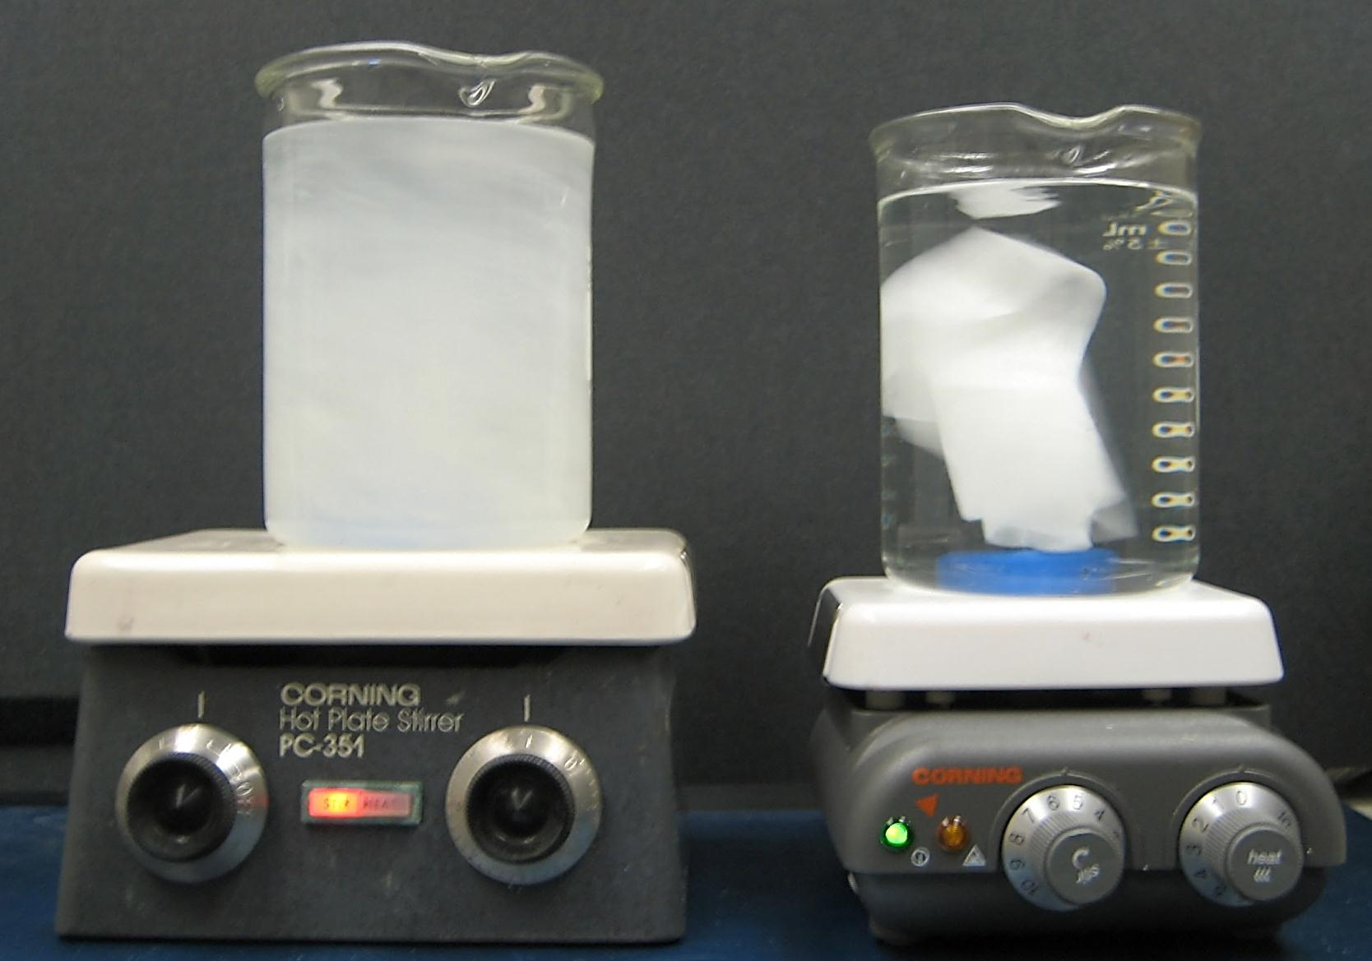
Flushable vs. Dispersible OCSD Lab 2012
Toilet Paper after 5 min.
Wipes after 24 hours

Slide 6
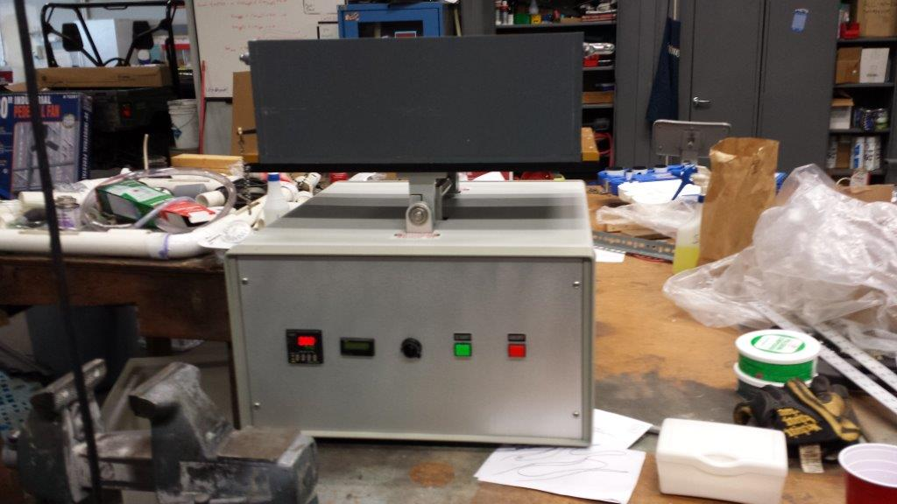
INDA Slosh Box

Slide 7
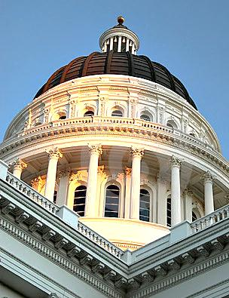
Proposed Legislation
2010 – AB 2256 California Proposed labeling and third-party verification of dispersibilty, and fines for non-compliance
2011 – LD 781 Maine Proposed establishing standards for products advertised as flushable
Inactive NOV 2010
New studies starting fall 2013

Slide 9
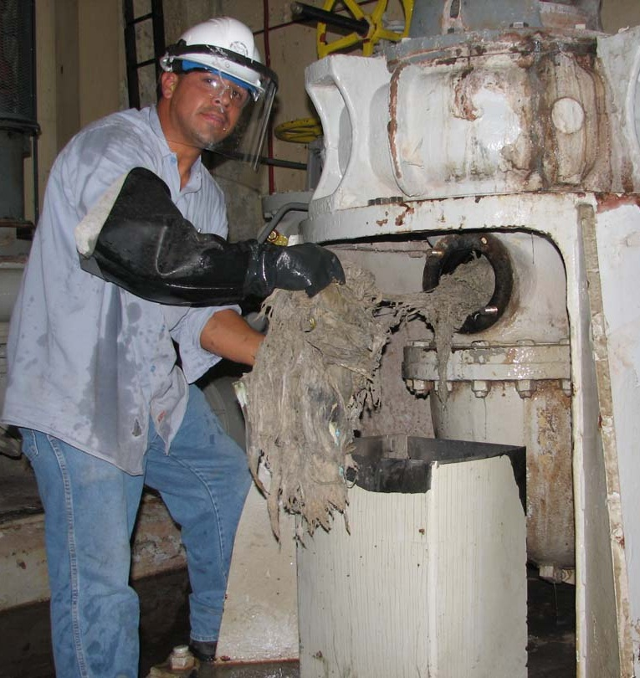
OCSD’s First Deragging Study
2010-11
971 preventative or corrective deragging tasks on 10 pump stations
Total labor cost $320,000
Occasional needle sticks add more risks
08/13/2012
New Plant 2 Headworks
40 large trash bags of debris removed from 3 plugged washer compactors took 6-8 hours and 10 staff to correct
Engineering the problem away – pushes it down the line
Debris doesn’t disappear
$$$
Using SCAP Incident Report forms
Notes:
Currently – every Monday and Thursday crews remove nondispersibles from 3 pump stations.
At each station a minimum of 3 pumps must be taken out of service to be cleaned.
A task that takes two employees up to two hours to complete.

Slide 10
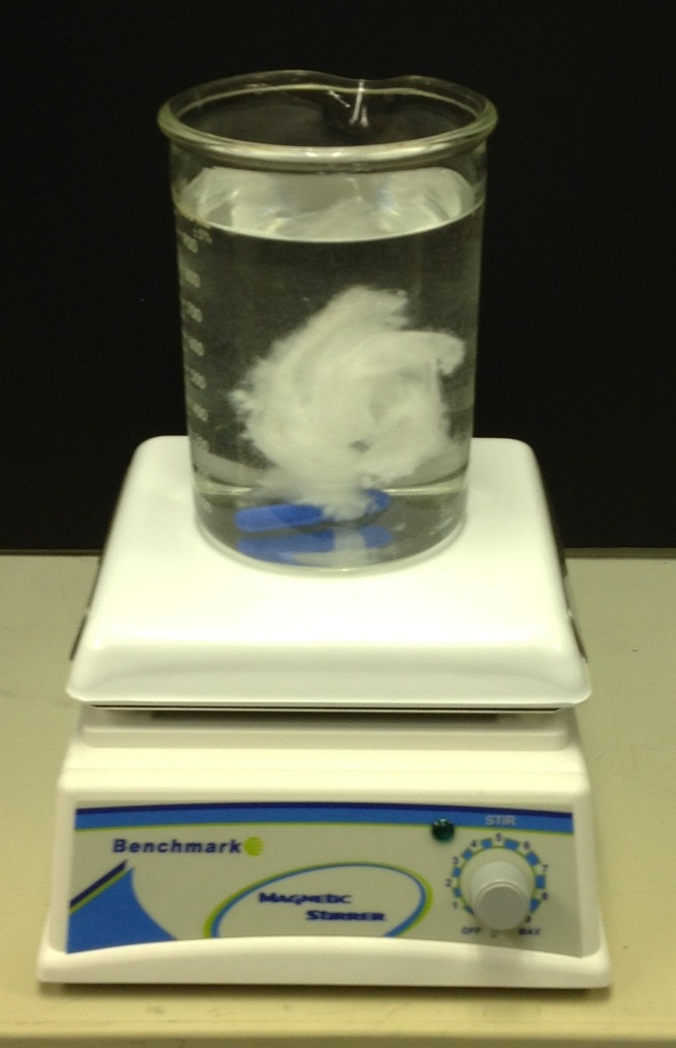
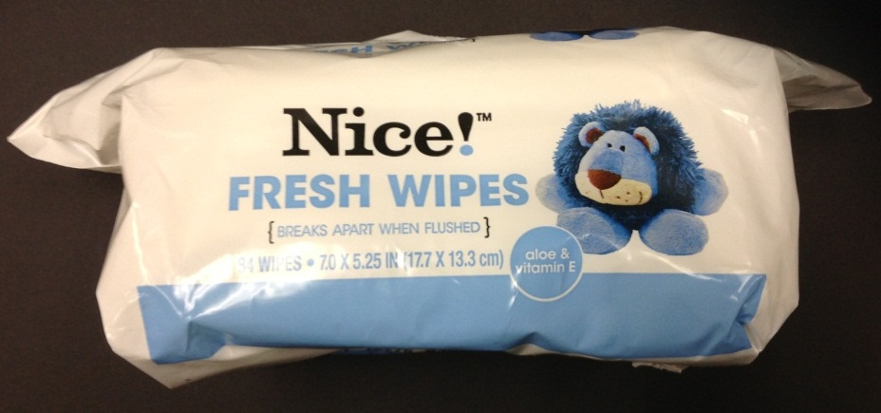
HydraSpun® – Flushable vs. Dispersible? OCSD Lab JAN 2013
HydraSpun® nonwoven substrate after 1 hour – some dispersion – some good news?
Product re-engineering is possible

Slide 11
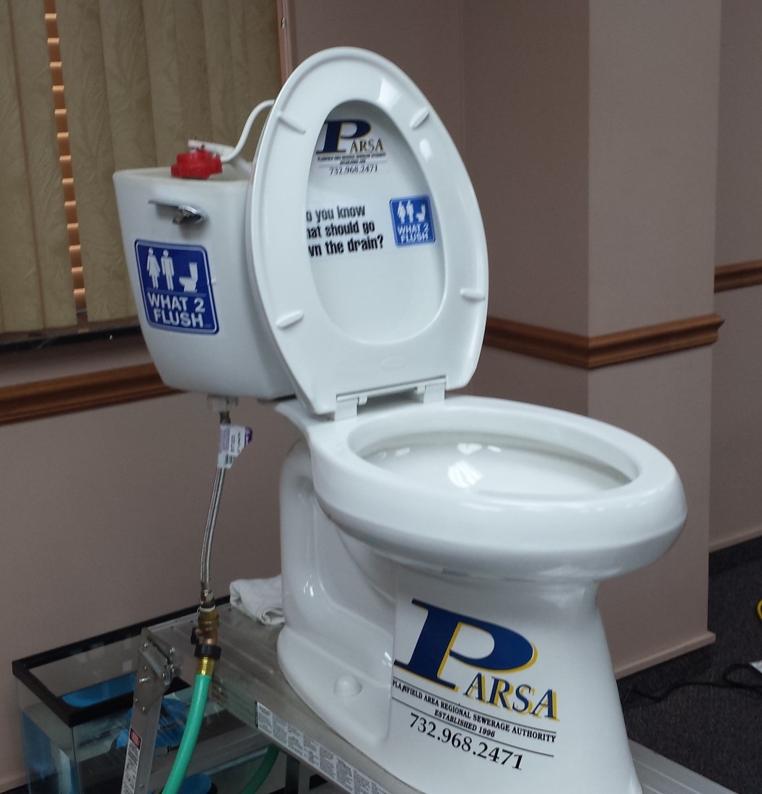
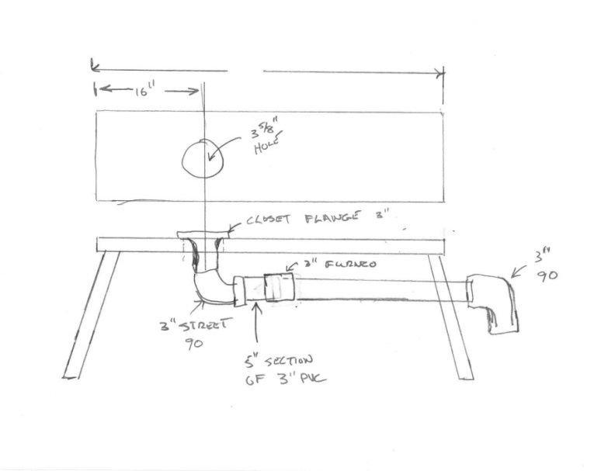
PARSA Potty – June 2013

Slide 12
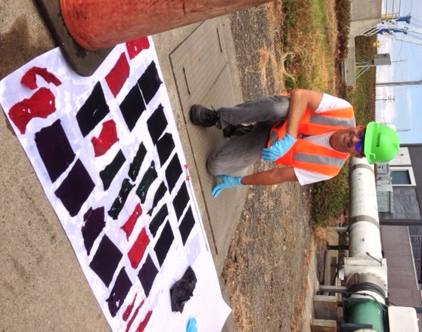
Vancouver In-Sewer Test for Wipes August 2013

Slide 13
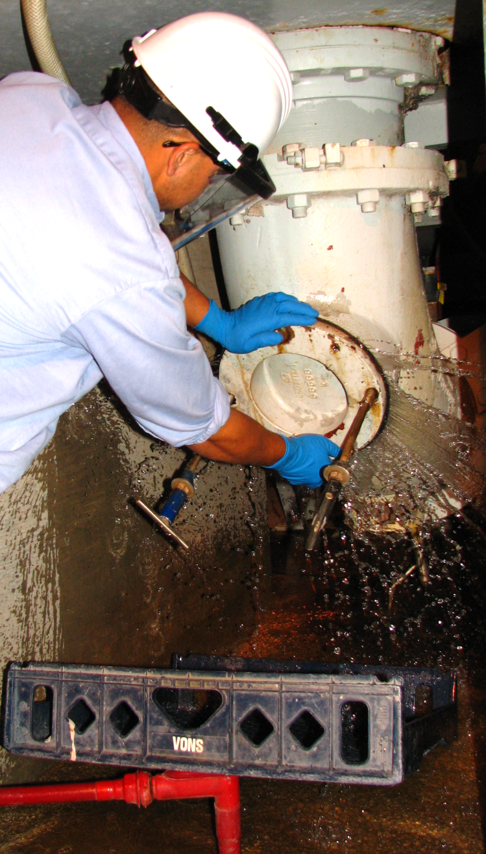
How SCAP Members Can Help
Continue to NETWORK regionally and
also Collect and Document all Costs on SCAP’s Incident Report form
Preventative and corrective maintenance tasks in sewers/pump stations/treatment plants
Labor hours/costs
Equipment repair/replacement costs
? CIP Projects needed $$$$
Fuel costs
Debris hauling fees
Blockages, SSO events, and fines
See www.nacwa.org/flushables and use Maine WWCA’s SOP for detailed characterization studies
Notes:
Sewers are a cost inefficient means to send rags to a landfill
The trash can is a better transport mechanism to move used nonwovens to the landfill
Helps prevent sewer spills and reduce O&M costs
Helps improve ratepayer access to a better functioning sewer and treatment system?
Other options and ideas ?

Slide 14
OCSD’s Message - What2Flush
OCSD’s Public Outreach Campaign Developed:
It’s simple – the toilet is only meant to flush the three P’s –
Pee
Poop
Toilet Paper
www.What2Flush.com
What’s your message?

Slide 15
More Ideas
Speak up and provide your examples using the SCAP form
Align with CWEA P3S & Gov’t Affairs……& NACWA P3S
Follow www.NACWA.org/flushables
Prepare a Position Papers like NEWEA’s
Consider renewing Legislation in CA?
Help strengthen city and agency ordinances
Understand the role of Federal Trade Commission (FTC) www.FTC.gov
New friends in Canada at MESUG
Push for improved labeling
Monitor tests being done in Vancouver, WE and at PARSA in NJ

Slide 16
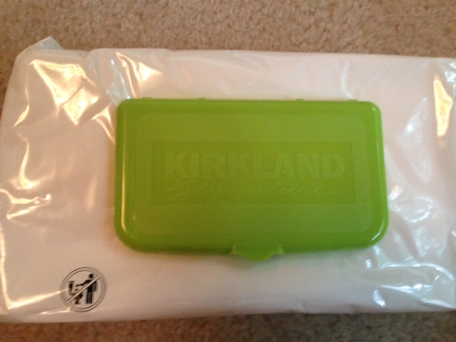
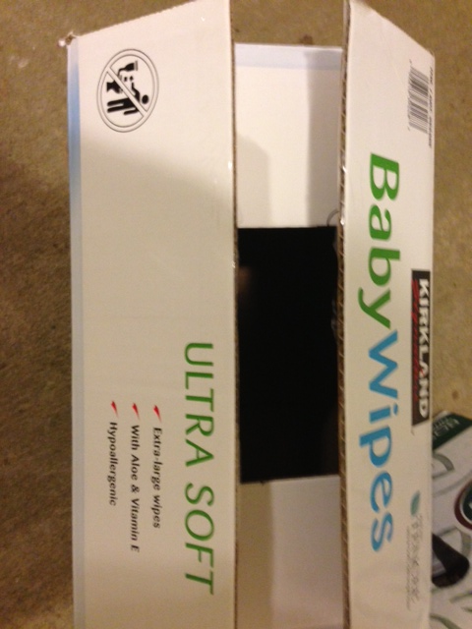
Costco Baby Wipes - June 2013

Slide 17
More Networking Opportunities
CWEA Committees & Sections
California Clean Water Summit Partners (CCWSP)
Water Environment Federation (WEF), WEF House of Delegates (HOD), WEF Member Associations, and Europeans
National Association of Clean Water Agencies (NACWA) hosts www.nacwa.org/flushables
American Public Works Assoc. (APWA)
American Water Works Assoc. (AWWA) ????
Canadian Water and Wastewater Assoc. (CWWA)
Onsite Systems: www.cowa.org and www.nowra.org
CA Rural Water Association?
Your suggestions
Graphic courtesy of King County
Notes:
Sewers are a cost inefficient means to send rags to a landfill
The trash can is a better transport mechanism to move used nonwovens to the landfill
Helps prevent sewer spills and reduce O&M costs
Helps improve ratepayer access to a better functioning sewer and treatment system?
Other options and ideas ?

Slide 18
Next Steps: Put Non-Dispersibles in the Trash, Not the Sewer
Sanitary and/or Combined Sewers are not an effective or proper way to move non-dispersibles to the landfill
Sustainability – long-term
Water Conservation
Energy Conservation
Extended Producer Responsibility (EPR) ???
Lower our labor needs
Graphic courtesy of King County
Notes:
Sewers are a cost inefficient means to send rags to a landfill
The trash can is a better transport mechanism to move used nonwovens to the landfill
Helps prevent sewer spills and reduce O&M costs
Helps improve ratepayer access to a better functioning sewer and treatment system?
Other options and ideas ?

Slide 19
www.What2Flush.com
Questions?
Nick J. Arhontes, P. E. Director of Facilities Support Services Dept. 714.593.7210 narhontes@ocsd.com
Notes:
19

