Slide 1
Irvine Ranch Water District
Michelson Water Recycling Plant
Biosolids & Energy Recovery Project
So Cal Alliance of POTWs
Energy Management/Biosolids Committee
Steve Malloy, Principal Engineer
August 12, 2014

Slide 2
Presentation Overview
IRWD Background
MWRP Biosolids & Energy Production Facilities
3-D Model Renderings
Construction Photos
Project Schedule

Slide 3
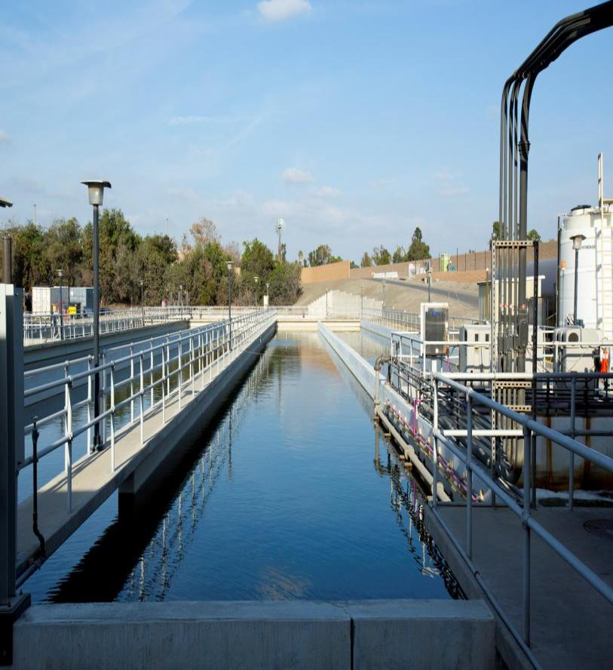
IRWD Services
 | Drinking Water 4 Water Treatment Plants, 26 Wells 1500 miles of water pipeline
 | Sewage Collection 1000 miles of collection pipeline
 | Recycled Water 2 Recycled Water Plants 500 miles of recycled water pipeline
 | Urban Runoff Treatment San Joaquin Marsh prototype 31 wetland treatment sites

Slide 4
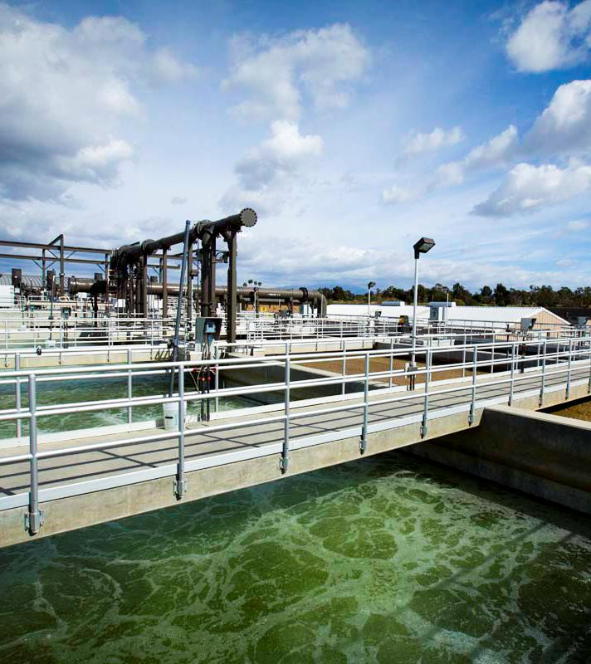
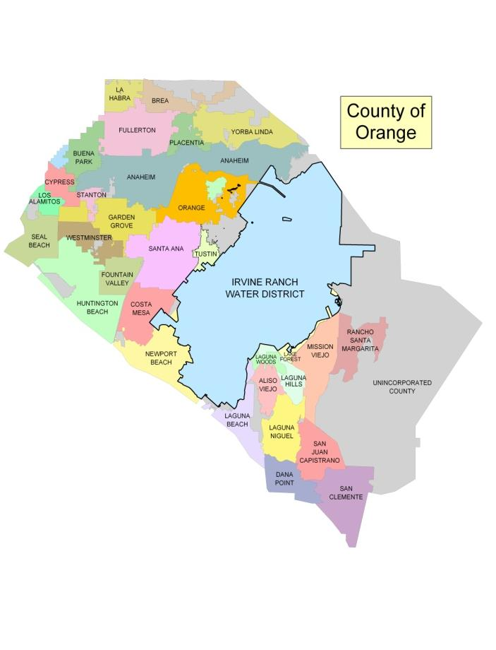
IRWD Serves 20% of Orange County

Slide 5
Biosolids & Energy Recovery Facilities Project

Slide 6
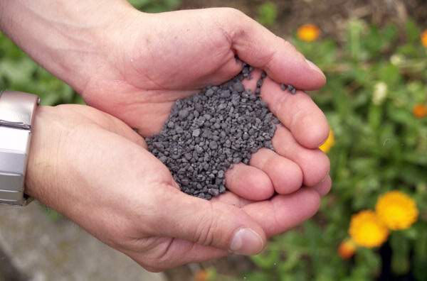
Biosolids & Energy Recovery Project
Project Objectives:
Beneficially reuse Biosolids and Biogases produced
during the treatment process.
Manage residuals (Biosolids) at reduced costs to
IRWD’s customers.
Construct project to meet IRWD’s
future Biosolids handling needs.
Minimize environmental impacts:
Drying and pelletizing reduces
export truck loads by a factor of four.
Reduces greenhouse gas effects
by beneficially using pellets locally
as a fertilizer or e-fuel.

Slide 7
Biosolids & Energy Recovery Project
Project Description:
IRWD to construct facilities at MWRP for:
  Biosolids digestion, dewatering and drying
  Biogas management and energy recovery
  Odor control systems
IRWD would no longer export solids to Orange County Sanitation District (OCSD).
Project would also accept Biosolids trucked in from IRWD’s
Los Alisos Water Recycling Plant (LAWRP).

Slide 8
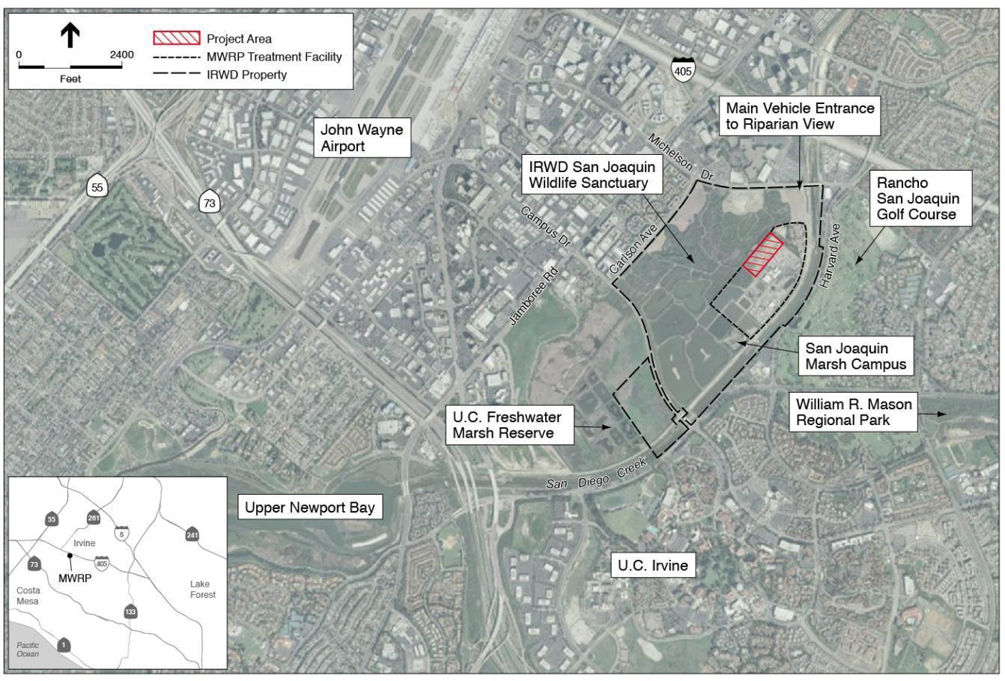
Biosolids Project Location

Slide 9
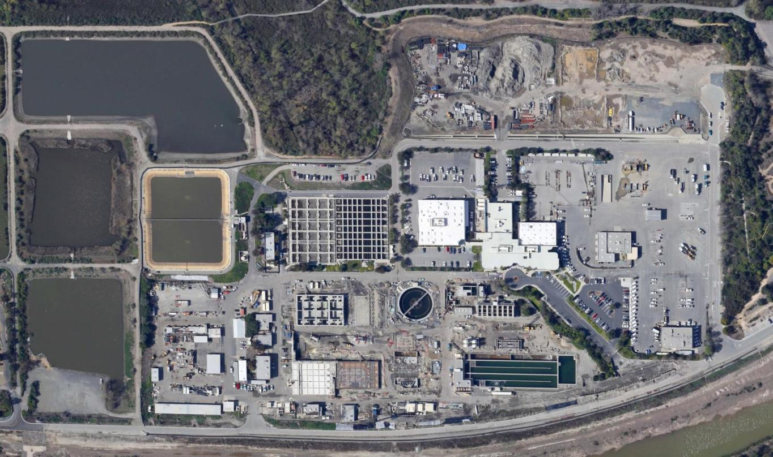
Biosolids Facilities Site Location
MWRP
Biosolids and Energy
Recovery Facilities

Slide 10
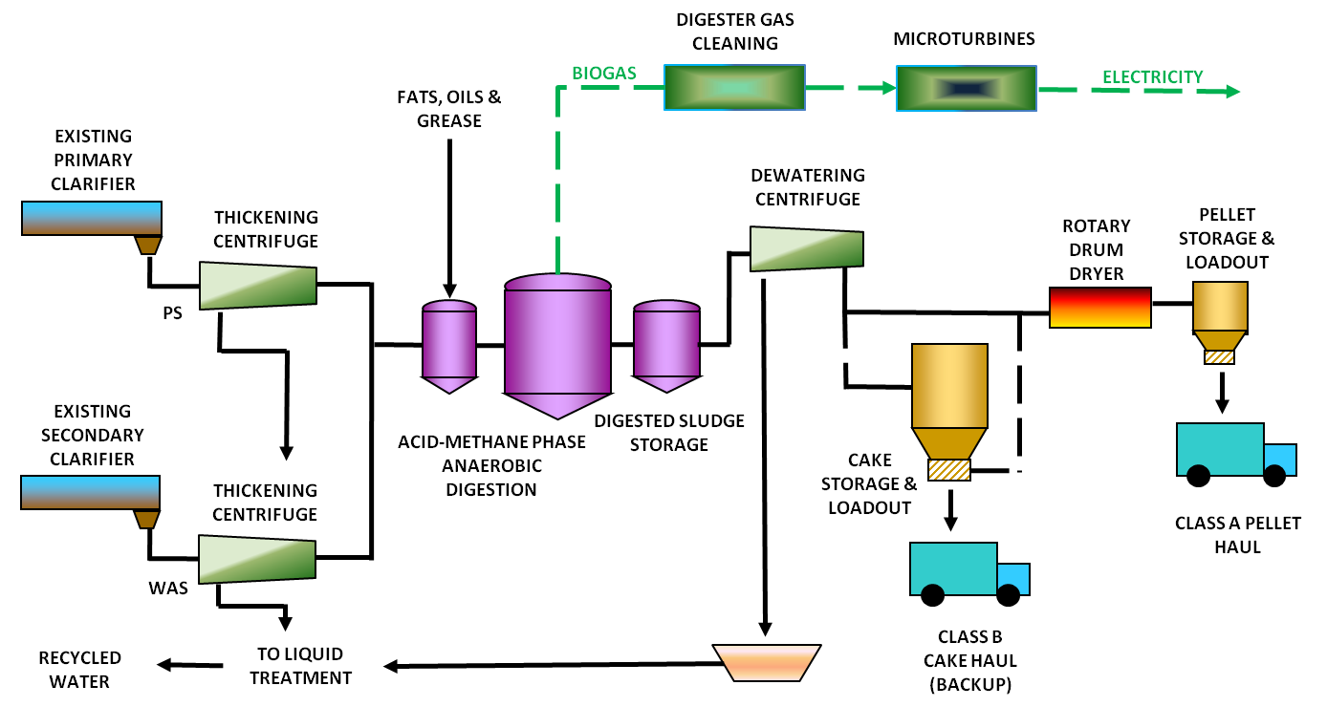
Simplified Process Schematic
CENTRATE
TREATMENT

Slide 11
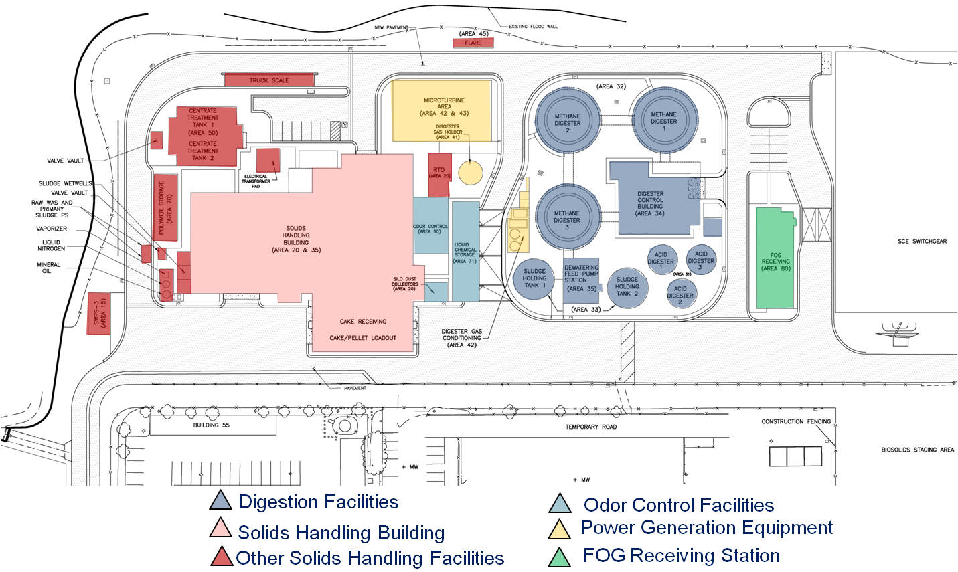
Biosolids Facilities Site Plan

Slide 12
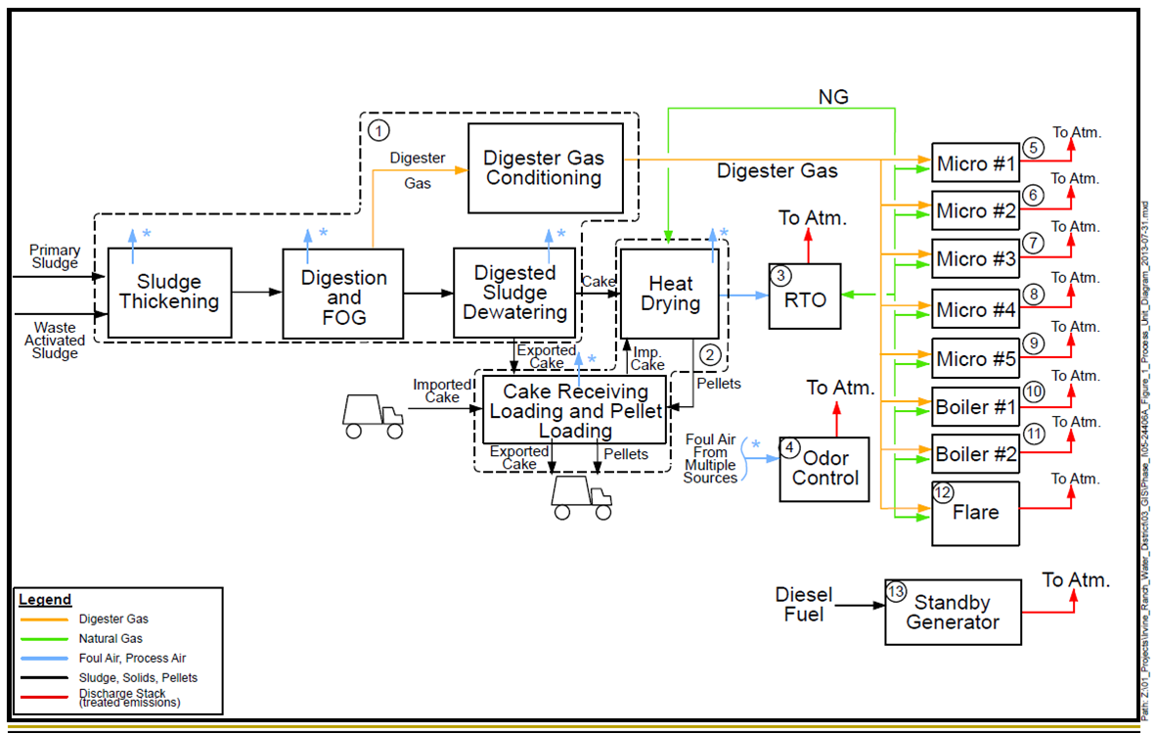
Air Permit Process Diagram

Slide 13
Cool Biosolids Stuff

Slide 14
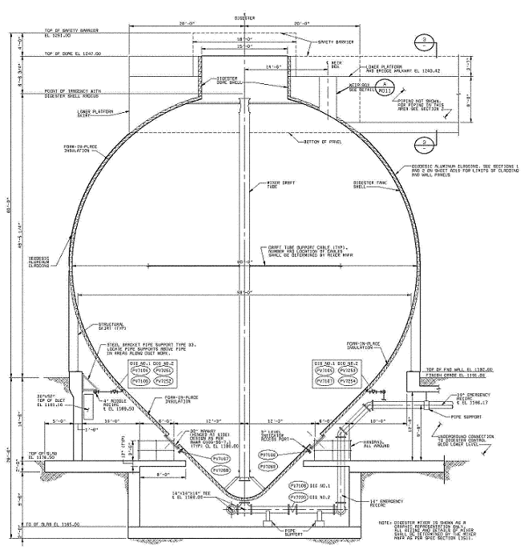
Egg Shaped Digester Characteristics
Operational benefits
  More efficient mixing
  Good foam control
  Easy grit removal
Structural
  Steel shell
  Insulated exterior
  Ring wall
Approx 67 Ft
Approx 73 Ft
Approx 35 Ft
Portion of
Digester
Below Grade

Slide 15


Heat Drying System

Slide 16
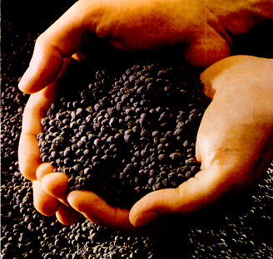
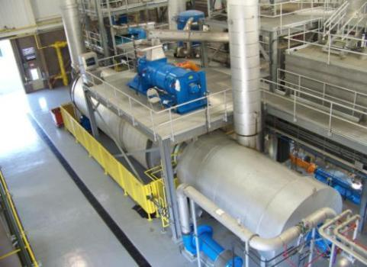
Heat Drying System
Produces a pellet
suitable for local
beneficial reuse
  Nitrogen for fertilizer
  Btu content for e-fuel
Dryers in CA:
  Encina (Carlsbad)
  Sacramento
  Corona

Slide 17
Alt. 3 – Microturbines
Biogas Priorities:
Use in the micro-turbines to get SCE incentives.
When dryer and micro-turbines are off, use in boilers to heat digesters, if needed.
Excess biogas (very little) diverted to enclosed gas burner.
Use natural gas in the dryer.

Slide 18
Electrical Power Summary
MWRP Recycled Water Production (MGD) | Recycled Water Treatment Electrical Demand (MW) | Biosolids Handling Electrical Demand (MW) | Total MWRP Electrical Demand (MW) | Micro-Turbine Power Generated (MW) | Percent of Power Self-Generated
23 | 5.1 | 1.8 | 6.9 | 1.0 | 15%
28 | 6.1 | 2.4 | 8.5 | 1.5 | 18%
Biogas Production (Digestion)
Power Generation (Microturbines)
Power Use (Aeration Blowers)
Continuous biogas production and power generation.
All power used on MWRP site.

Slide 19
3-D Model Renderings

Slide 20
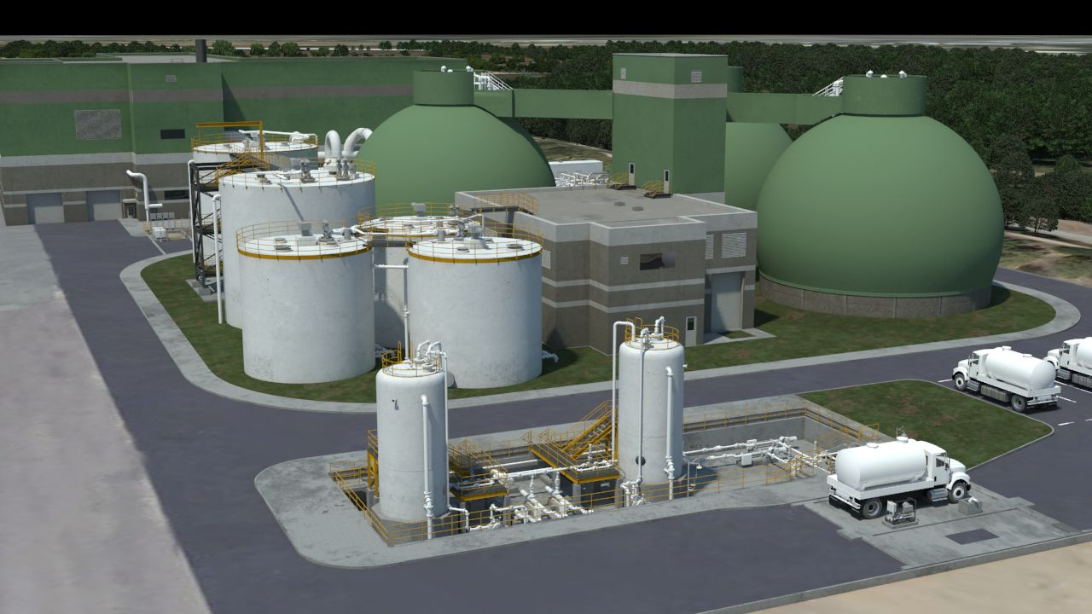
Digestion Facilities
Egg-Shaped Digesters
Sludge Holding Tanks
Digester Control Bldg.
Acid Phase Digesters
FOG Foodwaste Receiving

Slide 21
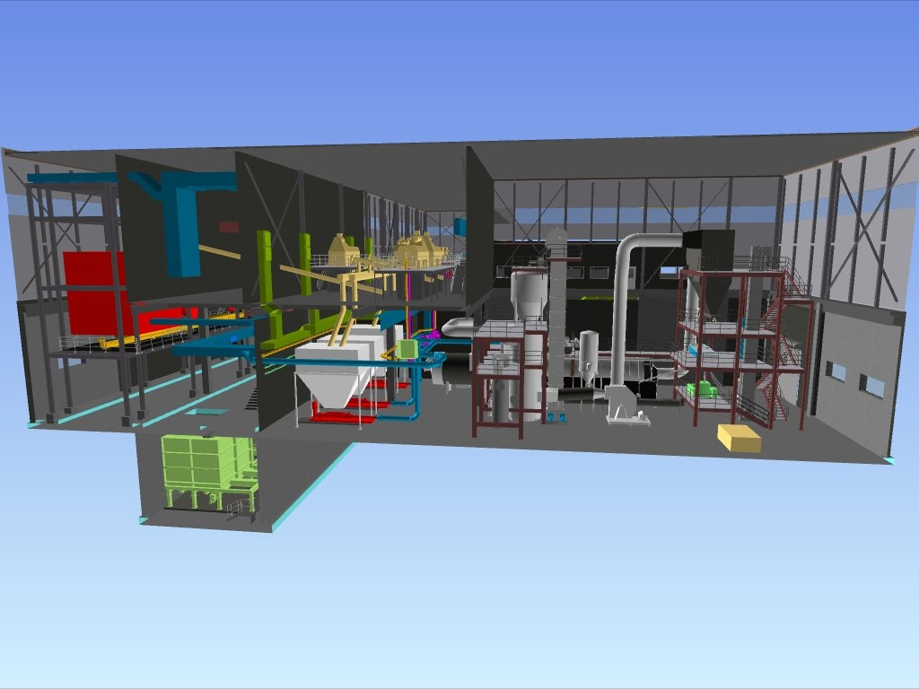
Biosolids Handling Building Interior
Pellet & Cake Truck Loading
Centrifuges & Cake Handling
Cake Bins
Heat Dryer
Cake Receiving & Storage

Slide 22
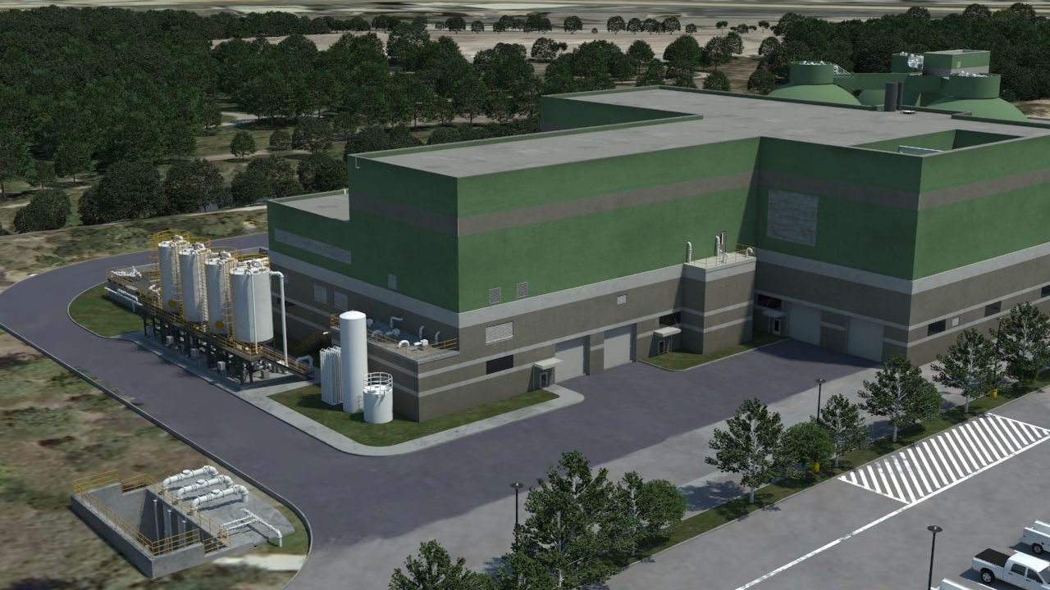
Biosolids Handling Building
Dryer and Odor Control
Discharge Stacks
Polymer Storage
Solids Receiving
Pellet Loadout

Slide 23
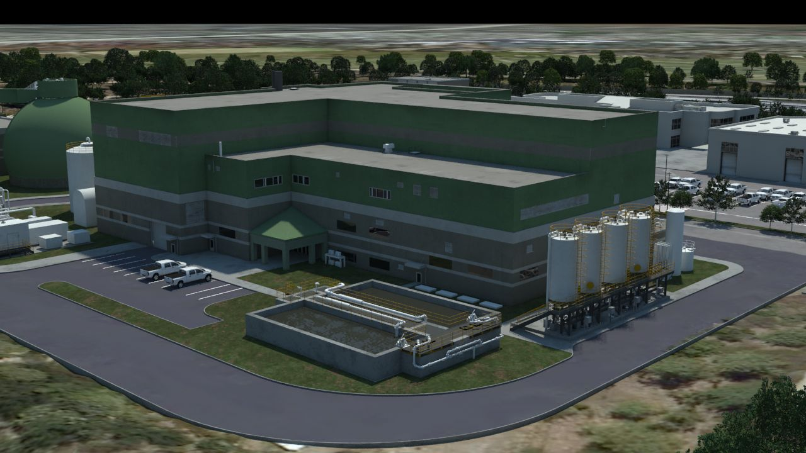
Biosolids Handling Building
Dryer Area
Centrifuge Area
Polymer Storage
Centrate Treatment

Slide 24
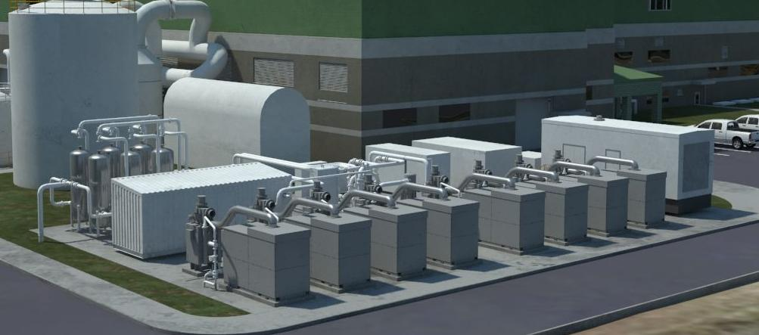
Biogas Treatment & Microturbines
Biogas Storage
Biogas Conditioning
Microturbines

Slide 25
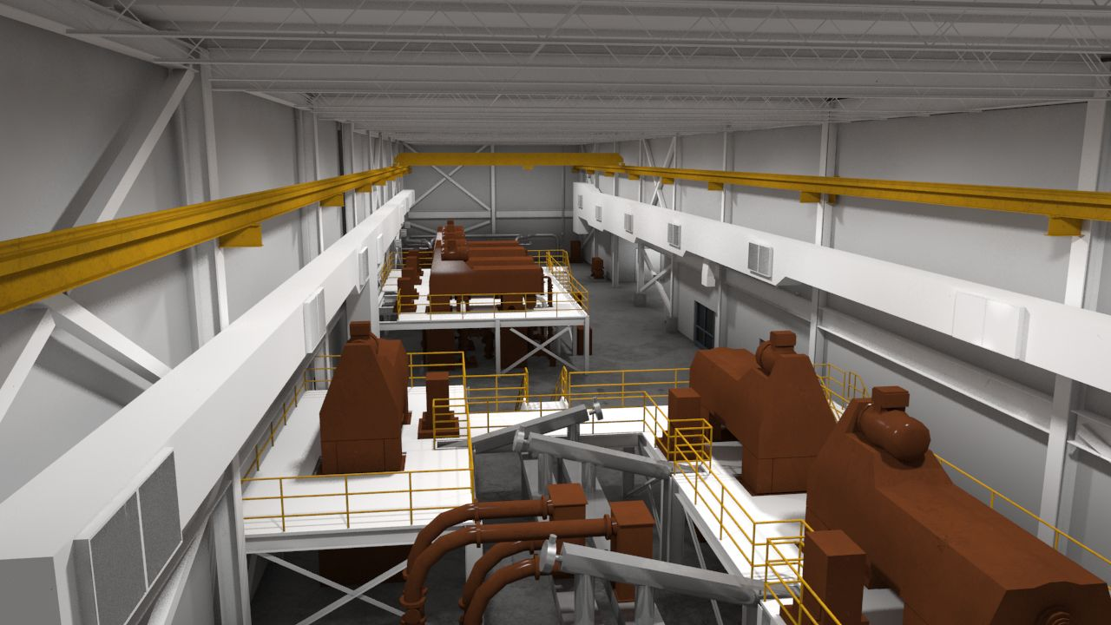
Centrifuge Room
Thickening Centrifuges
Dewatering Centrifuges

Slide 26
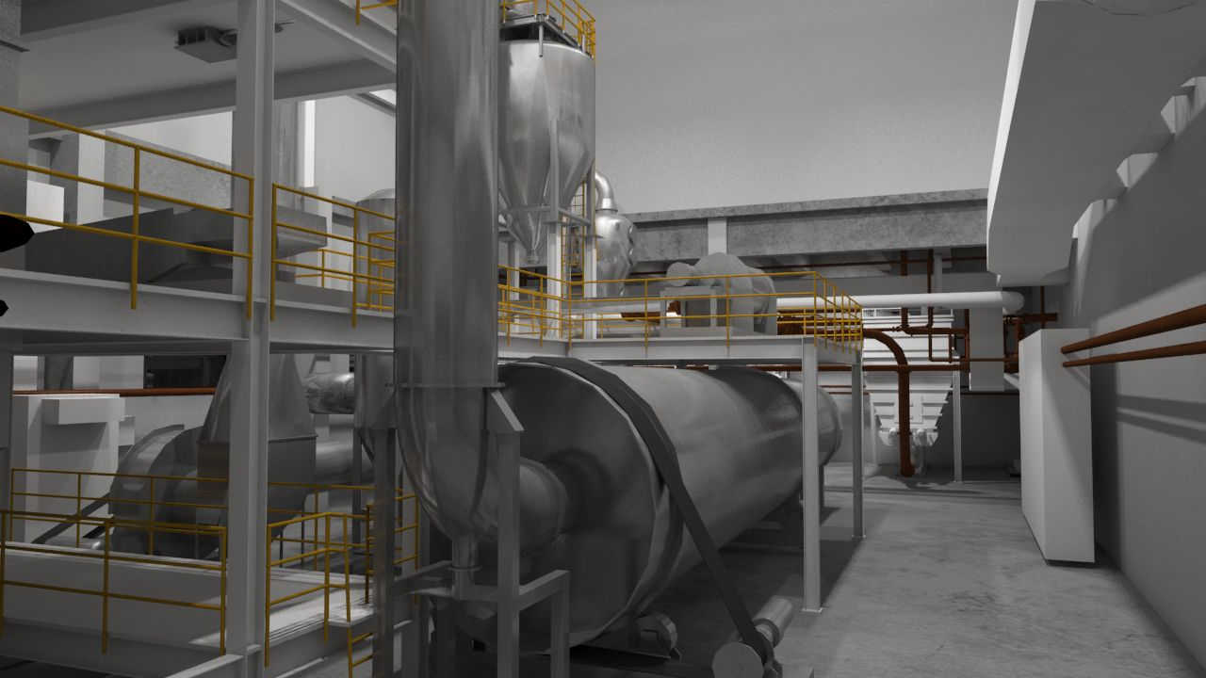
Dryer System – Lower Level
Pellet Screen
Dryer Drum

Slide 27
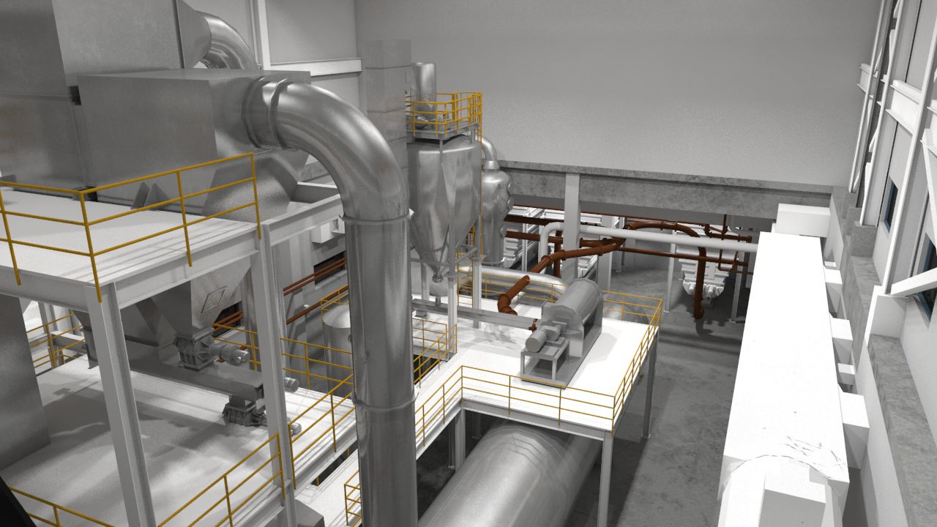
Dryer System – Upper Level
Solids/Off Gas
Separation
Recycle Bin
Pellet Mixer
Dryer Drum

Slide 28
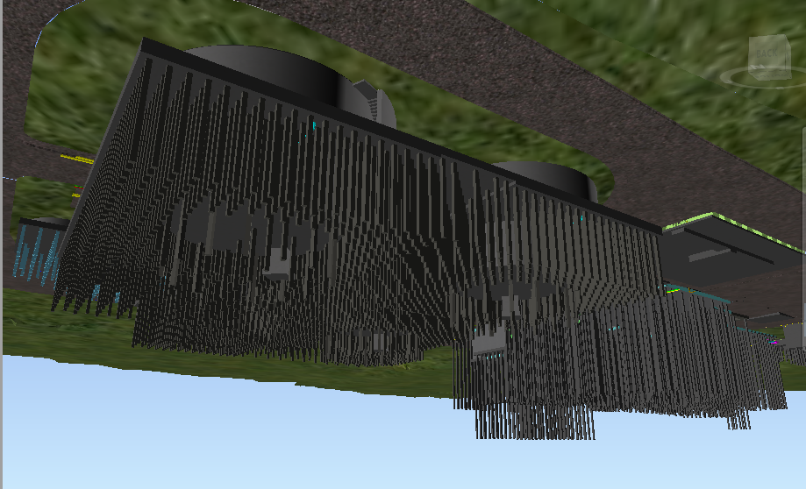
Sub-Surface View of 3,028 Piles

Slide 29
Construction Photos

Slide 30
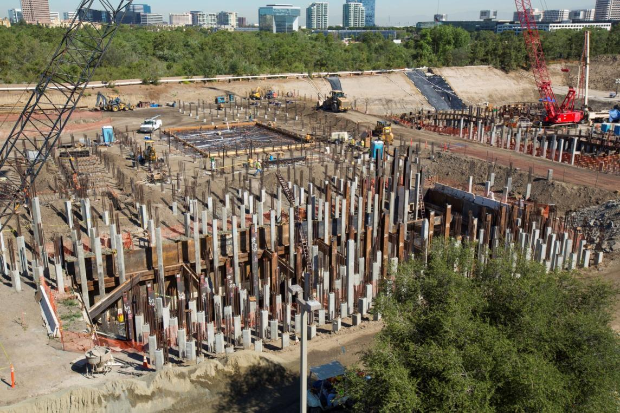
Construction Photos
Installation of Piles in Solids Handling Facility

Slide 31
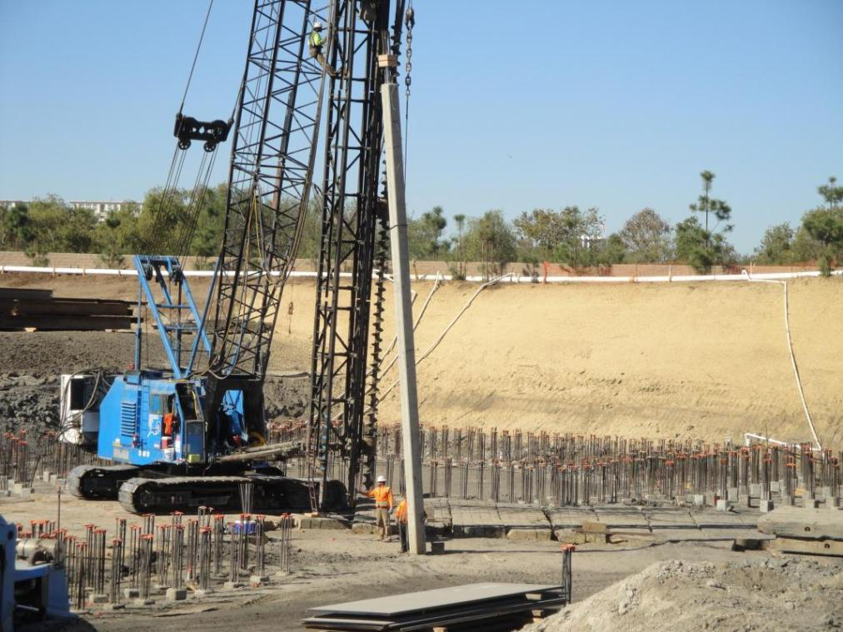
Construction Photos
Pile Installation – Digester Area

Slide 32
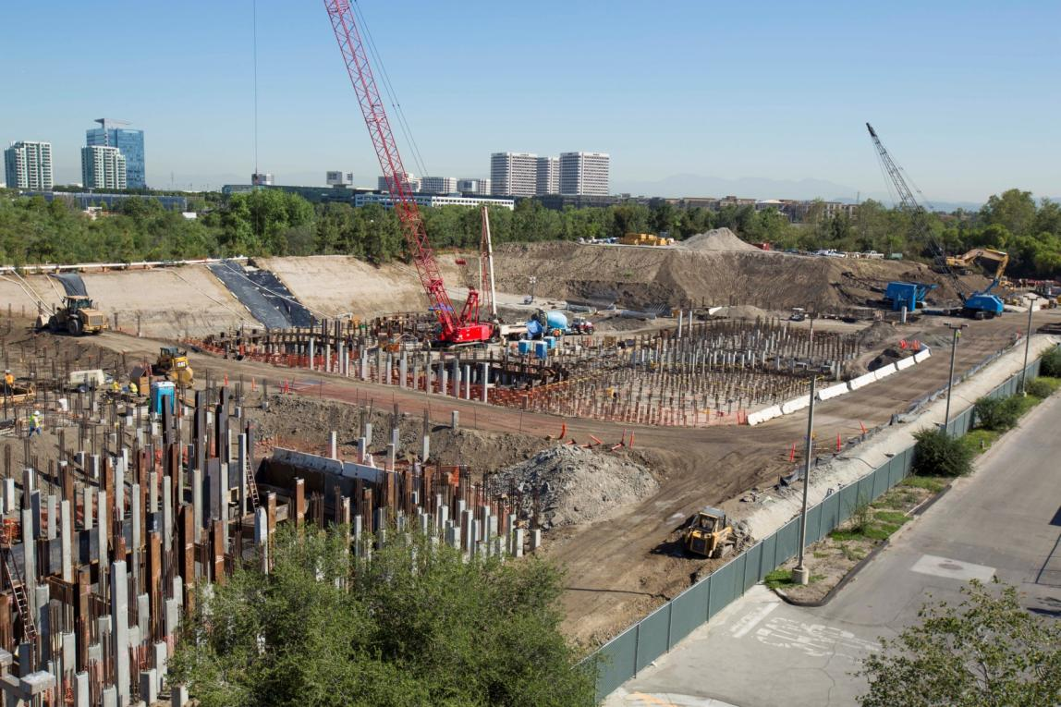
Construction Photos
Installation of Piles in Methane Digester Area

Slide 33
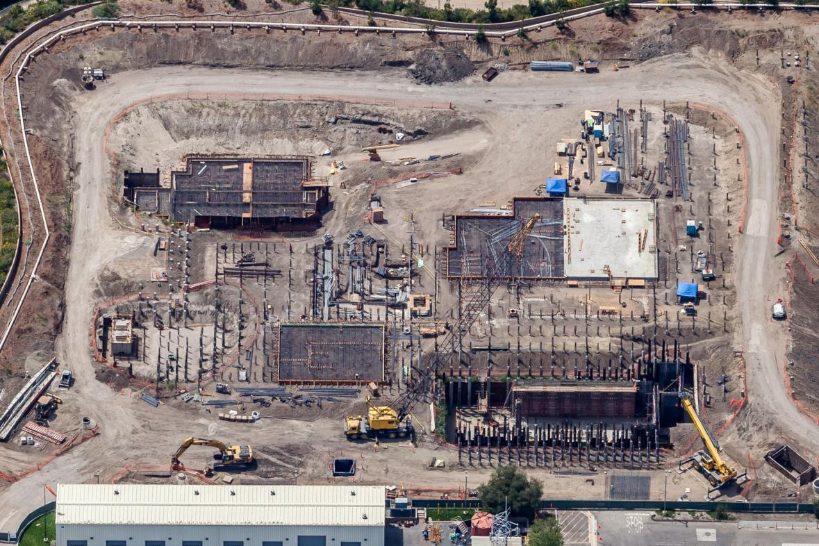
Construction Photos
Aerial View of Western Half of Biosolids Site – Solids Handling Area
Dryer Area
Centrate Treatment
Electrical Room
Sludge Wet Wells
Digester Feed Pumps
Sludge Receiving Basement

Slide 34
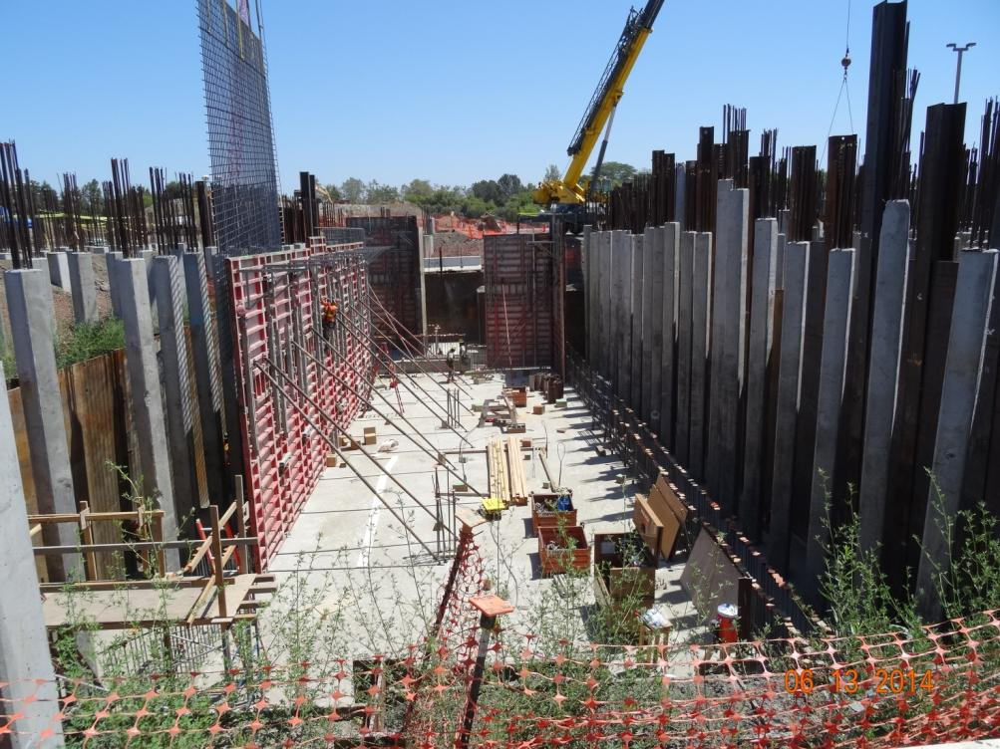
Construction Photos
Rebar Installation for Wall of Solids Handling Building Basement

Slide 35
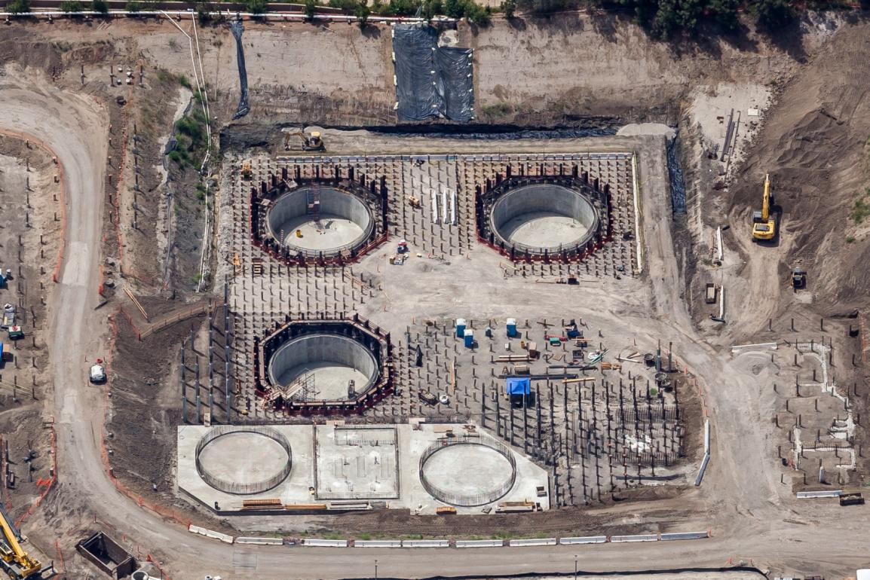
Construction Photos
Aerial View of Methane Digesters and Sludge Holding Tanks
Methane Digester No. 1
Methane Digester No. 2
FOG Receiving Area
Digester Control Building Area
Methane Digester No. 3
Sludge Holding Tank No. 1
Sludge Holding Tank No. 2
Acid Digesters Area
Digester Sludge Pump Station

Slide 36
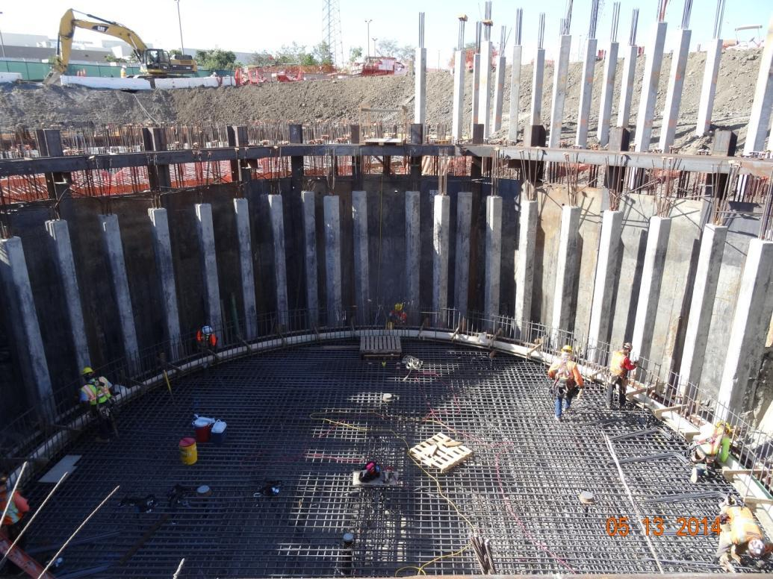
Construction Photos
Rebar Work for Methane Digester No. 3

Slide 37
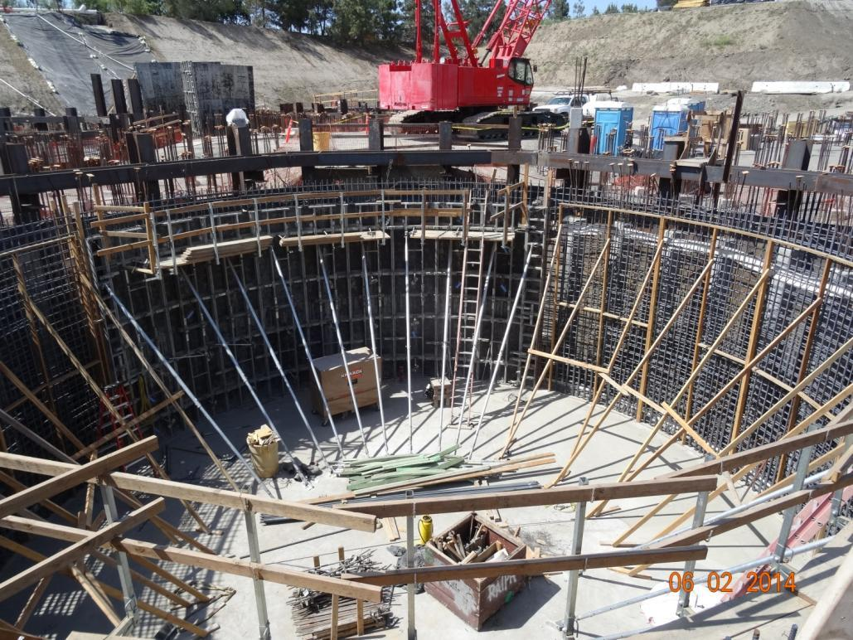
Construction Photos
Formwork and Rebar Work for Methane Digester No. 3 Wall

Slide 38
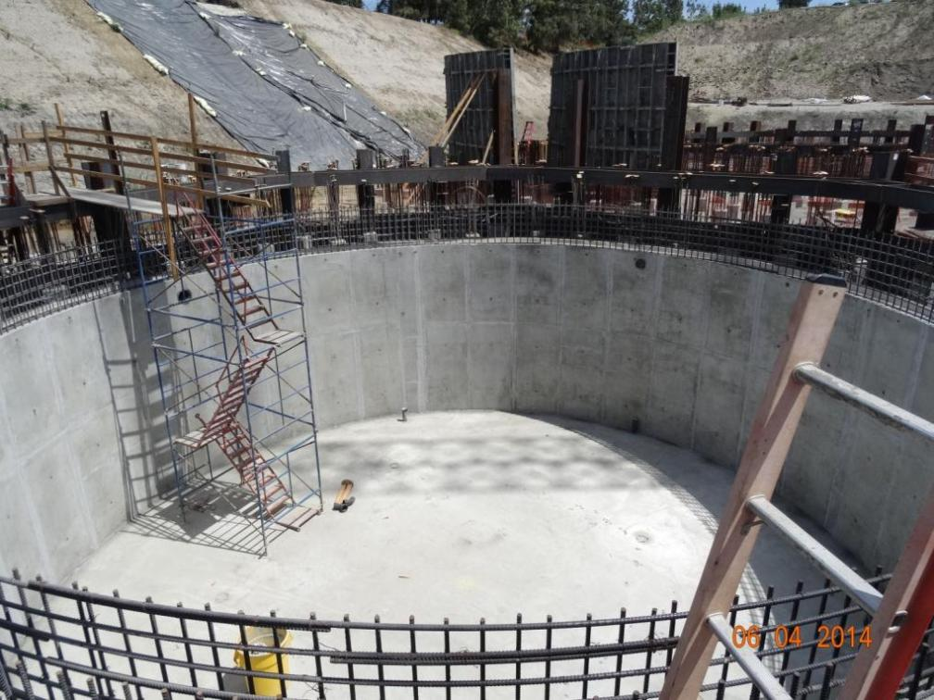
Construction Photos
Finished Concrete Work of Methane Digester No. 2 Wall

Slide 39
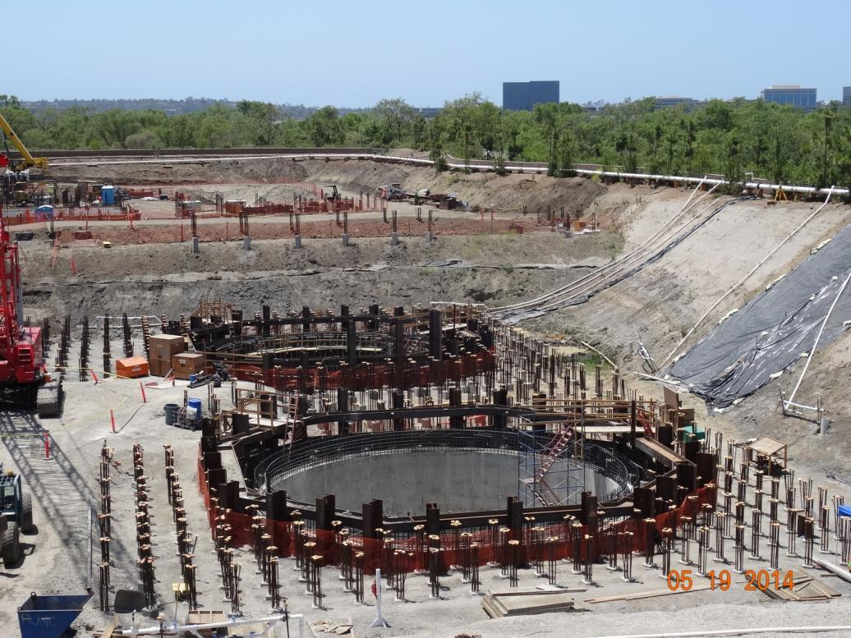
Construction Photos
Basements of Methane Digesters Nos. 1 and 2

Slide 40
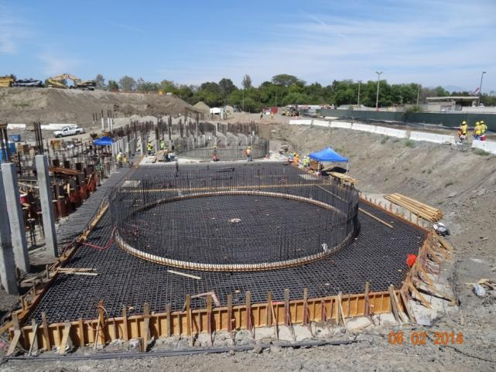
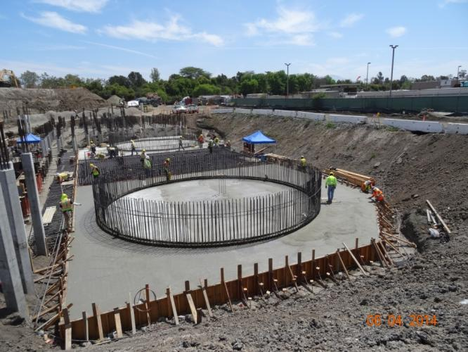
Construction Photos
Rebar and Concrete for Work of Sludge Holding Tank No. 2

Slide 41
Project Schedule

Slide 42
Project Schedule
DATE | ACTIVITY
April 29, 2013 | Notice of Award
June 3, 2013 | Notice to Proceed
Sept. 2013 – March 2014 | Pile Driving
January 17, 2016 | Anaerobic Digestion Facilities Online
March 2, 2016 | Produce Class B Biosolids (Cake)
June 30, 2016 | Microturbine Power Generation Online
August 29, 2016 | Produce Class A Biosolids (Pellets)
October 28, 2016 | Project Completion

Slide 43

Contact Information:
Steve Malloy, P.E.
Irvine Ranch Water District malloy@irwd.com
(949)-453-5695 (business hours)

