Slide 1
Paul A. Weghorst
Executive Director of Water Policy
Irvine Ranch Water District Energy Savings and Embedded Energy Programs
August 12, 2014

Slide 2
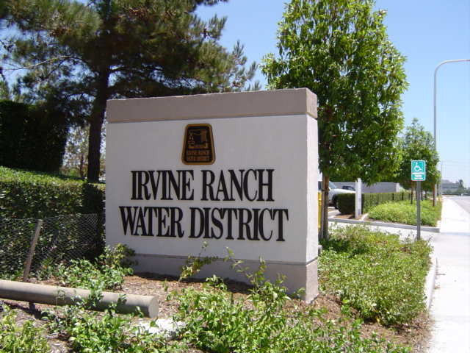
Presentation Overview
Irvine Ranch Water District programs that save energy
Energy master planning
Recommended programs to save energy
Embedded energy plan development

Slide 3
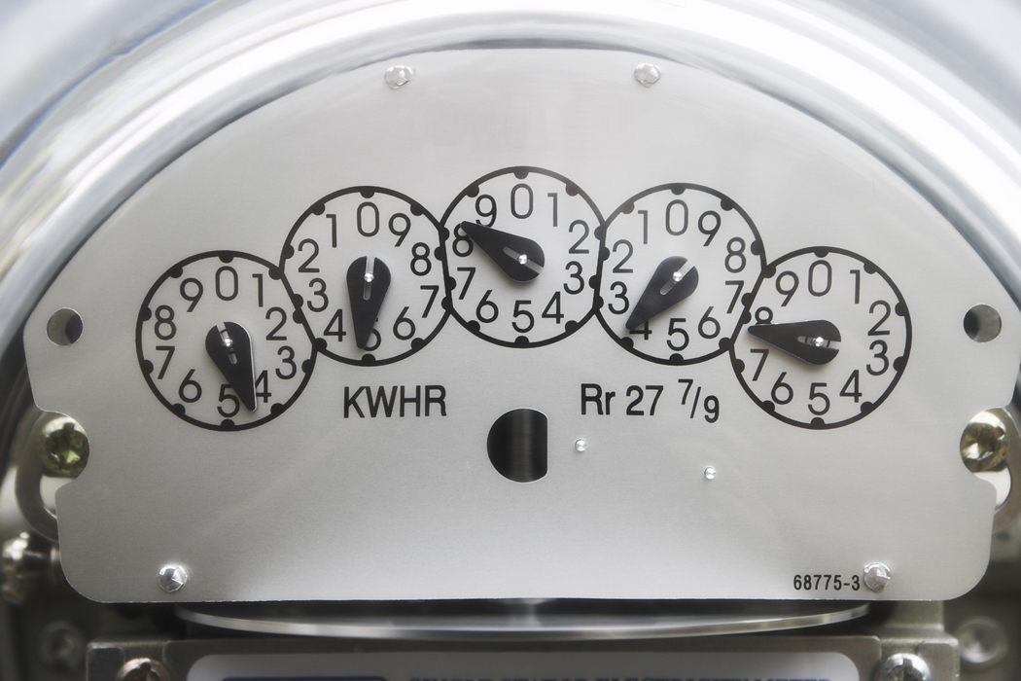
IRWD Programs that Save Energy
Reducing dependency on imported water
  Water conservation
  Recycled water use
  Use of groundwater
Participation in SCE’s Savings by Design Program
Solar energy generation (322 KW)
Installation of energy efficient UV system
Demand response (Monthly bids ~1.6 MW)
Minimizing peak time of pumping
Premium efficiency pumps, motors, RO cartridges, VFD’s , HVAC systems, etc.
Energy Master Planning
Embedded Energy Plan development
Biosolids and Energy Recovery Project (up to 1.6 MW)

Slide 4

Planning for the Future
Energy and Greenhouse Gas (GHG) Master Plan
Objective:
  “To Identify a portfolio of cost-effect projects to reduce IRWD’s existing and future energy costs and, as required under future regulatory conditions, reduce GHG emissions.”
Notes:
Alan - The Five step process does several things…
Let’s go through each step briefly, I will tell you what we have completed, where we are and what is coming.

Slide 5
IRWD’s Estimated Future Energy Use

Slide 6
Estimated Total Future Energy Costs

Slide 7
Estimated Future GHG Emissions
1/ Emissions embedded in the purchase of imported water make up 40% of the amounts shown

Slide 8
Energy Saving Project Identification Process
Started with 64 projects such as:
  Building & facility energy efficiency
  Wastewater treatment optimization
  Pump and motor efficiency
  Digestion of pre-processed food waste
  IC engines, microturbines & fuel cells
  Solar power
  Wind power
  Microhydro
  Fleet fuel reductions
  New groundwater supplies
  Renewable energy credits
  Additional water conservation
  Pump storage projects
20 Projects
Assessed
12 Additional
Analysis
9
Recommended

Slide 9
Project Evaluation Scoring Criteria
Developed by Staff and Kennedy/Jenks Consultants
Evaluation Scoring Criteria | Points (100 Total)
Cost effectiveness NPV, capital cost, life cycle energy costs | 40
Operational impacts Risk, complexity, staffing | 20
Risk and uncertainty Financial, regulatory, political, autonomy | 20
GHG Impacts Emission levels | 10
Environmental Impacts Air, land, water, noise, other | 10

Slide 10
Recommended Programs to Save Energy
# | Project Description
1 | Additional Water Conservation Activities (Ongoing)
2 | Accelerated Pump Efficiency Improvement Program (Ongoing)
3 | Implement Building Energy Efficiency Measures (Complete)
4 | Solar PV Lease Program on property outside service area (Not Feasible)
5 | Further optimize recycled water production (Ongoing)
6 | Implement results of a Process Energy Audit (Ongoing)
7 | Optimize the San Joaquin Marsh winter time pumping (Complete)
8 | Install an Automated Dissolved Oxygen Control at LAWRP (Future)
9 | Implement a Processed Food Waste-to-Energy Program (Future)
.

Slide 11
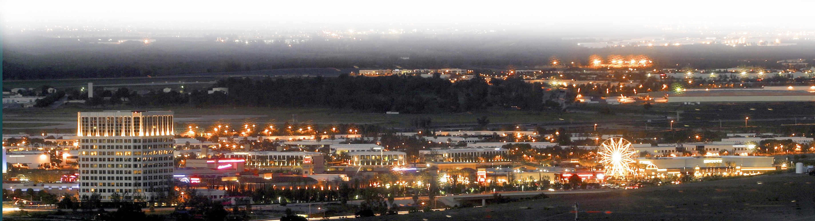
Energy & GHG Master Plan Summary
Capital Cost = $7.0 million
Annual savings = $1.4 million
Annual electricity savings = 9,200,000 KWh
  10 percent of current use
Annual GHG reductions = 3,650 metric tons

Slide 12

Embedded Energy Plan Development
To support additional energy savings through water conservation
Consultant team of Navigant Consulting and HDR
Work began in May 2014
Will quantify energy use associated with:
  Production, treatment and distribution of potable water (kWh/af)
  Sewage collection, treatment and distribution of recycled water (kWh/af)
  Production of reusable biosolids (kWh/ton)

Slide 13
Embedded Energy Components

Slide 14

Benefits of Embedded Energy Plan
Identify facilities of operational changes and energy efficiency improvements
Quantify the avoided cost of energy due to past and present water conservation programs
Identify the most cost-effective areas to target future water conservation programs
To develop pumping surcharge recommendations
To position IRWD to obtain energy utility funding for water conservation programs
To provide embedded energy estimates for 20 years into the future

Slide 15
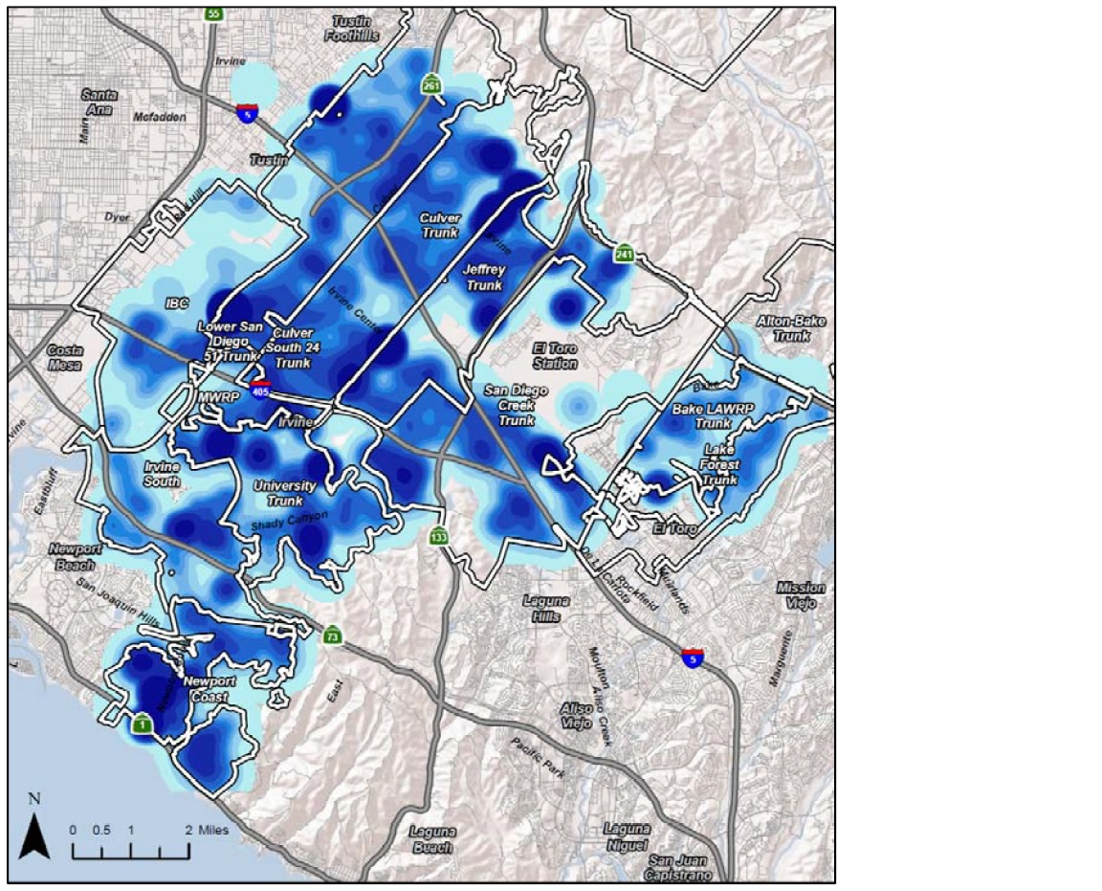
Illustration of Embedded Energy
Conceptual areas of high and low energy intensity

Slide 16
Questions?
  Contact Information:
Paul Weghorst
Executive Director of Water Policy
Irvine Ranch Water District
weghorst@irwd.com
(949)-453-5632

