Slide 1


CA Wholesale Power and RPS
Market Update
May 2013

Slide 2
Discussion Topics
California Wholesale Power Market Trends
SONGs Impacts in the Market
Direct Access Market – Status and Reopening
RPS Market

Slide 3
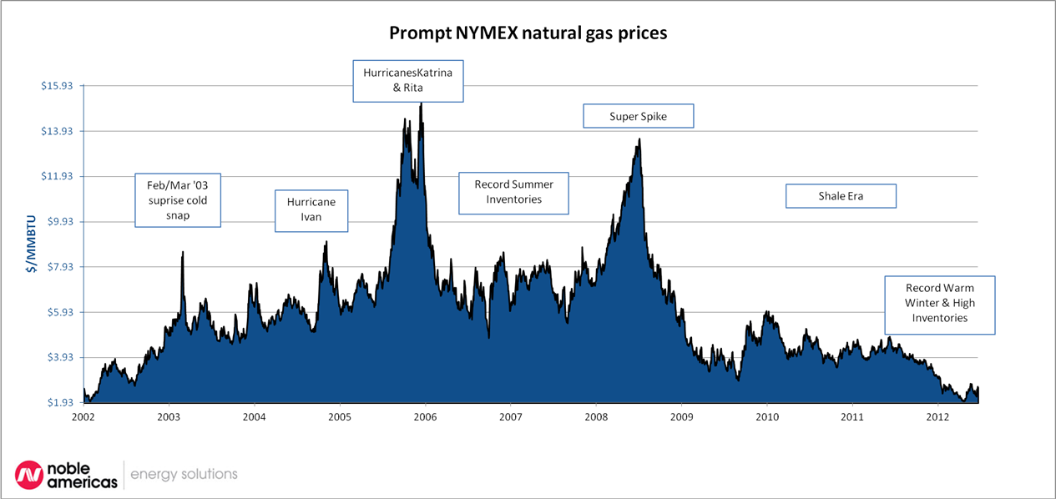
Natural Gas Prices - 10 Year History
- Role of Natural Gas in CA Power Prices

Slide 4
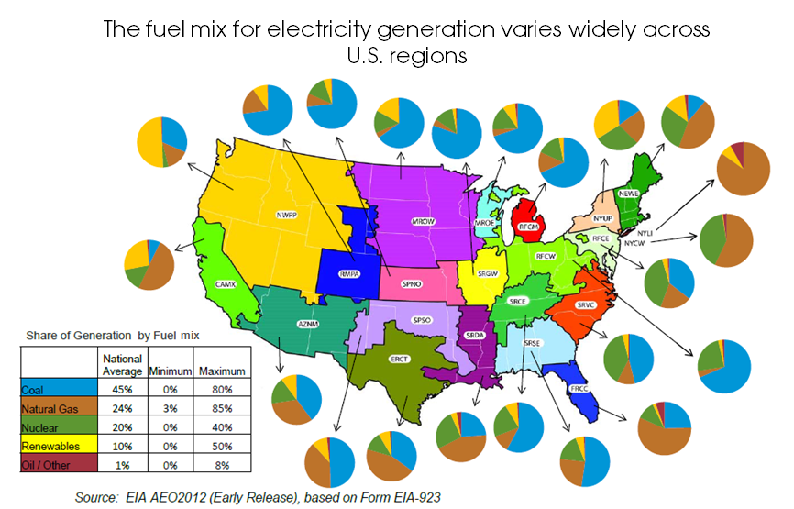
Source: US Energy Information Administration

Slide 5
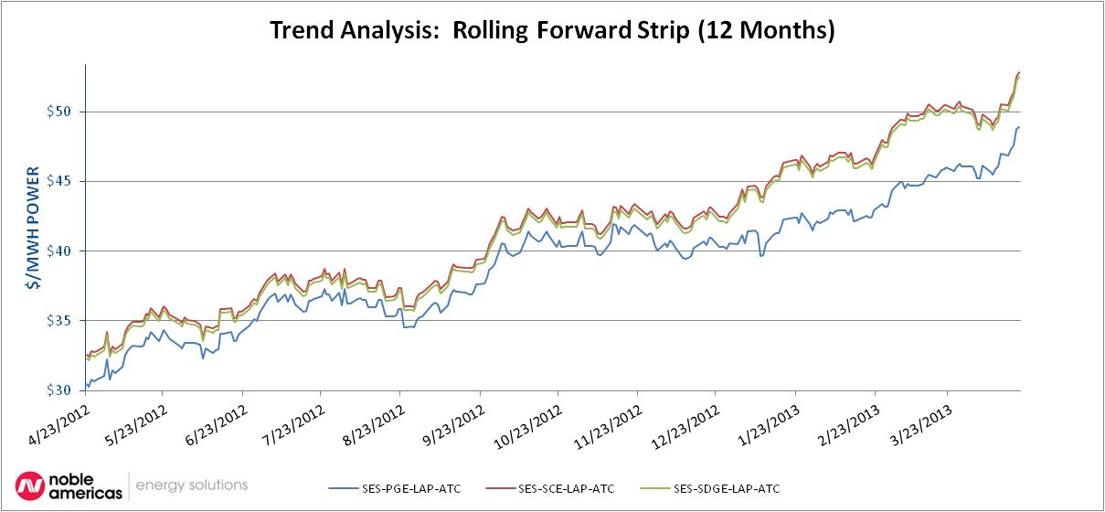
West Coast
Observations:
- Natural Gas Influence
- San Onofre Nuclear Plant off line
- Green House Gas Regulations (heavier impact on Southern California)
- NP (Northern CA) and SP (Southern CA) Spread is widening

Slide 6
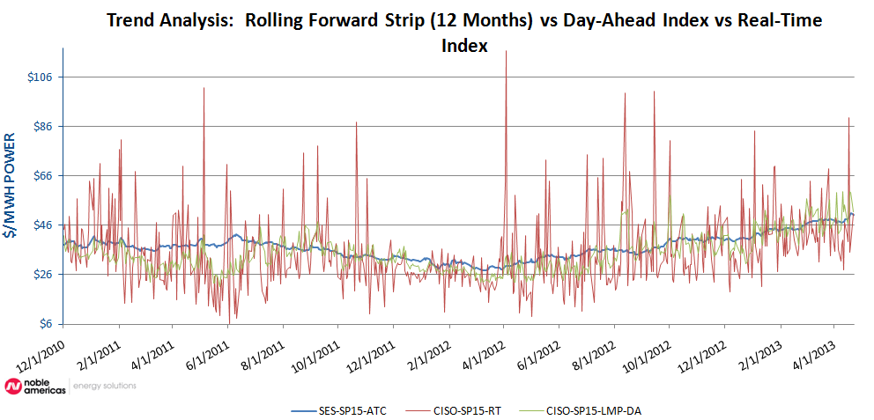
West Coast

Slide 7

California Power Market
Capacity Challenges due to Renewable Energy
New Capacity Needs - Flexible RA Capacity
  As more intermittent generation resources connect to the grid (i.e. solar and wind), the CAISO has a greater need for generation that can follow the increased hourly variability of both load and generation
    Think of it this way, as solar generation falls off at the end of the day, the CAISO’s experiencing its afternoon/evening system peak
    With wind an unknown variable, the CAISO needs to be sure to have capacity available that can quickly ramp-up to meet the afternoon/evening peak

Slide 8
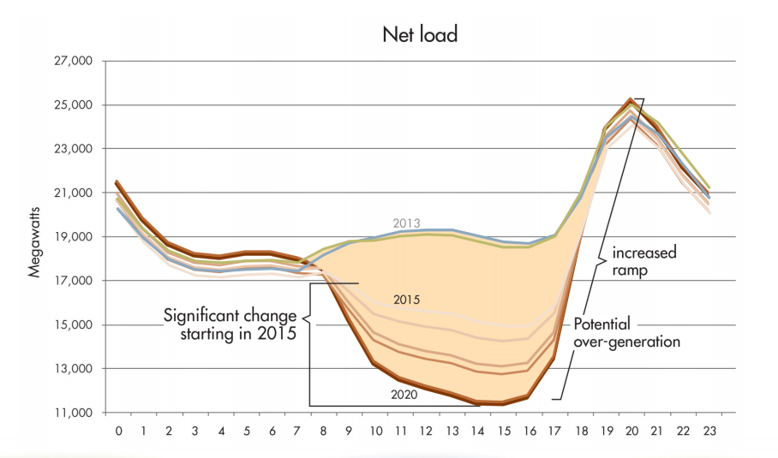
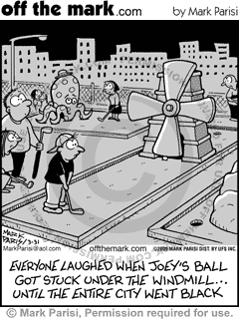
California
The “Duck” Curve due to hourly fluctuations in load and generation

Slide 9
California
SONGS outage, is it impacting SCE’s rates?
  SCE collects its cost of fuel and power purchases in an annual proceeding called the ERRA
  According to a SCE presentation, generation rates for bundled customers will be increasing by ~6% sometime in the next couple of months
    That equates to around an +$8 per MWh increase for bundled customers

Slide 10
California
SONGS outage, is it impacting SCE’s rates?
  Direct Access customers pay for the fixed cost of SONGS via the PCIA component in the DA-CRS rate schedule
    That equates to around a $5 per MWh increase for DA customers
  The Commission is looking at over $400 million in potential SONGS related refunds, if refunded, that is expected to cause the PCIAs to go to zero for all vintages

Slide 11

California
April Direct Access Lottery
  Current estimates of available load:
    PG&E 35 MWs
    SCE 70 MWs
    SDG&E 3 MWs
  Expecting the results of the lottery to be announced first week or so in June
  33% of state-wide investor owned utility industrial load (>500 kW) is taking service from Electric Service Providers

Slide 12

California
AB 1350 – Authored by Assembly Member Rodger Hernandez
  Bill is a 2-year bill, meaning it won’t be voted on until next year
  Raises DA cap by same volumes as last round
  Approximately 450 MW PG&E, 450 MW SCE and 80 MW SDG&E over a multi-year period

Slide 13
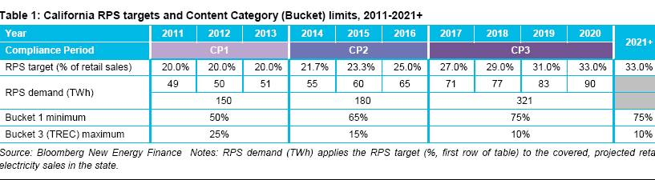
Renewable Portfolio Standard
SCE appears to be long RPS energy versus the RPS targets for Compliance Periods 1 and 2
As more renewable energy delivers to SCE, that will push up SCE’s generation costs in the near term (~+3% for 2014 and 2015)

Slide 14

California
AB 153 (Bonilla) – Noble Solutions Supports
  AB 153 requires CARB to:
    On or before January 1, 2015, to consider new GHG offset protocols to increase offset supply, provide for more transparency in the offset protocol review process, and provide additional mechanisms for public input

Slide 15
Noble Americas Energy Solutions
Mike Lee (714 846-6286)
and
Greg Bass (619 684-8199)

Slide 16
Key Legal Information
The information, opinions, estimates, projections and other materials contained herein are provided to intended recipient for its own personal or internal company use as of the date hereof and are subject to change without notice. Some of the information, opinions, estimates, projections and other materials contained herein have been obtained from numerous sources (e.g. publically available information, internally developed data and other third party sources, including, without limitation, exchanges, news providers, market data providers and other content providers) and Noble Americas Energy Solutions LLC ("NES") has made reasonable efforts to ensure that the contents hereof have been compiled or derived from sources believed to be reliable and to contain information and opinions which are believed to be accurate and complete. However, NES has not independently verified and makes no representation or warranty, express or implied, in respect thereof, takes no responsibility for any errors and omissions which may be contained herein and accepts no liability whatsoever for any loss arising from any use of or reliance on the information, opinions, estimates, projections and other materials contained herein whether relied upon by the intended recipient or any other third party. Information may be available to NES which is not reflected herein. The information, opinions, estimates, projections and other materials contained herein are not to be construed as an offer to sell, a solicitation for or an offer to buy, any products or services referenced herein, nor shall such information, opinions, estimates, projections and other materials be considered as investment advice or as a recommendation to enter into any transaction. Materials herein containing charts, tables and graphs are for informational and illustrative purposes only and are not intended to be used to assist the intended recipient in determining whether or not to buy or sell any product or service. Any benchmarks are used solely for purposes of comparison and the comparison does not mean that there will necessarily be a correlation between the outcomes described herein and the benchmarks. To the extent any materials contain statements about the future, such statements are forward looking and subject to a various risks and uncertainties. Past performance does not guarantee or indicate future results. NES and/or its affiliates may deal as principal in certain products referenced herein (e.g. commodities or related financial instruments). Except as permitted herein, the information, opinions, estimates, projections and other materials contained herein may not be reproduced, disseminated, sold, distributed, published or circulated in any manner or for any purposes without the prior express written consent of NES and/or any relevant source, as may be required. NES reserves all rights to the intellectual property presented herein, including, without limitation, any copyrights, trademarks and corporate logos of NES and/or of its affiliates.

