Slide 1
LOS ANGELES COUNTY PRIORITIZATION OF SEWER REHABILITATION PROJECTS
Fernando Villaluna, P.E.
Paper #
Notes:
Good morning,
Fernando Villaluna
Civil Engineer
Los Angeles County Department of Public Works
I am part of the Department’s Sewer Maintenance Division,
where I manage the Sanitary Sewer Condition Assessment
Program.

Slide 2
Overview
Los Angeles County Sanitary Sewer System
Condition Assessment Program
Program Methodology
Program Results
Questions
Paper #
Notes:
For this morning’s presentation, I will share with you
Condition Assessment Program that we developed seven years ago
Why we do what we do?
How we manage our Inspection Projects
A look at the condition of our system so far
And how we prioritize our repairs and rehabilitation projects within our capital improvement budget

Slide 3
LOS ANGELES COUNTY Wastewater System Overview
Paper #

Slide 4
SYSTEM OVERVIEW Los Angeles County Consolidated Sewer Maintenance District (District)
Comprises of
38 contract cities
unincorporated communities
Serves over 2.5 million people
Collection System
4,600 miles of gravity sewer lines
Over 90% 8” VCP
Paper #
Notes:
This is an overview of the Los Angeles County
Consolidated Sewer Maintenance District
In our District, we have 38 contract cities
which relinquishes the maintenance of their
sewers and pump stations to the District
The District also includes the unincorporated communities of the County
Serves over 2.5 million people
Collection system consists of 4,600 miles of gravity sewer lines
Over 90% of our lines are 8-inch vitrified clay pipe
The system is the main collector for home/businesses which transports wastewater to trunk lines which are operated/maintained by the County Sanitation District.

Slide 5
Sanitary Sewer Condition Assessment Program
Paper #
Notes:
Our District started the Condition
Assessment Program as a response to State of
California’s adoption of Waste Discharge Requirements
in 2006.
Required us to be PROACTIVE in our maintenance and
operation of our system by developing a Sewer System Management Plan
This Plan considers CCTV inspection a MANDATORY element of determining the current condition of our pipes and addressing defects to avoid potential Sanitary Sewer Overflows.

Slide 6
GOAL
To reduce the number of Sanitary Sewer Overflows
Paper #
Notes:
With the ultimate goal of reducing the number of overflows in our system!

Slide 7
Program Objectives
Conduct Closed-Circuit Television (CCTV) inspection
Identify maintenance issues
Determine structural intregrity
Analyze data for benchmarking
Paper #
Notes:
Our Program Objectives include:
Performing CCTV inspection of our sewers on a 10-year repeating cycle; it is our goal to have our sewers inspected every 10 years.
Identify any maintenance issues and immediately clean those sewers
identify any structural defects and schedule the repairs accordingly
Analyze data for future comparisons which includes
Creating reports that summarize the overall condition of the collection system

Slide 8
Program Methodology
Paper #

Slide 9
Program Cycle
Conduct CCTV
INSPECTION
ANALYZE inspection data
Distribute MAINTENANCE REPORTS to field crews to enhance current routine maintenance activities
Identify & repair critical STRUCTURAL DEFECTS
Provide collection system owners with a REPORT of the condition of their sewer collection system
DATA MANAGEMENT and Integration into map-based application for historical comparisons & benchmarking
Continuously repeating cycle
Paper #
Notes:
This slide highlights the 6 steps in the repeating cycle of our projects.
These are the “main” phases of our projects.
Our contractors performing the CCTV inspection
Once we receive the data from our contractors, we analyze the information, and
Create a report of maintenance issues for our field crews to clean or investigate
Identify structural defects which we address either by point repair or include in a long-term rehab project
Provide a report to the owners of the collection system (our contract Cities) of the condition of their sewer pipes
The information is then incorporated into our data management system for historical comparisons in the future

Slide 10
Inspection Process
Light Cleaning vs. Complete Cleaning
CCTV Inspection
Data Collection
Paper #
Notes:
These steps summarize the activities involved in the inspection process:
Light Cleaning
Originally, we started out with a light cleaning of our lines so that we could observe the grease buildup, roots, and other maintenance issues that existed in our pipes; but just recently, we had changed our scope to include a complete cleaning of the lines by our contractor prior to the actual televising to remove all debris to note all structural defects and to eliminate the need to having a crew come back to the line to remove roots, grease and debris.
CCTV Inspection
Conducted via robotic camera controlled through a CCTV truck
Data Collection
Chose the nationally recognized standard for coding defects developed by NASSCO…the Pipeline Assessment and Certification Program (PACP)
This program rates the maintenance and structural defects separately on a standard scale between 1 to 5, with 5 being the worse.
It also provides an overall score for the sewer line. By having this overall score, a baseline is then established for that pipe, and we can measure the deterioration over time between inspection using this score.

Slide 11
Data Review
Conducted by in-house Engineering Staff
Verify upon receipt of data
All segments were inspected
Inspections were conducted using PACP
Data is properly formatted
Paper #
Notes:
Once we receive the data from the contractor, the data is reviewed by our in-house engineering staff
We verify that:
All segments were inspected
Inspections were conducted using PACP standards
Data is properly formatted

Slide 12
Reports
Provide a summary of overall health and condition of system
Include maps and tables
Highlight maintenance and structural issues
Paper #
Notes:
In our case we write reports for each jurisdiction that were part of that particular project. The report provides a summary of the overall condition of their system.
The report includes maps and tables, which highlights maintenance and structural issues that were found during the inspection.

Slide 13
What to repair or maintain?
Utilize PACP Ratings
Structural and Maintenance
Prioritize the highest rated segments
Paper #
Notes:
Using the PACP ratings helps narrow the list of segments needed to review for both Structural and Maintenance Issues
After reviewing photos and videos of the highest rated segments with critical issues they are prioritized for repair or maintenance service by our crews.

Slide 14
Maintenance Ratings
PACP Rating Descriptions
Grade | Description of Defect Grades
1: | Minor
2: | Minor to Moderate
3: | Moderate
4: | Significant
5: | Most Significant
Due to continued deterioration, MAINTENANCE issues with a Grade 3 may be a problem in the next 10 years
Paper #
Notes:
In terms of maintenance defects, we look at sewers with ratings of 3, 4, and 5s. In the beginning, we only focused our review on defects with grades of 4 and 5. But a couple of years into our program, we soon realized that we were experiencing overflows at sewers with defect ratings of 3s and so we changed our strategy to clean these additional sewers.
If needed, these sewers are also placed on our periodic maintenance schedule for repeated cleaning.

Slide 15
Maintenance Summary
PACP SCORE | # SEGMENTS | %
1 | 16,723 | 32.80
2 | 24,674 | 48.40
3 | 4,423 | 8.68
4 | 4,617 | 9.06
5 | 545 | 1.06
18.80%
10.12%
Paper #
Notes:
Looking at this breakdown of our maintenance issues… it clearly shows that our system falls within the 80-20 RULE
→ that 80% of the effects come from 20% of the causes
Our decision to include Grade 3 maintenance issues to our review and cleaning has helped us in reducing and managing our overflows.
We doubled our efforts in addressing maintenance issues, but, on the upside, we protected ourselves from costs associated with potential overflows. So, it has proven to be a good return for our additional efforts.

Slide 16
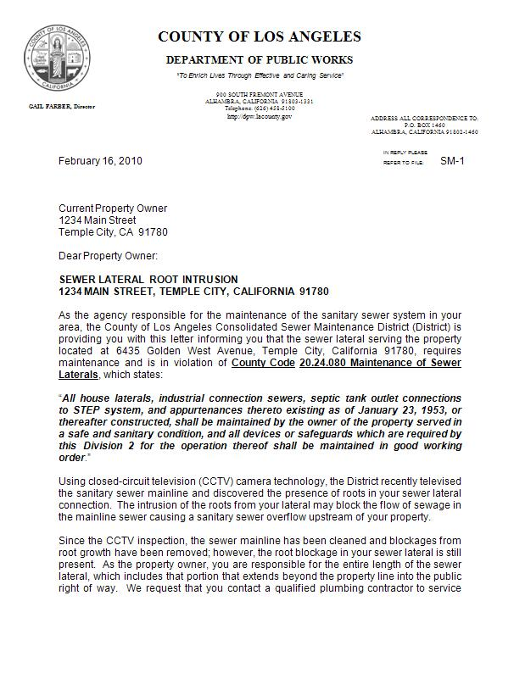
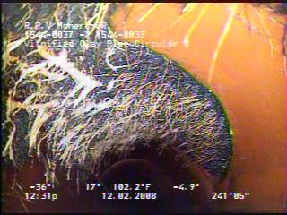
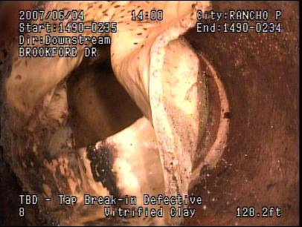
Public Education
Lateral connections with excessive roots, grease or other defects
Homeowners are notified to
maintain their connections
Paper #
Notes:
Included in the public education feature of our program, are lateral notices sent to property owners.
Homeowners are notified when defects from their lateral are visible from the mainline that may impact the flow of the mainline sewer.
In this notice, the homeowners are informed of their responsibility according to our County code to clean and maintain their sewer laterals.

Slide 17
Structural Ratings
PACP Rating Descriptions
Grade | Description of Defect Grades
1: | Minor
2: | Minor to Moderate
3: | Moderate
4: | Significant
5: | Most Significant
Segments with STRUCTURAL Grades of 4 and 5 will most likely be an issue in the next 10 years
Paper #
Notes:
For our structural review,
we determined that the sewers with Structural ratings of 4 or 5 should be reviewed for necessary repairs, since these items will likely be issues before the next inspection occurs.
If a repair is needed, we determine if the fix can be done by a point repair, lining the pipe, or be included in a future capital improvement project.

Slide 18
Structural Summary
PACP SCORE | # SEGMENTS | %
1 | 36,414 | 71.41
2 | 4,341 | 8.51
3 | 7,143 | 14.01
4 | 1,983 | 3.89
5 | 1,114 | 2.18
6.07%
Paper #
Notes:
Looking at the summary of the sewers we’ve inspected so far, you can see the number of sewers with Grades 4 and 5 is approximately 6% of our system. So for any given year, we review and focus our attention on approximately 30 miles of sewers with structural defects.

Slide 19
Rehabilitation Budget
Annual fee of $5/sewage unit
District rehabilitation budget: $3.81 million
Design, advertising, project management, construction
Emergency Sewer Repair Program
$950,000/year for as-needed emergency contractor repairs
Paper #
Notes:
To address the necessary repairs, the District collects an annual fee of $5 per sewage unit for our rehabilitation budget.
This amounts to approximately $3.8 million dollars a year for the design, advertising, project management and construction of rehabilitation projects.
In addition to this, the District also sets aside $950,000 a year for emergency sewer repairs using as-needed contractors on an emergency basis.

Slide 20
Prioritizing Repairs
Emergency / Immediate Repairs
Collapsed / blocked pipe
Defect at invert / evidence of voids around defects
Near watercourse or public facility
High volume of flow / high risk
Capital Improvement Repairs
Breaks / fractures above the flow line
Partially obstructed flow
Easement / local street location
Moderate volume of flow
Monitor defects
Cracks / minor fractures
Unobstructed flow
Paper #
Notes:
When reviewing structural defects the following criteria provides a basis on how we approach particular repairs:
Emergency / Immediate Repairs usually are based on
- Collapsed or blocked pipes
- Defects are typically at the invert of the pipe with large voids showing continuous erosion of the soil around the pipe with potential risks of sinkholes
- The sewer is near a watercourse of public facility where an overflow may cause high risk of public and environmental contamination
On the other side of the spectrum, scheduled capital Improvement repairs often include:
- Moderate breaks or fractures above the flow line
- The flow is only partially obstructed
- The sewer is located at an easement or local street
And for minor cracks or fractures with unobstructed flows, we typically would monitor these sewers for future repairs.

Slide 21
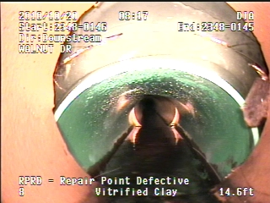
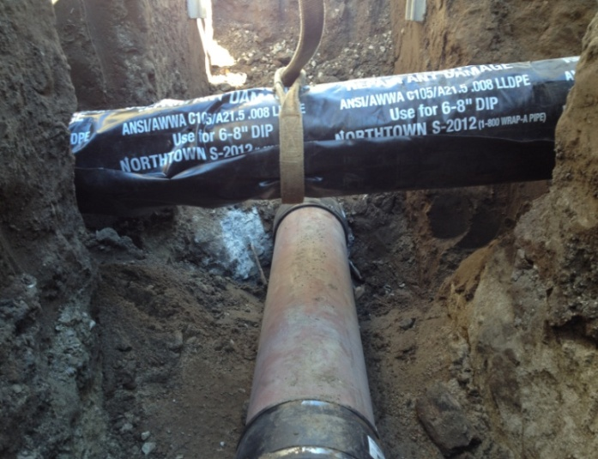
Emergency Repairs
Traditional open-trench repairs (typical)
Time and Materials
Costs range $12k – $25k
Construction 3-5 days
Paper #
Notes:
Emergency repairs are typically handled by as-needed contractors on an emergency basis. Once something like this is discovered, a contractor is notified with the necessary information for immediate dispatch to the project site.
These repairs are typically traditional open trench repairs, and is handled on a time and materials basis.
The cost can range between 12,000 – 25,000 dollars depending on any conflicting utilities underground.
Typically, this type of project is completed within five days including road restoration.
This particular emergency repair was a botched repair of our sewer line from a crossing water line. The water company ended up raising their water line to avoid having their pipe resting on our sewer line. In this instance, the repair was done on the water company’s dime.

Slide 22
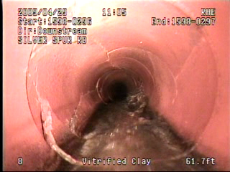
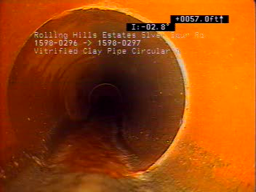
Repairs by District Forces
Low risk of collapse
Scheduled repair
Residential / local streets or easements
Approximate cost: $10k
Completed between 2-3 days
Paper #
Notes:
Our District forces are also able to perform repairs of defects that have a lower risk of collapse.
We can schedule these repairs during normal business hours.
Typically these sewers are located in residential and local streets or easements where traffic control is more manageable. Also, the depth of these sewers will not exceed more than 8 feet.
Typical costs for these repair are below $10,000, and can be completed within three days.
The pictures shown here is typical of repairs done by our crews. This particular sewer was located at a residential area.

Slide 23
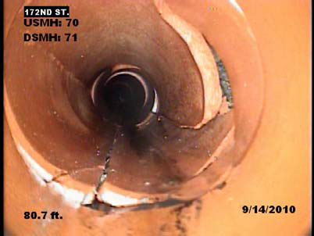
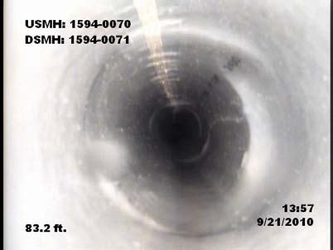
Trenchless Lining Projects
Moderate deficiencies
Multiple breaks / fractures along sewer pipe
Minimum obstacles along pipe from manhole to manhole
Approximate construction cost: $22/foot
Completed between 6-8 hours
Paper #
Notes:
Our rehabilitation project s tend to revolve around trenchless, lining projects. A lining project typically includes about 40 segments of sewers totaling 15,000 feet of pipe.
Sewers to be lined usually have multiple, moderate defects which may include cracks and fractures along the sewer pipe.
The most important criteria is that there are minimum obstacles along the pipe from manhole to manhole. A good rule of thumb is if the camera can get through the defects, then the sewer can be lined.
Approximate construction cost for lining is around $22/foot. With soft costs including design, project management, advertising, and inspection costs, the true cost for lining is around $35/foot.
A sewer segment can usually be lined under an 8-hour timeframe.
The sewer shown on this slide was lined using cured-in-place plastic liner. The District also accepts and installs machine spiral wound PVC pipe liner (such as RibLoc) in lining our sewers.

Slide 24
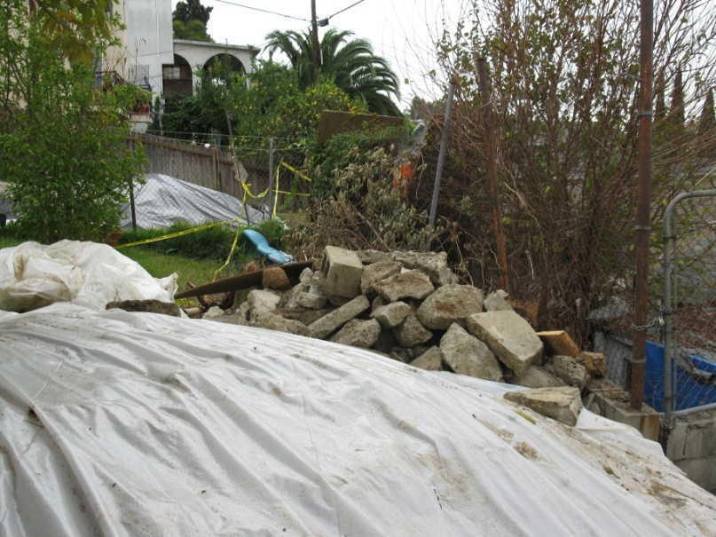
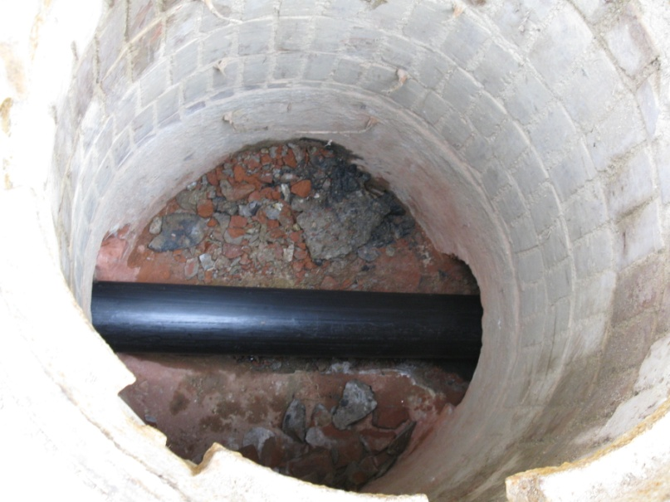
Pipe Bursting
Replacement of 83-year old concrete sewer
Deterioration from age and H₂S exposure
Limited access due to easement location and overbuild
One hour for pipe bursting
Two weeks prior to expose lateral connections
Paper #
Notes:
A couple of years ago, the District ventured into another form of trenchless technology in pipe bursting. In one of our oldest, and highly developed community in East Los Angeles, we discovered a sewer pipe, or remains of a concrete sewer line that had been eaten away by hydrogen sulfide gas. Ironically, what had kept this line from completely deteriorating was the amount of grease that was covering the remaining portions of concrete.
The sewer was located at a narrow easement on a hillside community in between homes and retaining walls where areas above the sewer line were built over with backyard patios and storage areas. Traditional trenching would have been extremely expensive due to the limited access to our sewer, not to mention a public relations nightmare with the homeowners So, it was determined that the pipe bursting would be the least obtrusive option in replacing this sewer line.
It took two weeks to dig and expose the lateral connections. Once that was done, the actual pipe bursting of 300 feet of HDPE pipe took less than 1 hour. The lateral connections were done a few hours later.

Slide 25
RESULTS
Paper #

Slide 26
Results
Inspected over 3,000 miles of sewers to date
Produced over 3,500 maintenance work orders
Completed 65 Emergency Structural Repairs
District Crews completed over 50 repairs
Rehabilitated 120 miles of concrete pipes
Lined over 21 miles of pipe from CCTV projects
Paper #
Notes:
Since the beginning of our Program, we have
Inspected over 3,000 miles of sewer
Produced over 3,500 maintenance work orders for cleaning
Completed 65 emergency sewer repairs, in addition to 50 repairs done by our District crews
Rehabilitated 120 miles of concrete pipes
And lined over 21 miles of sewers from defects found in our CCTV projects.

Slide 27
Reduction in Overflows
Paper #
Notes:
But what we are most delighted with is in the reduction in our overflow numbers.
The graph compares the total number of overflows
throughout the calendar years from 2007 (the top line in orange)
to 2013 (the blue line at the bottom).
The graph shows a reduction of 60% in our overflow numbers during this time period.
More often than not, the overflows that we currently experience are from sewers that we have not yet televised. So we are optimistic that these numbers will continue to drop as we move towards the end of the first 10-year cycle of our Program.

Slide 28
Benefits Realized
Enhanced service to the community
Lessen impact on public health, safety and the environment
Reductions in
Emergency overtime
Service requests
Claims
Increased productivity
Increased life expectancy of our collection system
Paper #
Notes:
Reduction in overflows has really improved our service to our community by lessening the impact on public health, safety and environment contamination
It has resulted in
- Less Emergency Overtime
- Less Service Requests by customers
- Fewer Claims due to the decrease in flood outs
Our crews can focus our resources on the problem areas that we can actually see from our inspection. In the end, we increase our productivity and the efficiency of our Maintenance Program.

Slide 29
QUESTIONS?
Contact Information:
Fernando Villaluna, P.E.
fvillaluna@dpw.lacounty.gov
(626) 300-3380
OR VISIT US ONLINE:
WWW. DPW.LACOUNTY.GOV/SMD/SMD/
Paper #
Notes:
That, in a nutshell, is an overview of the District’s sewer condition assessment program and how we manage our point repairs and rehabilitation projects.
At this time, I can answer any questions you may have.
Thank you!

