Slide 1
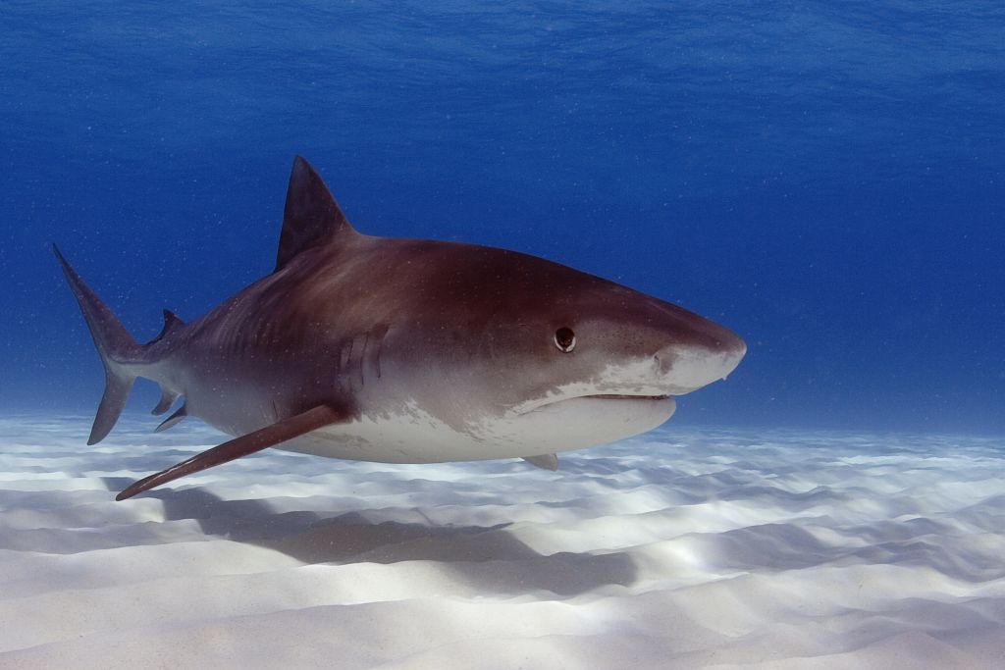
The Shark in the Pool
Notes:
Today, I’m going to talk to you about the shark in the pool. Weeellll, there really isn’t a shark in the pool, but the analogy is similar. Sea captain Charles Moore discovered what has become to be known as the “Great Pacific Garbage Patch” quite by chance halfway home to Long Beach from Hawai’i in 1997. Today’s discussion will deal with Microplastics and Their Relationship to the Pretreatment Program.

Slide 2
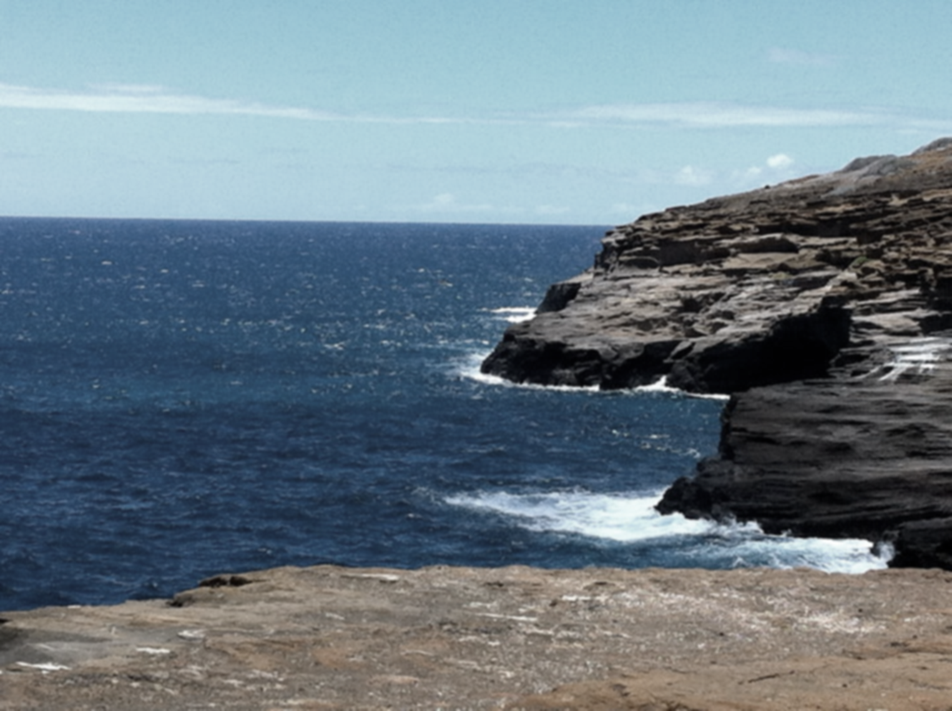
Plastic fragments, hiding in plain sight, in a “plastic soup”
Notes:
“The ocean is the largest habitat on earth, home to more than twice the number of species found on land. We’re drawn to the ocean, pay premiums for houses near it, restore our spirits on its shores, …” From consumption, to ingestion, I’ll tell you what’s happening. “A thousand miles from land, a place less likely to be littered than the moon, you’d think.” He’d come across an immense section of the northeastern Pacific Ocean that was littered with buoyant plastic scraps. And he’s gone on to tell his story to the world, as author of “Plastic Ocean”, and ocean researcher.
I think a plastic garbage patch in the middle of the Pacific screams harm just by being there. Plastic garbage does not belong in the ocean any more than sharks belong in municipal swimming pools.” – Captain Charles Moore, Plastic Ocean, 2011

Slide 3
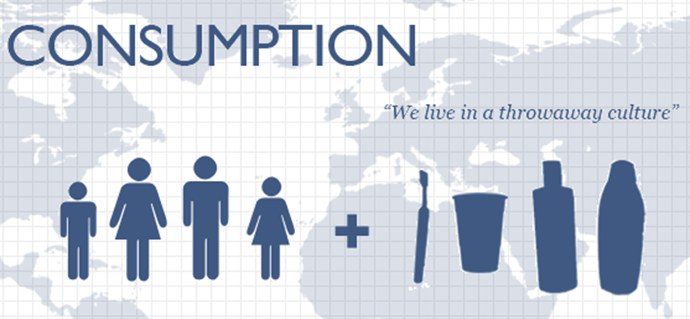
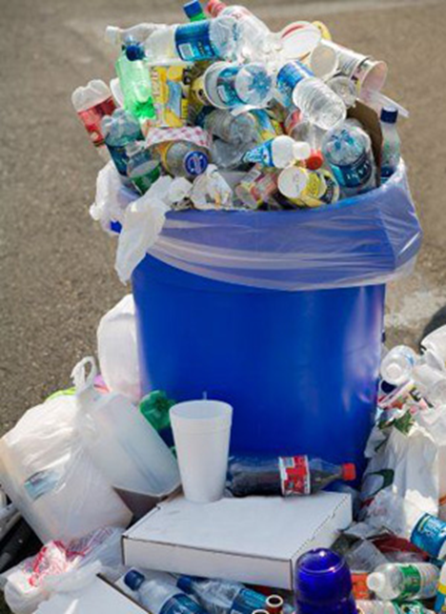
Notes:
So how does the plastic get there? Let’s start with our consumption of “stuff”, including plastics. We live in a throwaway culture. Today, we consume billions of bags & bottles per YEAR in the U.S. alone!

Slide 4
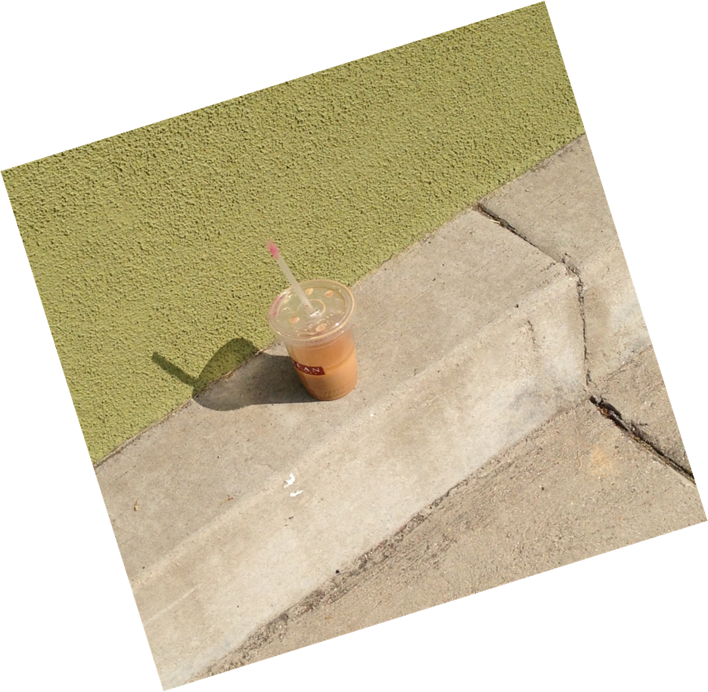
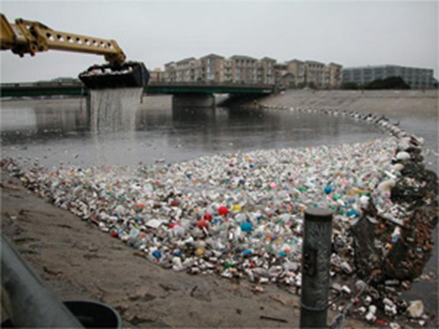
Common marine debris items includes things like cigarette butts, cans, plastic bags and bottles, Styrofoam, balloons, lighters, and toothbrushes.
Discarded or lost fishing gear such as lines, nets and buoys are especially dangerous
to sea life.
Notes:
What happens to our consumed materials – they become “trash”, “litter”, “pollution” in our environment – extending from land-based sources to our oceans.

Slide 5
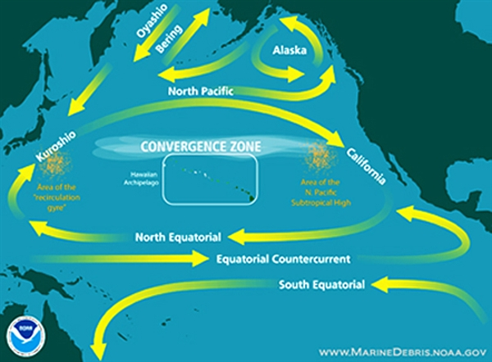
Hundreds of kilometers off the coast of southern California lies the Great Pacific Garbage Patch, a vast soup of degraded plastic fragments.
Plastic pollution isn’t just a North Pacific phenomenon but rather a global problem with global implications for fisheries, tourism, marine ecosystems and human health
On the other side of the country, tiny flecks of floating plastic swim in a swath of seemingly pristine Atlantic Ocean at least two-thirds the size of the United States.
Researchers have estimated that for every 2.2 pounds (1 kilogram) of plankton in these areas, there is 13.2 pounds (6 kilograms) of plastic.
Notes:
Microplastics are being introduced to our waters via both commercial and residential sources (initially) and POTWs. These microplastics then adsorb pollutants and become even more of a problem. The stuff consumed and littered on land could end up far from where we think. The amount of plastic produced globally and thrown away in the United States alone has grown, and presumably some of it winds up in the ocean. Allowed to circulate in the various gyres of the world’s waters. What does that say about the developing countries?

Slide 6
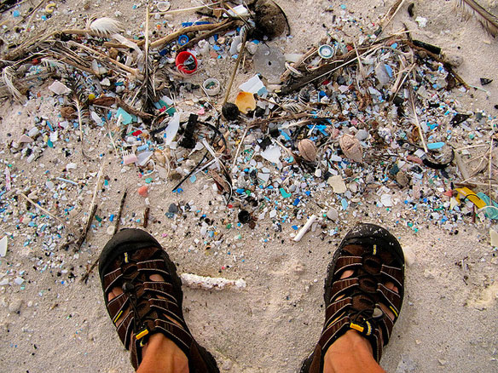
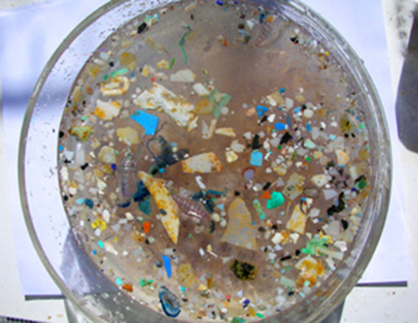
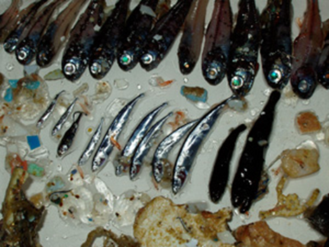
Plastic is accumulating on Midway Atoll – a 2 square-mile island in the Pacific, roughly halfway between North America and Asia
Notes:
Let’s talk about accumulation – in the environment and in marine life. The plastic might disintegrate into pieces too small to be caught in a net. Or algae-coated pieces might sink to the sediments, or the plastic could be eaten by plankton or fish.

Slide 7
"It's relatively sparse, and you might or might not see something visible to the human eye at any particular location out there”
"one does encounter pieces of plastic stuff that are big enough to see”
“But the other side of the puzzle is all the little bits and pieces of plastic that you can't even see unless you scoop up a sample of seawater and see what's in there."
"it's a little misleading to think of it as a great big island …, the point is it's a big area of ocean. So even a few pieces of plastic per square meter amounts to a lot of plastic when you add it up over this enormous ocean area."
- Robert Knox, deputy director
for research at the Scripps Institution
Notes:
Larger bits of plastic gradually break down into microscopic fragments called “microplastics”. And minute plastic fibers have turning up in treated sewage and on beaches. In a study conducted by a team of researchers on six continents sand was scooped from 18 beaches. The plastic was painstakingly separated from the sand—a process that involved, among other things, hand plucking microscopic fibers from filter papers. A chemical analysis showed that nearly 80% of those filaments were made of polyester or acrylic, compounds common in textiles. (Mark Browne of University College Dublin) In a recent beach cleanup here, a colleague of mine noted that it wasn’t the big stuff you’d think, but “you need a sand sifter to get all the little bits and pieces”.
Not a single beach was free of the colorful synthetic lint. Each cup (250 milliliters) of sand contained at least two fibers and as many as 31. The most contaminated samples came from areas with the highest human population density, suggesting that our cities are an important source of the lint.

Slide 8
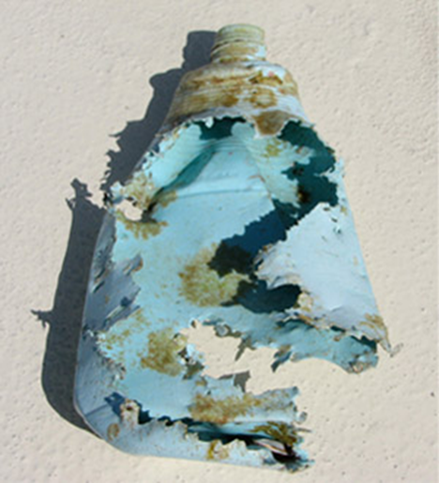
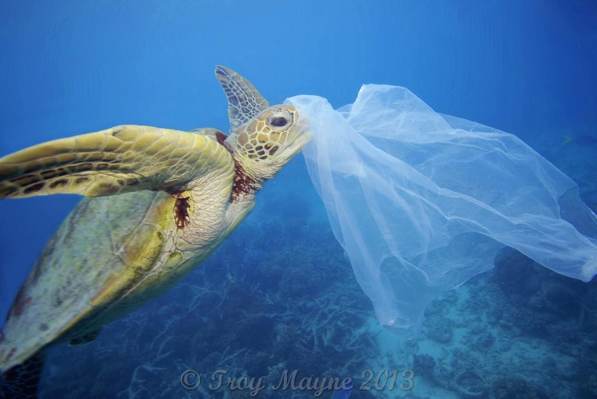
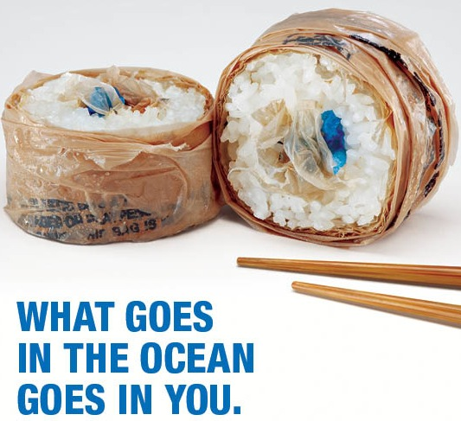
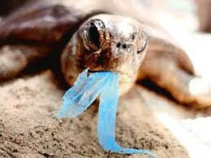
the plastic might disintegrate into pieces too small to be caught in a net
"there's some sort of missing sink“ - Law
That raises the concern that marine animals could be poisoned by toxic chemicals carried by the plastic
Or algae-coated pieces might sink to the sediments, or the plastic could be eaten by plankton or fish
Notes:
Science is beginning to ask the question: do chemicals such as PCBs and DDTs (banned pesticides) that sorb onto plastics then get into the tissues and blood of the animals that eat the plastic? Do these chemicals work their way up the food chain, becoming increasingly concentrated and potentially entering our bodies when we eat seafood? These plastic fibers could "end up on our dinner plates," incorporated into seafood. (Mark Browne)
(Credit to Surfrider Rise Above Plastics campaign for the photo of “sushi”.)

Slide 9
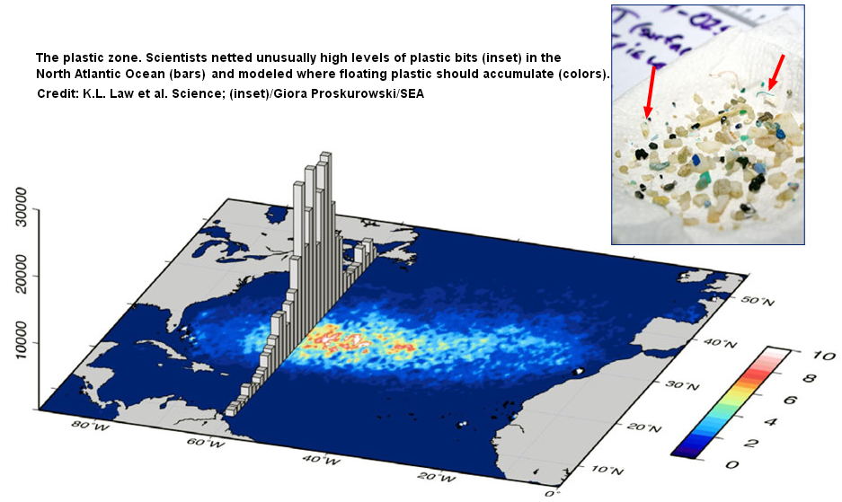
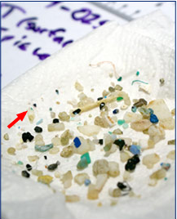
A chemical analysis found that the plastic consists mostly of plastics used to make things such as plastic milk jugs and grocery bags.
Researchers found plastic in more than 60% of 6136 tows over 22 years in North Atlantic Ocean and Caribbean Sea – Bahamas to Baltimore
"When you expect to see zero plastic hundreds of miles
from shore, it's shocking"
author and SEA oceanographer Kara Lavender Law
Notes:
This depicts an ongoing study since 1986 in which students on research sailing trips led out of Massachusetts have been documenting plastic snagged in their plankton nets in the western North Atlantic Ocean and Caribbean Sea. The team reported recently that it found plastic in more than 60% of more than 6000 tows over 22 years. The levels are low close to shore but rise hundreds of kilometers off the coast between 22 and 38 degrees latitude (roughly from the Bahamas to Baltimore). (Sea Education Association (SEA), Woods Hole, Massachusetts)

Slide 10
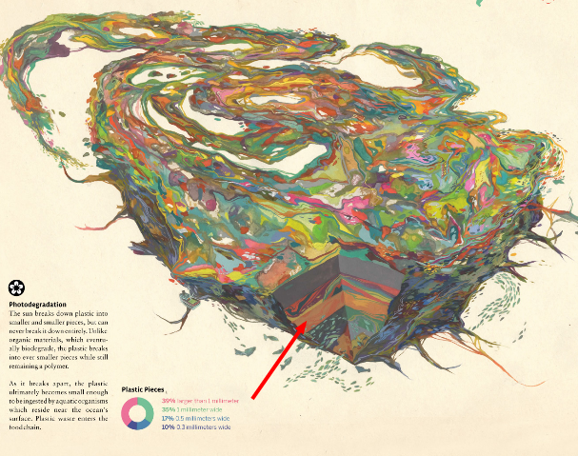
Plastic is really the toxic killer. While it slowly degrades, it turns into increasingly smaller bits of plastic.
Seabirds mistake it for food and they dive down and eat it
Photodegradation
The sun breaks down plastic into smaller and smaller pieces, but not entirely.
Unlike organic materials, which eventually biodegrade, the plastic breaks into ever smaller pieces while still remaining a polymer.

Slide 11
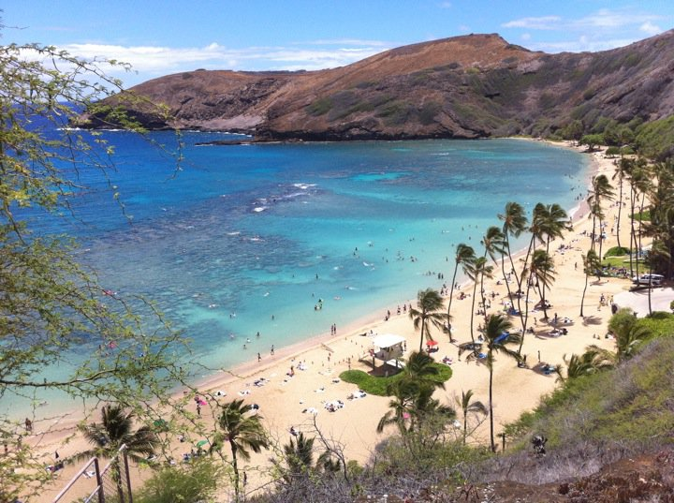
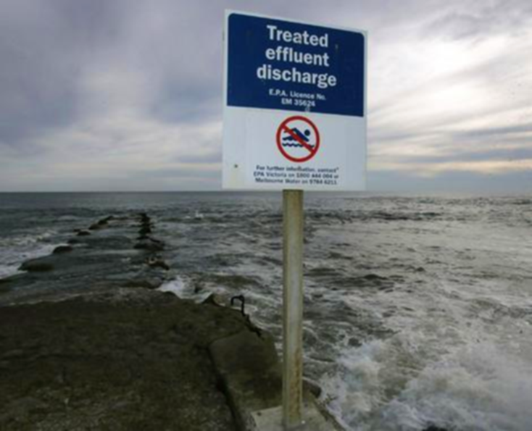
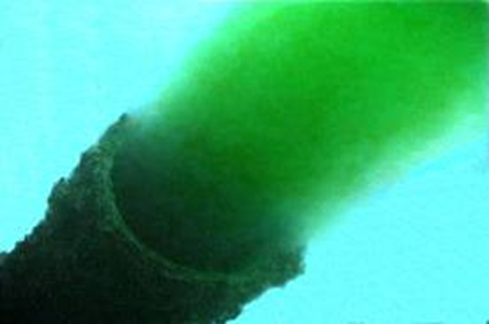
Where’s it coming from?
18 beaches
6 continents
all contaminated with microplastics
Notes:
Many cities along coasts have sewage outfalls. Sewage wastewater has been shown to contain microplastic particles or fibers. But it was also in sediment analyzed from beaches in the U.K. near sewage disposal sites. They found that this sediment had 250% more microplastic fibers than beaches further from disposal sites, even though sewage had not been discharged at the disposal sites for over a decade.
Browne, M.A., Crump, P., Niven, S.J. et al. (2011) Accumulation of Microplastic on Shorelines Worldwide: Sources and Sinks. Environmental Science & Technology. 45. 9175-9179.

Slide 12
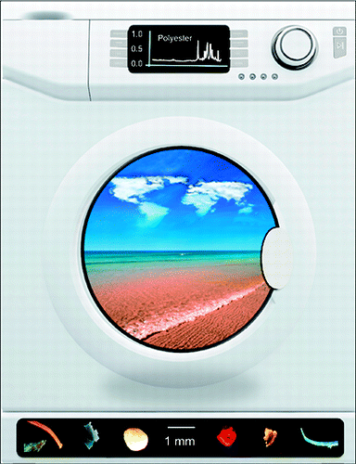
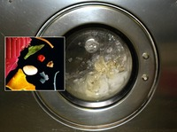
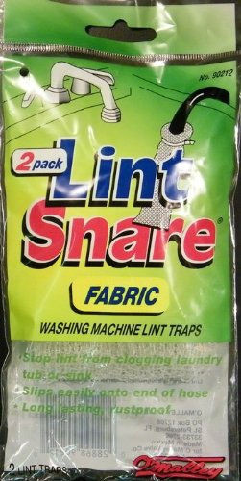
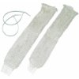
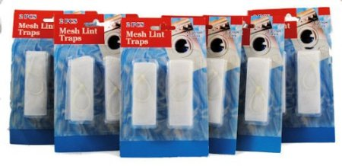
An important source of microplastic appears to be through sewage contaminated by fibers from washing clothes.
Nearly 2000 polyester fibers can float away, unseen, from a single fleece sweater in one wash cycle, a new study reports.
80% of those filaments were made of polyester or acrylic
Notes:
These microplastic filaments are <5 mm in size. A relatively simple way to help control them is at their source, with (click) lint traps for the washing machines, similar in nature to those used for our dryers.

Slide 13
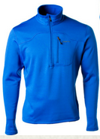
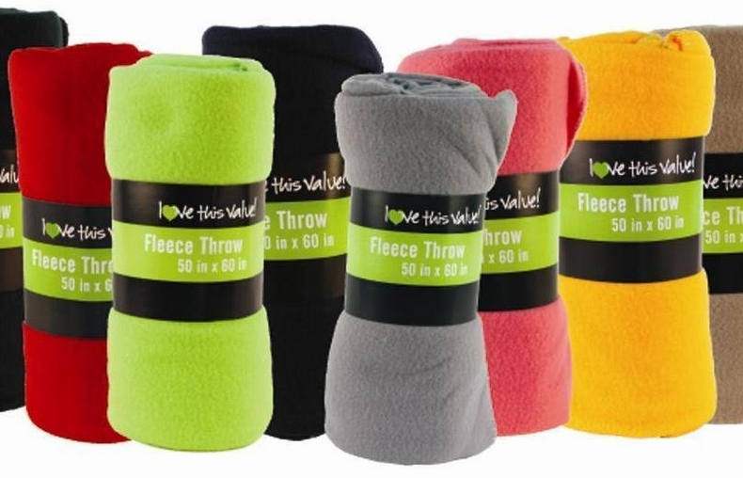
how does synthetic lint get into sewage??
Microplastic lint producers – fleece, polyester-acrylic materials
polyester-acrylic composition
Notes:
The researchers wanted to see how synthetic lint got into sewage in the first place. Given its polyester-acrylic composition, they thought clothing and blankets were a good bet. So they purchased a pile of polyester blankets, fleeces, and shirts and commandeered three volunteers' home washing machines for several months. They collected the wastewater from the machines and filtered it to recover the lint. Each polyester item shed hundreds of fibers per washing, the team reported. (November issue of Environmental Science and Technology).

Slide 14
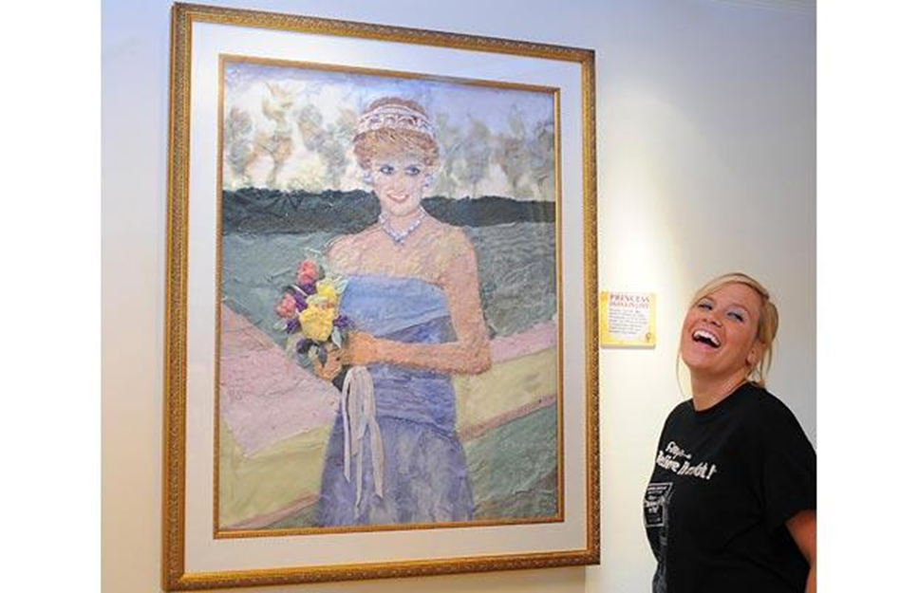
Notes:
Princess Diana in lint at Ripley’s Believe It or Not museum in U.K., cute dog

Slide 15
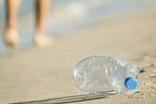
What is the solution?
With disposability comes litter.
It’s a “People Problem”.
Notes:
Need to address the source of the problem – whether it’s the manufacturer, the type of material used for clothing, filters in wastewater including washing machines … it’s really on us, and what we choose to do. Textile manufacturers can help by making garments that shed less lint. The newer HE washing machines don’t have agitators, so wear on clothing that produces lint is greatly reduced. Filters that trap the fibers on all washing machines might help.
Sewage treatment plants, should be looking for ways to keep the fibers out of the ocean. Because clarification of wastewater doesn’t work on plastics because it relies on densities, which are very similar to water. Coagulation and flocculation won’t work because plastic has no net charge – it doesn’t react with the agents. Ultrafiltration is an answer, but not the best – lots of energy is required to filter the water (pushing water through the small holes and removing the waste, similar to the GWRS here). Also more maintenance, and retrofit issues for older treatment plants.

Slide 16
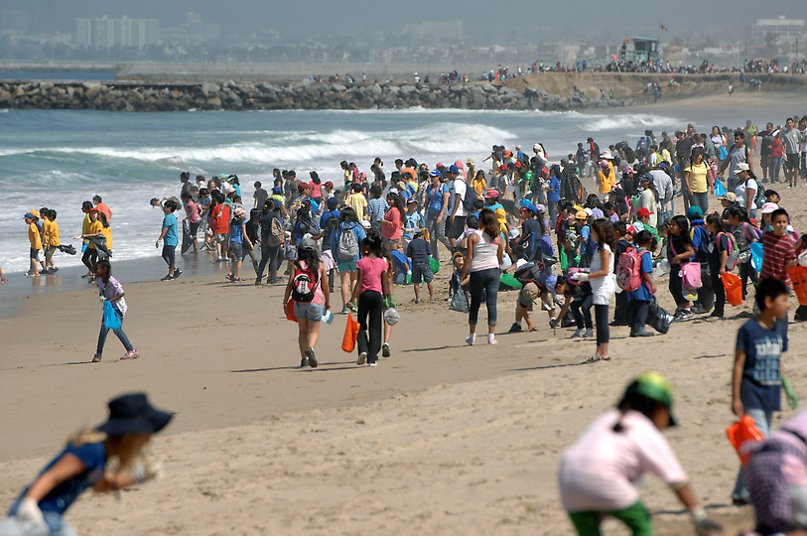
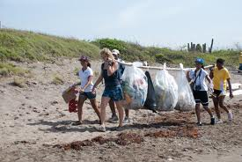
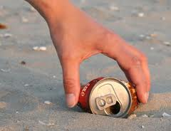
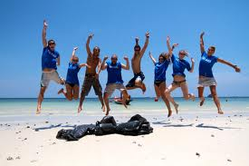
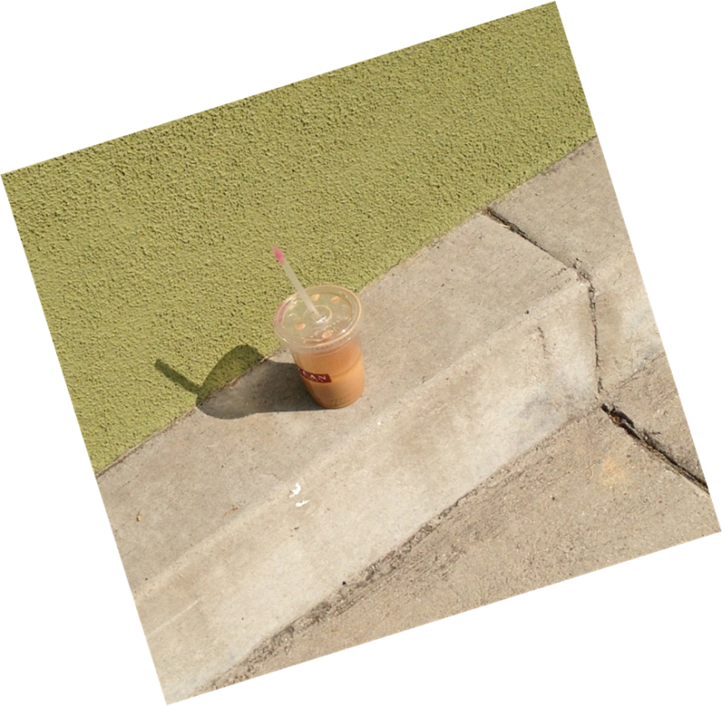
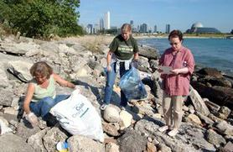
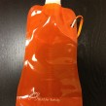
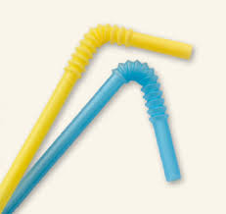
Notes:
More cleanups? More education – certainly – But more important, let’s address our consumption through our consumerism. Let’s reduce our personal use of disposable plastics whenever possible. Do you really need a straw? What about using reusable bags for shopping? Let’s ask our favorite restaurants to eliminate Styrofoam from their facility, and use something more environmentally friendly. And use a refillable water bottle – why would you pay more for water than you do gasoline?

Slide 17
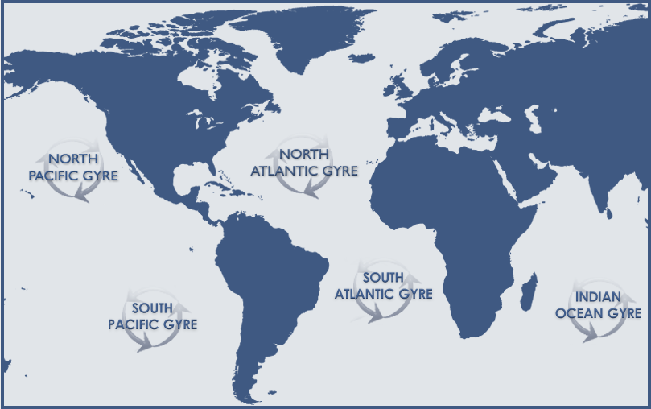
Intrigued?
Visit these for more information:
Algalita.org
5gyres.org
PlasticPollutionCoalition.org
Surfrider.org
Notes:
Thank you for the opportunity to talk about this tonight! I hope you’re intrigued to learn more, so here are a few sites you can check for more information. Are there any questions?
And here’s how you can get in contact with me. (click to move forward)

Slide 18
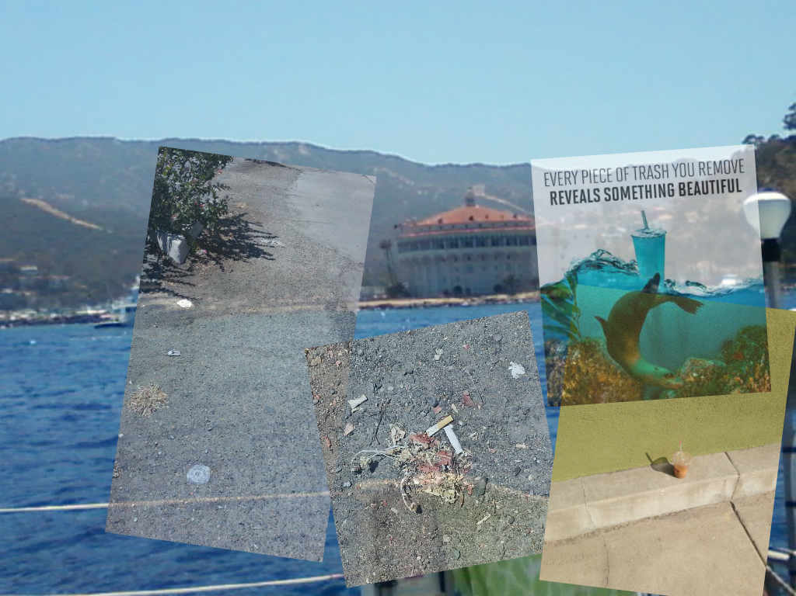
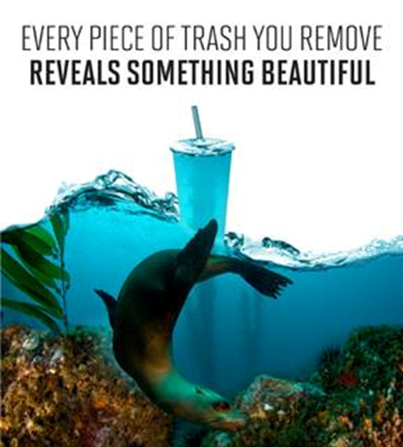
facebook.com/InnovareEnvironmental
twitter.com/Innovare4Water
Jmarquez@Innovare4Water.com
Notes:
Judith Marquez, Innovare Environmental, is working with restaurants and food service establishments to ensure proper disposal of used cooking grease (FOG) to prevent pollution to the environment and protect water quality. She is also working on projects with the Algalita Marine Research Institute to reduce plastic pollution in the environment through research and collaboration with agencies and the general public.

